Slide 1
Animal Digestion
Describe the major parts and functions of the digestive system
Define monogastric and list characteristics of monogastric animals
Describe the Ruminant Digestive System
Describe the Avian Digestive System
Classify animals according to their type of digestion
List Digestive Enzymes and their function

Slide 2
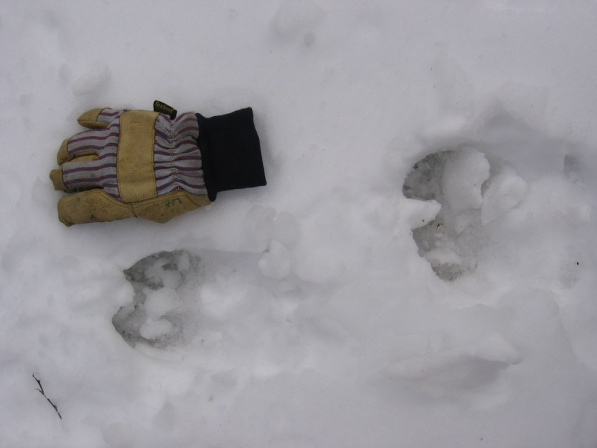
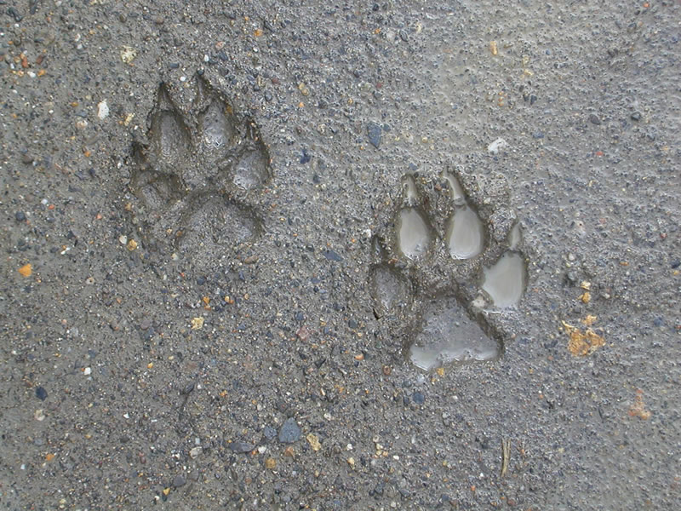
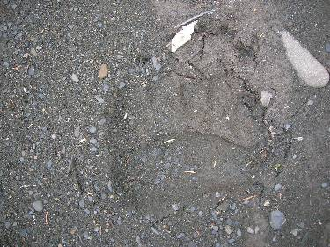
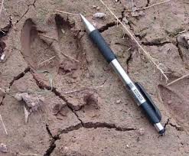
Can you identify these tracks??
1
2
3
4
Notes:
1-moose 2-wolf 3-bear 4-deer

Slide 3
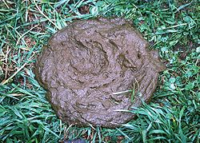
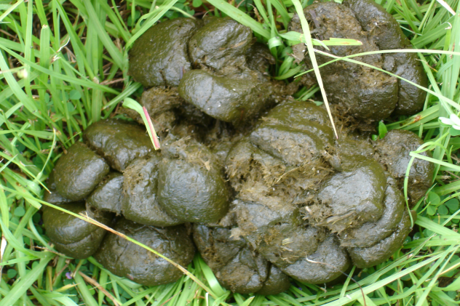
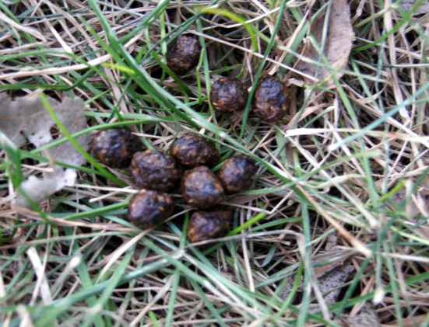
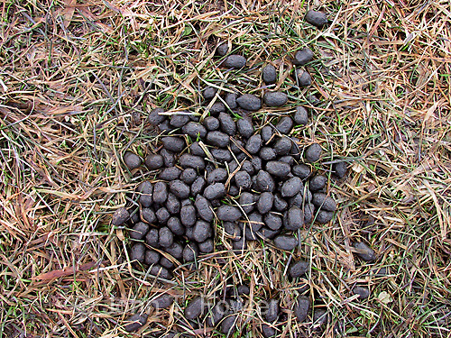
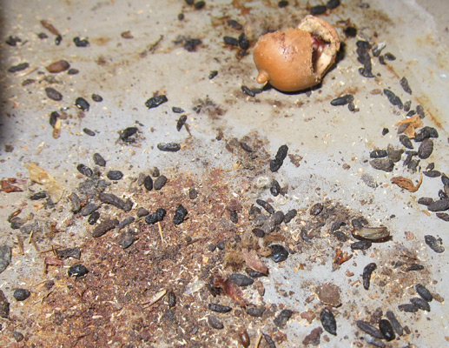
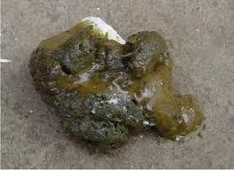
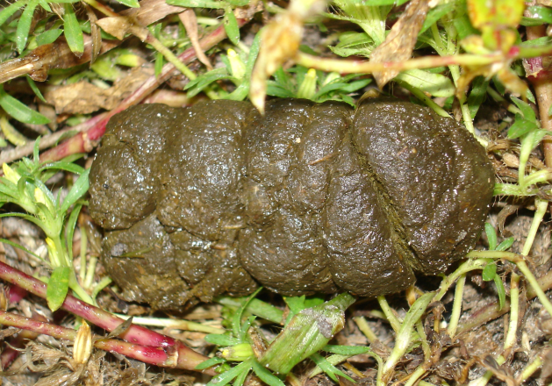
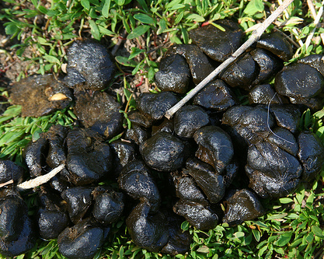
Can you identify these “Tracks”??
1
2
3
4
5
6
7
8
9
Notes:
1- cow 2-horse 3- rabbit 4-dog 5-deer 6-mice 7-chicken 8-pig 9-sheep

Slide 4
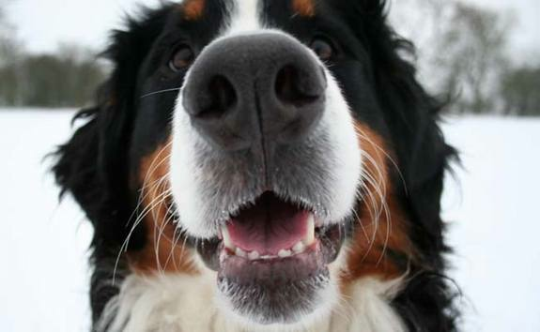
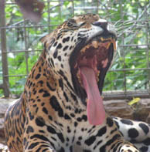
Describe the major parts and functions of the digestive system
Parts of Digestive System
The MOUTH is the starting point that begins the digestive process.

Slide 5
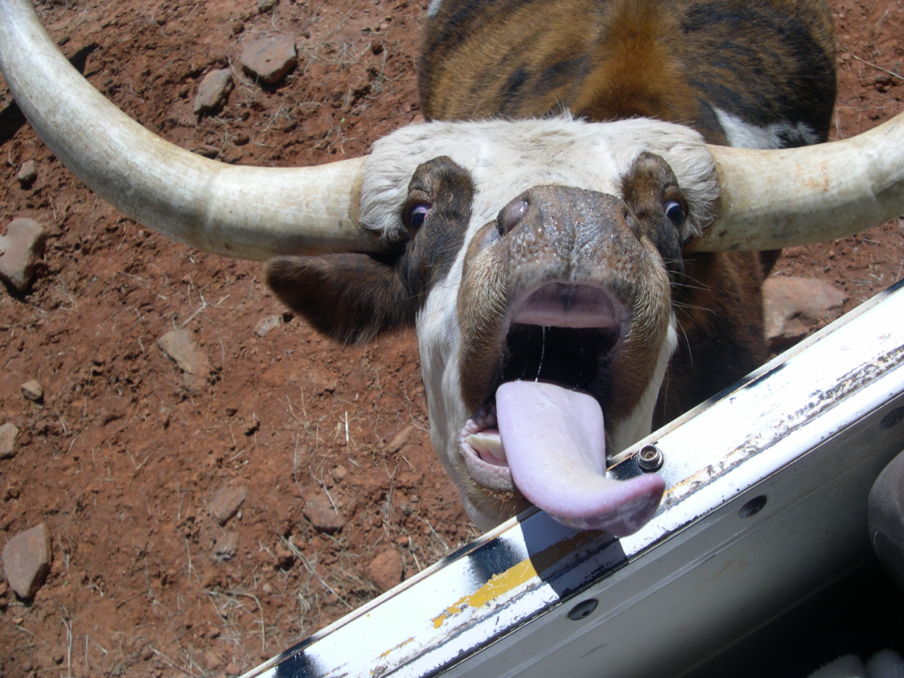
Describe the major parts and functions of the digestive system
Parts of Digestive System
The TONGUE is used for grasping the food, mixing, and swallowing.

Slide 6
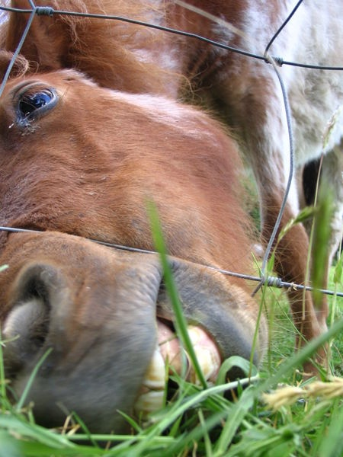
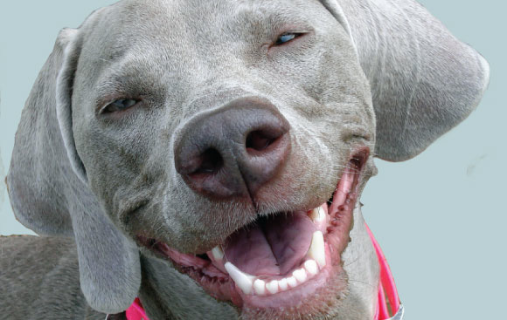
Describe the major parts and functions of the digestive system
Parts of Digestive System
The TEETH tear and chew the feed into smaller particles that may be swallowed.

Slide 7
Describe the major parts and functions of the digestive system
Parts of Digestive System
2 Types of Digestion:
Physical: Breakdown of food into smaller sized pieces.
Chemical: Breakdown of the chemical composition of food

Slide 8
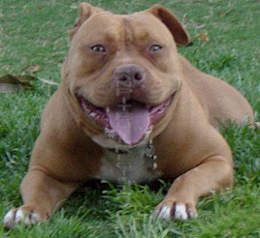
Describe the major parts and functions of the digestive system
Parts of Digestive System
In the mouth
SALIVARY GLANDs: excrete saliva, which serves many purposes:
-Water to moisten
-Mucin to lubricate
-Bicarbonates to buffer acids
-Enzyme amylase to
breakdown carbs.

Slide 9
Describe the major parts and functions of the digestive system
Parts of Digestive System
The ESOPHAGUS is the hollow, muscular tube that leads from the mouth to the opening of the stomach.
Esophagus
Review: What type of muscle makes up the esophagus?

Slide 10
Describe the major parts and functions of the digestive system
Parts of Digestive System
The STOMACH is a hollow muscle that contracts and relaxes to integrate digestive juices with the food causing it to breakdown chemically

Slide 11
Describe the major parts and functions of the digestive system
Parts of Digestive System
The SMALL INTESTINE is next and is controlled by a sphincter muscle that helps move food into and through the tract.
The small intestine is made up of three segments
1- Duodenum
2- Jejunum
3- Ileum

Slide 12
Describe the major parts and functions of the digestive system
Parts of Digestive System
The Small Intestine cont’d:
DUODENUM
-First segment
-Uses secretions from the pancreas and intestinal wall to break down protein, starch, and fats.
JEJUNUM & ILIUM:
-Where absorption takes place
-Absorption passes nutrients from the intestine to the bloodstream.

Slide 13
Describe the major parts and functions of the digestive system
Parts of Digestive System
The Small Intestine cont’d:
Walls of the Jejunum & Ileum…
VILLI
Small fingerlike projections
Increase surface area for absorption
Absorb nutrients through membranes known as semipermeable membranes.
These membranes allow particles to pass through in a process called diffusion.

Slide 14
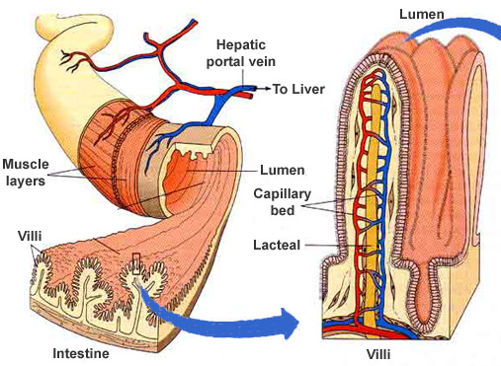
Describe the major parts and functions of the digestive system
Parts of Digestive System
The Small Intestine cont’d:
Walls of the Jejunum & Ileum…
VILLI

Slide 15
Describe the major parts and functions of the digestive system
Parts of Digestive System
The LARGE INTESTINE is the last organ of the digestive tract.
It contains two segments:
1- Cecum: is where fibrous food such as hay and grass is broken down into usable nutrients.
2- Colon: provides a storage space for waste from the digestive process,
and is the largest part of the
large intestine.

Slide 16
Describe the major parts and functions of the digestive system
Parts of Digestive System
Rectum is the terminal end of the large intestine and the entire digestive system.

Slide 17
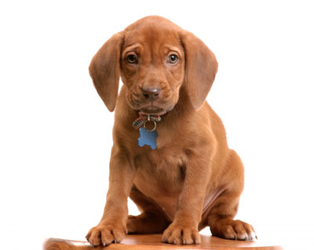
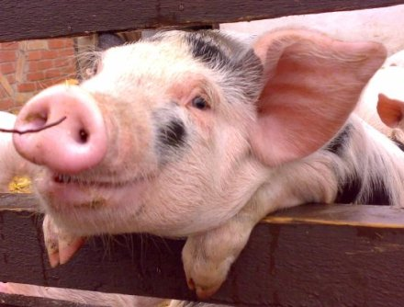
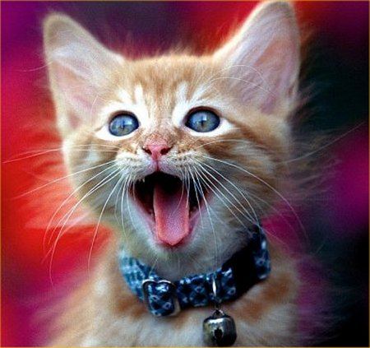
B. Define Monogastric and list characteristics of monogastric animals
Monogastric Digestive System
Monogastric= 1 Simple Stomach

Slide 18
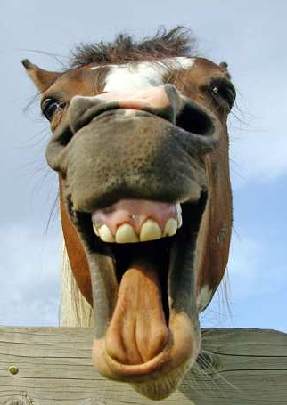
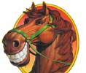
B. Define Monogastric and list characteristics of monogastric animals
Monogastric Digestive System
Characteristics:
TEETH
They have an UPPER & LOWER set

Slide 19
B. Define Monogastric and list characteristics of monogastric animals
Monogastric Digestive System
Characteristics:
DO NOT
Chew Cud
Factiod: Horses cannot vomit

Slide 20
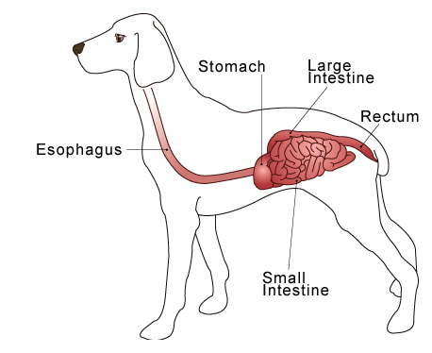
B. Define Monogastric and list characteristics of monogastric animals
Monogastric Digestive System

Slide 21
C. Describe the Ruminant Digestive System
Ruminant Digestive System
Ruminant Systems:
A system with four compartments:
1- Rumen
2- Reticulum
3- Omasum
4- Abomasum
Ruminant animals are often called “cud chewers”

Slide 22
C. Describe the Ruminant Digestive System
Ruminant Digestive System
1- Rumen
Serves as a storage vat where food is soaked, mixed, and fermented by bacteria.
It contains fingerlike projections called papillae that absorb nutrients through the rumen wall to provide energy.

Slide 23
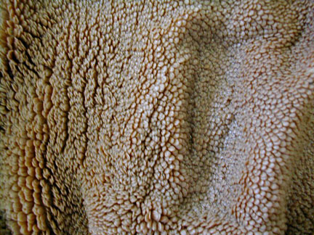
C. Describe the Ruminant Digestive System
Ruminant Digestive System
Resembles carpet

Slide 24
C. Describe the Ruminant Digestive System
Ruminant Digestive System
2- Reticulum
2nd Compartment
Contains bacteria & microbes to promote fermentation
Food is ingested, then eructated, chewed, & swallowed again
**Eructated means vomit
Factoid: Non digestible items that are consumed such as small stones, nails, or wire fall into the reticulum. They usually stay in the reticulum

Slide 25
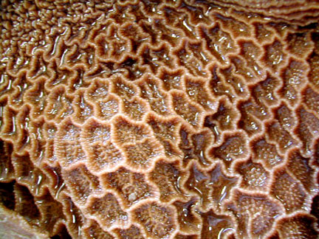
C. Describe the Ruminant Digestive System
Ruminant Digestive System
Nicknamed Honeycomb or Hardware Stomach

Slide 26
C. Describe the Ruminant Digestive System
Ruminant Digestive System
Why is the reticulum
often referred to as the
“Honeycomb” or
“Hardware Stomach”?

Slide 27
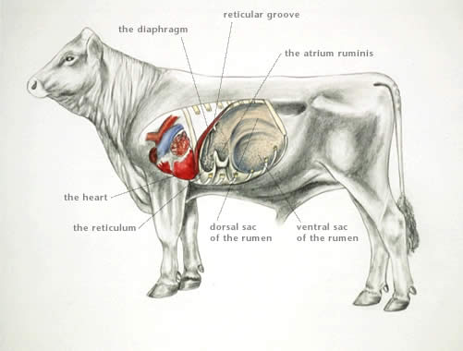
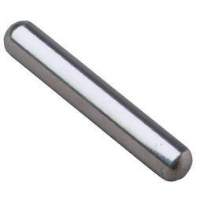
C. Describe the Ruminant Digestive System
Ruminant Digestive System
What is Hardware Disease?

Slide 28
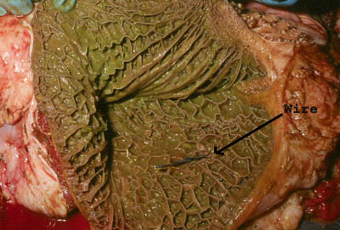
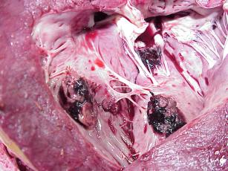
C. Describe the Ruminant Digestive System
Ruminant Digestive System
What is Hardware Disease?
Wire in reticulum
Nail punctured from reticulum to heart

Slide 29
C. Describe the Ruminant Digestive System
Ruminant Digestive System
Factoid:
In young ruminants, there is a structure called a Reticular groove or heavy muscular fold that allows milk from the mother to bypass the rumen and reticulum to go directly to the omasum.
Why??
Notes:
Calves and other young ruminants do not need multiple chambers of stomach to digest milk, therefore it is bypassed through the reticular groove until the animal begins eating roughages.

Slide 30
C. Describe the Ruminant Digestive System
Ruminant Digestive System
3-Omasum
A round organ with walls that contain many folds or “plies”
Lined with blunt muscular papillae that grind roughage.

Slide 31
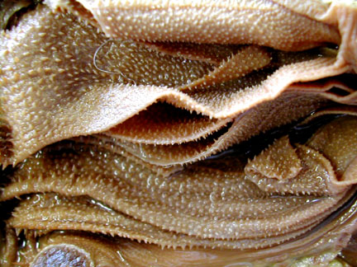
C. Describe the Ruminant Digestive System
Ruminant Digestive System
3-Omasum
Has the appearance of pages of a book

Slide 32
C. Describe the Ruminant Digestive System
Ruminant Digestive System
4-Abomasum
This compartment is the only glandular (true) stomach of the ruminant.
Secretes gastric juices to digest microbes

Slide 33
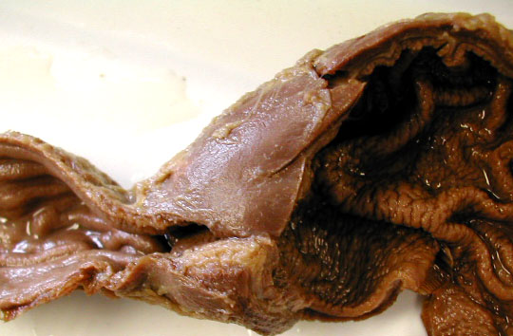
C. Describe the Ruminant Digestive System
Ruminant Digestive System

Slide 34
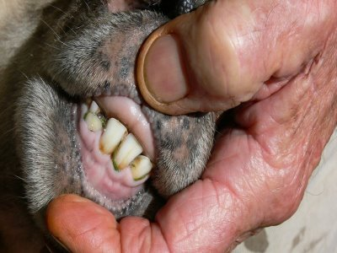
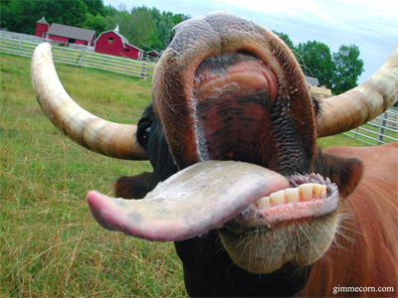
C. Describe the Ruminant Digestive System
Ruminant Digestive System
Characteristics of ruminants:
Ruminants do not have upper front teeth.
Instead, they have a dental pad that works with the lower front teeth (incisors) in tearing off feedstuff.

Slide 35
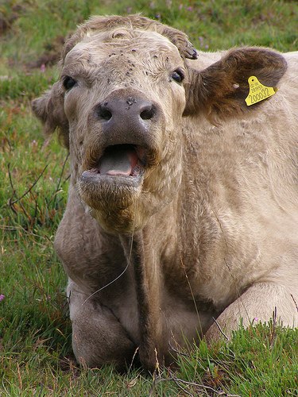
C. Describe the Ruminant Digestive System
Ruminant Digestive System
Characteristics of ruminants:
Saliva does not contain enzymes
…though they produce large quantities.
Factoid: A full grown steer produces about 50 liters of saliva per day.

Slide 36
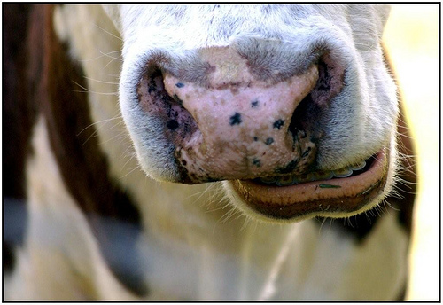
C. Describe the Ruminant Digestive System
Ruminant Digestive System
Characteristics of ruminants:
Chew Cud

Slide 37
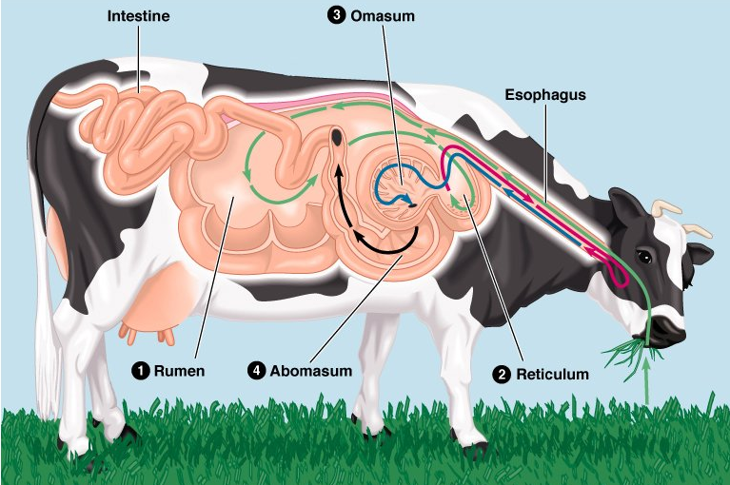
C. Describe the Ruminant Digestive System
Ruminant Digestive System

Slide 38
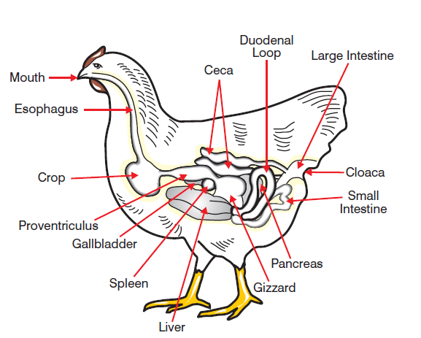
D. Describe the Avian Digestive System
Avian Digestive System

Slide 39
D. Describe the Avian Digestive System
Avian Digestive System
1- Mouth: No teeth-NO chewing
2- Esophagus
3- Crop: Pouch where food is stored and soaked
Factoid: an empty crop is what sends hunger signals to the bird’s brain.

Slide 40
D. Describe the Avian Digestive System
Avian Digestive System
4- Proventriculus: true stomach where hydrochloric acid is added (remember no physical breakdown of the feed has begun)

Slide 41
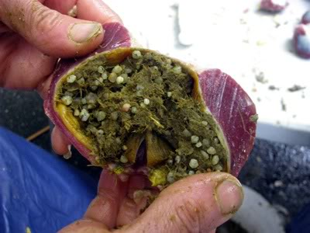
D. Describe the Avian Digestive System
Avian Digestive System
5- Gizzard: Muscular organ which functions LIKE teeth to grind food
-Often find small pieces of stones here that the bird ate. They help in the breakdown of feed.

Slide 42
D. Describe the Avian Digestive System
Avian Digestive System
6- Small Intestine
7- Ceca Same as other animals
8- Large Intestine
9- Cloaca: Digestive system waste AND wastes from the renal (urinary) system exit here.

Slide 43
E. Classify animals according to their type of digestion
Types of Digestion
…Pull it all together…
Name 4 types of animal digestion
1- Monogastric
2- Ruminant
3- Avian
4- ???

Slide 44
E. Classify animals according to their type of digestion
Types of Digestion
Modified Monogastric
Animals that:
-Eat large amounts of roughage
(like a ruminant)
-Have a single compartment stomach (like a monogastric)
-Have a large cecum to digest large amounts of roughage

Slide 45
E. Classify animals according to their type of digestion
Types of Digestion
Ruminant:
-Eats mostly roughage
-4 chamber stomach
Monogastric
-Eats mostly concentrates
-1 chamber stomach
Modified Monogastric:
-Eats mostly roughage
-1 chamber stomach
Avian
Birds: Have Crop & Gizzard in place of teeth

Slide 46
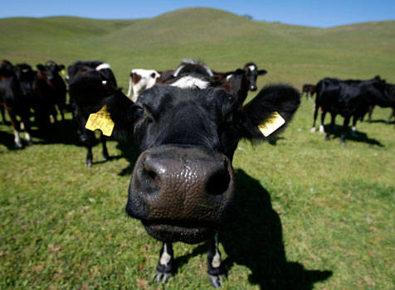
E. Classify animals according to their type of digestion
Types of Digestion
… What do they eat?
Mostly Roughage with some concentrates
…How many stomach compartments?
4
… What type of digestive system?
Ruminant

Slide 47
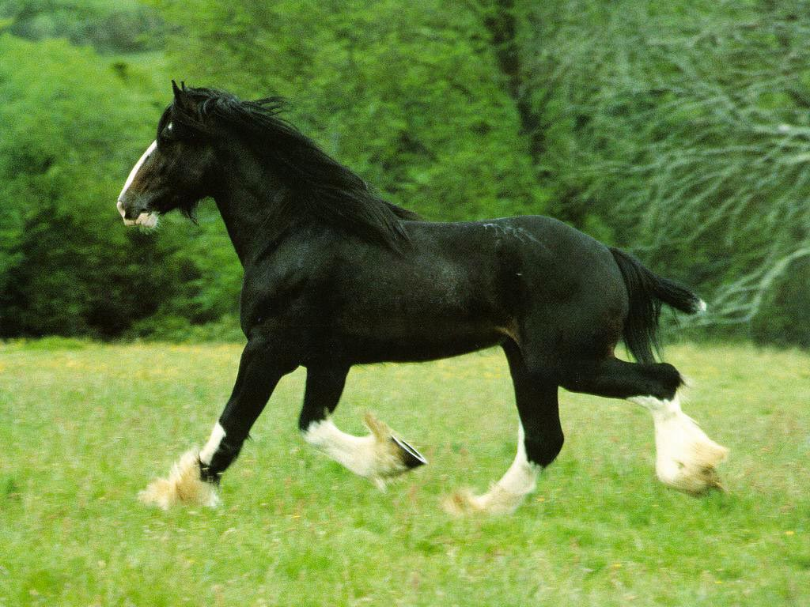
E. Classify animals according to their type of digestion
Types of Digestion
… What do they eat?
Mostly Roughage with some concentrates
…How many stomach compartments?
1
… What type of digestive system?
Modified Monogastric

Slide 48
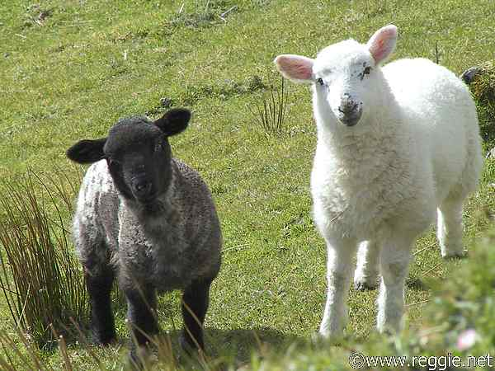
E. Classify animals according to their type of digestion
Types of Digestion
… What do they eat?
Mostly Roughage with some concentrates
…How many stomach compartments?
4
… What type of digestive system?
Ruminant

Slide 49
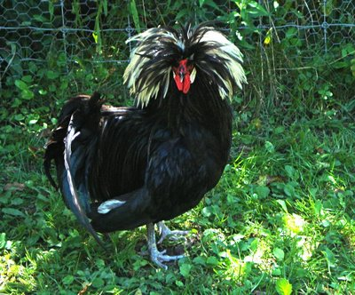
E. Classify animals according to their type of digestion
Types of Digestion
… What do they eat?
Mostly concentrates
…How many stomach compartments?
1
… What type of digestive system?
Avian

Slide 50
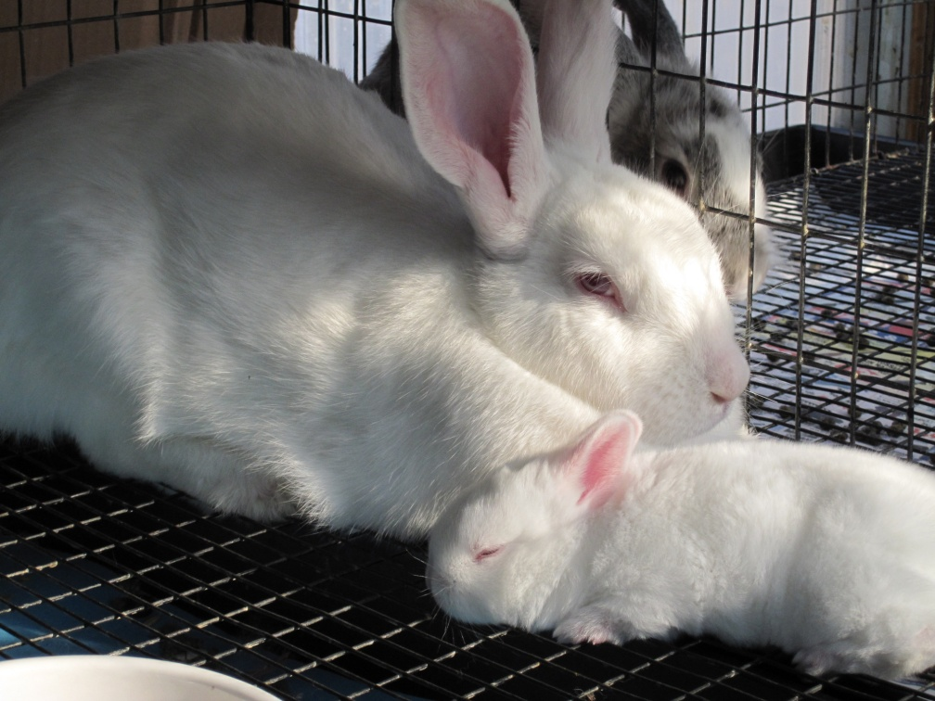
E. Classify animals according to their type of digestion
Types of Digestion
… What do they eat?
Mostly Roughage with some concentrates
…How many stomach compartments?
1
… What type of digestive system?
Modified Monogastric

Slide 51
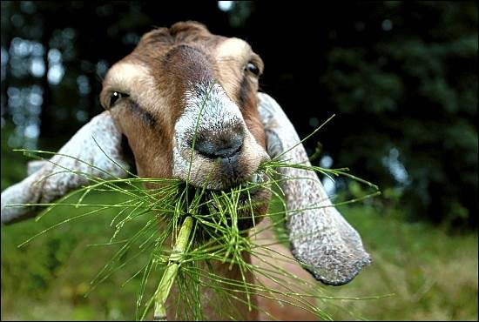
E. Classify animals according to their type of digestion
Types of Digestion
… What do they eat?
Mostly Roughage with some concentrates
…How many stomach compartments?
4
… What type of digestive system?
Ruminant

Slide 52
E. Classify animals according to their type of digestion
Types of Digestion
… What do they eat?
Concentrates
…How many stomach compartments?
1
… What type of digestive system?
Monogastric

Slide 53
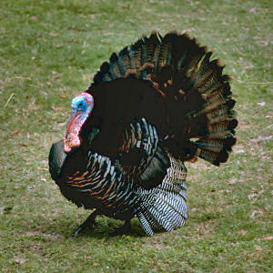
E. Classify animals according to their type of digestion
Types of Digestion
… What do they eat?
Mostly Concentrates
…How many stomach compartments?
1
… What type of digestive system?
Avian

Slide 54
F. List Digestive Enzymes and their function
Digestive Enzymes
Enzyme: A protein that chemically breaks down food
In the mouth:
Saliva: begins breakdown of carbs
In the stomach:
Gastric Juice:
0.2- 0.5% hydrochloric acid
Produced by stomach/abomasum
Pepsin:
Breaks down proteins

Slide 55
F. List Digestive Enzymes and their function
Digestive Enzymes
In the small intestine:
Chyme: An Acid
Pancreatic Juices
Trypsin: breaks down protein
Pancreatic Amylase: changes starch to a simple sugar
Bile: Green liquid produced in the liver and stored in gall bladder. Digests fat

Slide 56
Bell Quiz Objective A & B
List 2 characteristics that distinguish a monogastric animal.
What is the difference between the chemical and physical breakdown of feed?
What is the purpose of the teeth? Do they provide chemical or physical breakdown?
What are the 3 segments of the small intestine?
What is the purpose of villi and microvilli?

Slide 57
Bell Quiz Objective C & D
List the 4 chambers of the ruminant stomach in order.
What is “hardware disease” and which compartment collects non-food items?
What structure is found in young ruminants which allows milk to pass directly to abomasum?
Which structures are only found in the avian digestive system?
What is the purpose of the gizzard?

Slide 58
Bell Quiz Objective E & F
What 2 characteristics should you consider when determining what type of digestive system an animal has?
List 3 animals that are ruminants.
List 1 animal that is monogastric.
List 2 animals that are modified monogastrics.
What is the purpose of an enzyme? List 3 examples.

