Slide 1
Genetics in the Animal Industry
Describe the role and importance of genetics in the animal industry
Recognize & describe the interrelationship between genetics and the environment
Identify common characteristics used to select high quality breeding stock
Describe and predict how traits are inherited using the punnet square
Compare and contrast qualitative vs. quantitative animal traits
Use EPD’s to select quality sires
Compare common breeding systems used in the animal industry

Slide 2
How do genetics affect the animal industry?
Describe the role and importance of genetics in the animal industry

Slide 3
Importance of Genetics
Describe the role and importance of genetics in the animal industry
Natural Selection
“Survival of the Fittest”
If the animal has characteristics to survive, it reproduces
No human intervention
Artificial Selection
Humans control which animals reproduce based on presence of desirable characteristics

Slide 4
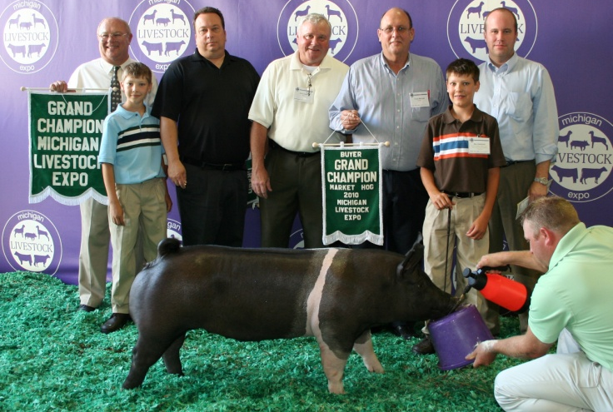
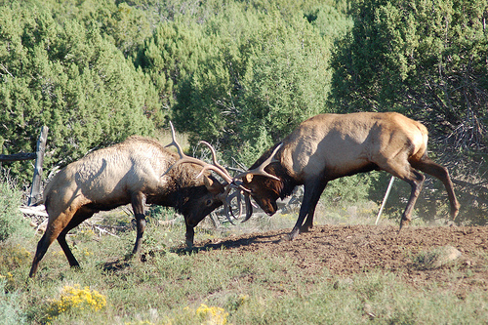
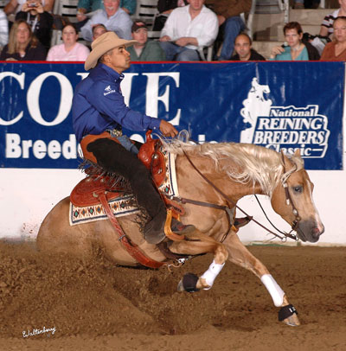
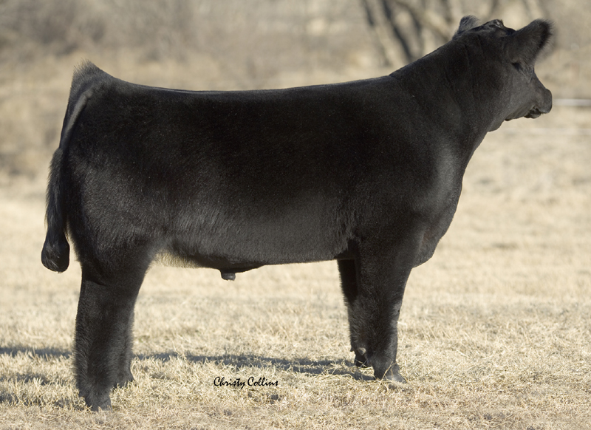
Importance of Genetics
Describe the role and importance of genetics in the animal industry
Natural Selection
Artificial Selection
Which do we use in Agriculture?
Notes:
Use pictures to illustrate the difference between natural and artificial selection. With natural selection, the biggest and strongest sire mates and passes on it’s genetic information. In agriculture, humans choose characteristics they like and breed those animals to produce quality show and performance animals. Many traits found in agricultural livestock would NOT be found in the wild.

Slide 5
Importance of Genetics
Describe the role and importance of genetics in the animal industry
Why use artificial selection in agriculture?
More rapid improvement of livestock
More ability to control and perpetuate desired characteristics
Agricultural products are higher quality and more consistent

Slide 6
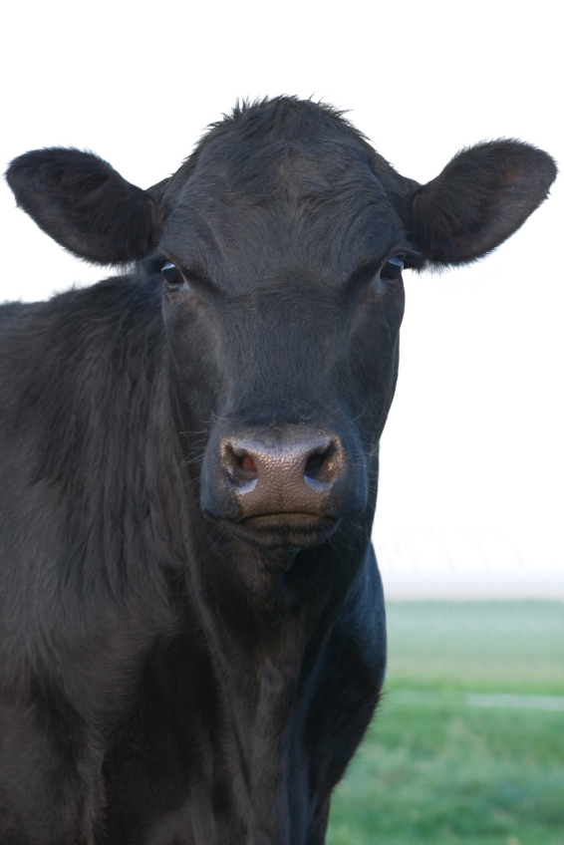
Importance of Genetics
Describe the role and importance of genetics in the animal industry
Phenotype vs Genotype
Observable, physical characteristics
An organism’s genetic code represented by a pattern of letters (genes)
Phenotype= Black
Genotype= BB or Bb

Slide 7
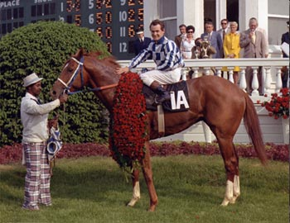
Heredity vs Environment
B. Recognize & describe the interrelationship between genetics and the environment
Heredity= the POTENTIAL an animal has to show specific traits or performance due to it’s genetic information
Bold Ruler
Secretariat
(1973 Triple Crown Winner)
Something Royal
Notes:
Use race horses as an example. Secretariat, 1973 Triple Crown Winner only had POTENTIAL to be a great racehorse. Breeding 2 great race horses will not necessarily produce a great racehorse, but it has potential. Show the section of Disney’s “Secretariat” where Penny Chenery is choosing which stud she will breed her mare to. She discusses traits of the studs she could choose.

Slide 8
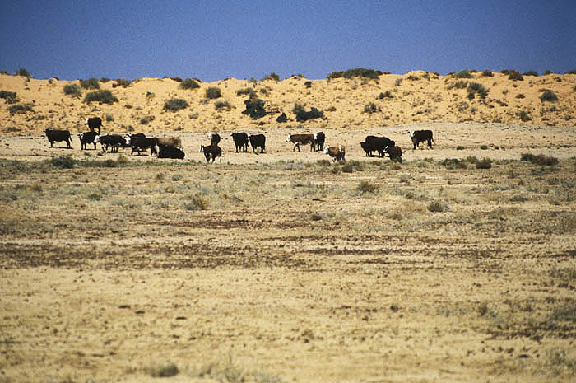
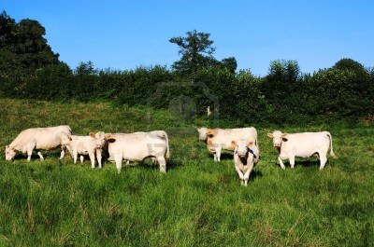
Heredity vs Environment
B. Recognize & describe the interrelationship between genetics and the environment
Environment= The EXTERNAL conditions that affect the traits and performance of an animal
Desert Range or lush green pastures?

Slide 9
Heredity vs Environment
B. Recognize & describe the interrelationship between genetics and the environment
Traits
&
Performance
(Phenotype)
+
=
Environment
Genetics
(Genotype)

Slide 10
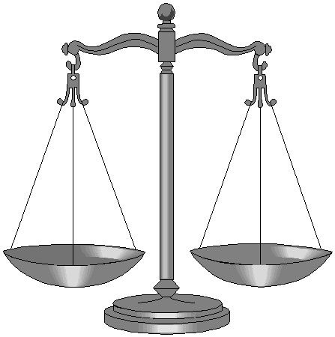
Heredity vs Environment
B. Recognize & describe the interrelationship between genetics and the environment
Some traits are influenced more by environment
Other traits are influenced most by genetics
Environment
Genetics

Slide 11
Heredity vs Environment
B. Recognize & describe the interrelationship between genetics and the environment
Heritability= The percentage a trait is affected by the animal’s GENETIC information
A heritability factor of 0.0 = little influence from genetics
A heritability factor of 1.0= BIG influence from genetics

Slide 12
Heredity vs Environment
B. Recognize & describe the interrelationship between genetics and the environment
Examples of Heritability Factors:
Cattle
Fertility = 0.10
Birth Weight = 0.45
Conformation = 0.30 - 0.38
Weaning Weight = 0.24
Height = 0.88 - 0.95
Dressing Percentage = 0.45
Ribeye Area = 0.70
Sheep
Multiple Births = 0.15
Lamb Growth Rate = 0.30
Wool Face Cover = 0.56
Wool Staple Length = 0.47
Loineye area = 0.53
Carcass Fat = .57
Notes:
Heritability Estimates from University of Missouri Extension: http://extension.missouri.edu/p/G2910

Slide 13
Heredity vs Environment
B. Recognize & describe the interrelationship between genetics and the environment
Examples of Heritability Factors:
Swine
Piglets Farrowed = 0.10
Growth Rate= 0.30
Backfat Thickness = 0.50
Loineye area = 0.50
Length = 0.60
Chilled carcass weight = 0.60
On your notes…
circle all of the traits with a HIGH heritability factor
(0.5 or greater)
Notes:
Describe heritability factors as needed for students to understand.
When completed, have students circle the traits with a high heritability factor.

Slide 14
C. Identify common characteristics used to select high quality breeding stock
What characteristics do farmers and ranchers look for when selecting which animals they breed?

Slide 15
Identifying Genetic Strengths
C. Identify common characteristics used to select high quality breeding stock
Breeders identify genetic strengths based upon their goals
Examples: Meat production, Temperament, Coat Color, etc.
Not every animal should pass on it’s genetics
In the pet industry, these animals are sterilized (spayed or neutered)
In the livestock industry, they are usually raised for terminal markets

Slide 16
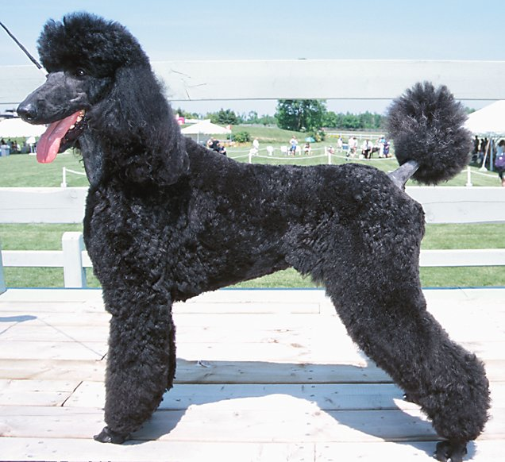
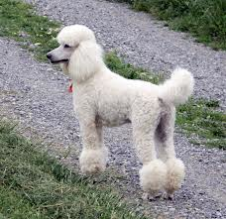
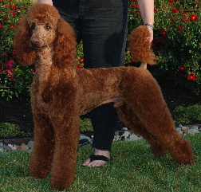
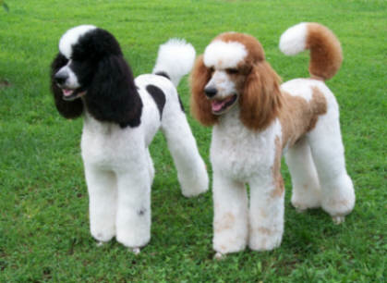
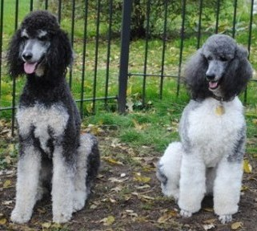
Identifying Genetic Strengths
C. Identify common characteristics used to select high quality breeding stock
Example:
A Standard Poodle dog breeder with the goal of raising show dogs will NEVER breed a poodle that is not solid colored because AKC breed standards only recognize solid colored Standard Poodles.
However…A Standard Poodle dog breeder with the goal of raising family pets will breed “parti” (2 colored) poodles because people like them and sometimes pay more for their unique coloring.
Notes:
-Use this slide as an example to emphasize that the breeders goals are very important to identify what traits and genes are valuable and which ones are not.
-AKC Standard Poodle Breed Guidelines: http://www.akc.org/breeds/poodle/index.cfm

Slide 17
Identifying Genetic Strengths
C. Identify common characteristics used to select high quality breeding stock
Dairy Cattle
Milk Production
Milk Components (Butterfat & Protein)
Longevity (Calves produced & lactations completed)

Slide 18
Identifying Genetic Strengths
C. Identify common characteristics used to select high quality breeding stock
Beef Cattle
Frame Size
Rib Eye Area
Growth Rates (Weaning & Birth weights)
Coat Color (only for “Black Angus Beef” Markets)
Notes:
Note: Coat color in beef cattle is only important to the successful marketing campaigns of “Black Angus Beef.” Clarify to students that coat color has no effect on meat quality.

Slide 19
Identifying Genetic Strengths
C. Identify common characteristics used to select high quality breeding stock
Sheep
Multiple Births (# lambs per ewe)
Wool Quality
Growth
Notes:
Refer students back to their heritability ratios. Multiple Births has a very low heritability ratio. Discuss with students that even if the trait isn’t highly heritable, the trait may be very important to the success of the overall breeding program. In the case of the sheep industry, twin births are a very valuable trait.

Slide 20
Identifying Genetic Strengths
C. Identify common characteristics used to select high quality breeding stock
Horses
Structure & Size
Coat Color
Performance Abilities
Temperament

Slide 21
Identifying Genetic Strengths
C. Identify common characteristics used to select high quality breeding stock
Pigs
Litter Size
Growth Rate
Degree of Muscling

Slide 22
Identifying Genetic Strengths
C. Identify common characteristics used to select high quality breeding stock
Dogs
Varies widely according to breed standards and use of dog:
Correct Size
Correct coat texture & color
Correct Structure
Notes:
Explain to students that every breed has a different standard. For example only black, yellow, and chocolate Labradors are considered correct. Chihuahuas should have ears that stand up, Airdale Terriers should have a black and tan coat that is curly/wiry in texture, etc. Any characteristics within the breed description add genetic quality. Any characteristics outside of the breed standards decrease genetic quality.

Slide 23
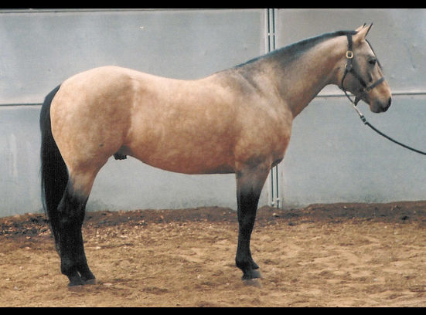
Identifying Genetic Strengths
C. Identify common characteristics used to select high quality breeding stock
Classified Ad Search Assignment
-AQHA Buckskin Stallion
-16.2 Hands 1500 lbs. Guaranteed not to produce Sorrel or Chestnut foals. 90% Buckskin, Dun, or Grullo. Genetically tested. Homozygous for the Black gene.
-Sire has a speed index of 95. Grand sire and Grand dam on top side both have speed index of 100.
-Registered with the following Associations:
American Quarter Horse Association
American Buckskin Registry Association
-From the show ring he is a Winning Halter, Western pleasure, English Pleasure & Western Riding. He was evaluated during an informal Sport Horse Inspection and scored in the Sport Horse range, these are the toughest standards in the horse industry. Scoring the highest in Frame, Back, Loin, Disposition with color an added Bonus. The inspector stated that in her opinion he is TOPS in the Quarter Horse Breed.
-EVA tested Negative
-Herda tested Negative
World Class Buckskin Stallion
$1500 Stud Fee

Slide 24
Can you predict traits an offspring will have before it’s born?
D. Describe and predict how traits are inherited using the punnet square

Slide 25
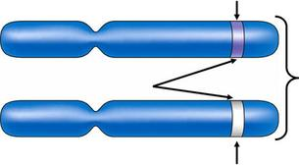
Punnet Squares
D. Describe and predict how traits are inherited using the punnet square
Learn the Terminology
Allele=
A form of a gene found in pairs
Located on chromosomes
1 allele inherited from each parent
Represented by a letter
Bb
Allele
Allele
Chromosome

Slide 26
Punnet Squares
D. Describe and predict how traits are inherited using the punnet square
Learn the Terminology
Dominant Alleles=
Represented by CAPITOL letters
This trait is the one expressed
Recessive Alleles=
Represented by lower case letters
Only expressed if both alleles are recessive

Slide 27
Punnet Squares
D. Describe and predict how traits are inherited using the punnet square
Learn the Terminology
Homozygous=
Both alleles are the SAME
(BB) = Homozygous dominant
(bb) = Homozygous Recessive
Heterozygous=
Different alleles for the same trait
(Bb)

Slide 28
Punnet Squares
D. Describe and predict how traits are inherited using the punnet square
Punnet Square= A method of calculating the chances of inheriting a specific trait
B b
Parent Genotypes
B
b
**This offspring has a 75% chance of being black and 25% chance of being red
BB
Bb
Bb
bb

Slide 29
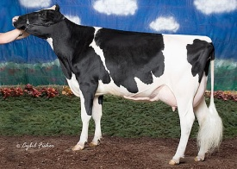
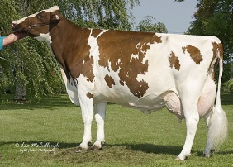
Punnet Squares
D. Describe and predict how traits are inherited using the punnet square
Now you try…
Holstein Cattle
Black & white
Red & White
B b
b
b
Bb
bb
Bb
bb
Bb
bb

Slide 30
Punnet Squares
D. Describe and predict how traits are inherited using the punnet square
Suppose you have a dairy with ONLY black and white Holsteins. Is it possible to breed 2 phenotypically black and white Holsteins and get a red and white?
B b
B
b
BB
Bb
Bb
bb

Slide 31
Punnet Squares
D. Describe and predict how traits are inherited using the punnet square
FYI…
Punnet squares can only be used with simple traits inherited by dominance
The inheritance of other traits are more complex

Slide 32
Qualitative & Quantitative Traits
E. Compare and contrast qualitative vs. quantitative animal traits
Qualitative Traits
Controlled by a SINGLE pair of genes
Can usually be observed visually (phenotypes)
Presence of Wattles
Coat Color
White Face vs Solid Face
Presence of horns
Coat Texture
(Wirehair, straight, curly)
Notes:
More clarification of quantitative vs qualitative traits: http://www.education.com/study-help/article/qualitative-quantitative-traits/

Slide 33
Qualitative & Quantitative Traits
E. Compare and contrast qualitative vs. quantitative animal traits
Quantitative Traits
Controlled by SEVERAL pair of genes
Can usually be measured
Back fat Depth
Rate of Gain
Weaning Weight
Birth Weight
Height
Milk Production
Litter Size

Slide 34
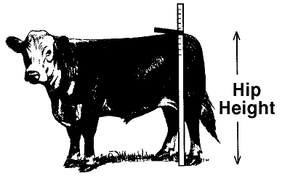
Qualitative & Quantitative Traits
E. Compare and contrast qualitative vs. quantitative animal traits
HIP Height of 48”
Quantitative …. OR …. Qualitative?

Slide 35
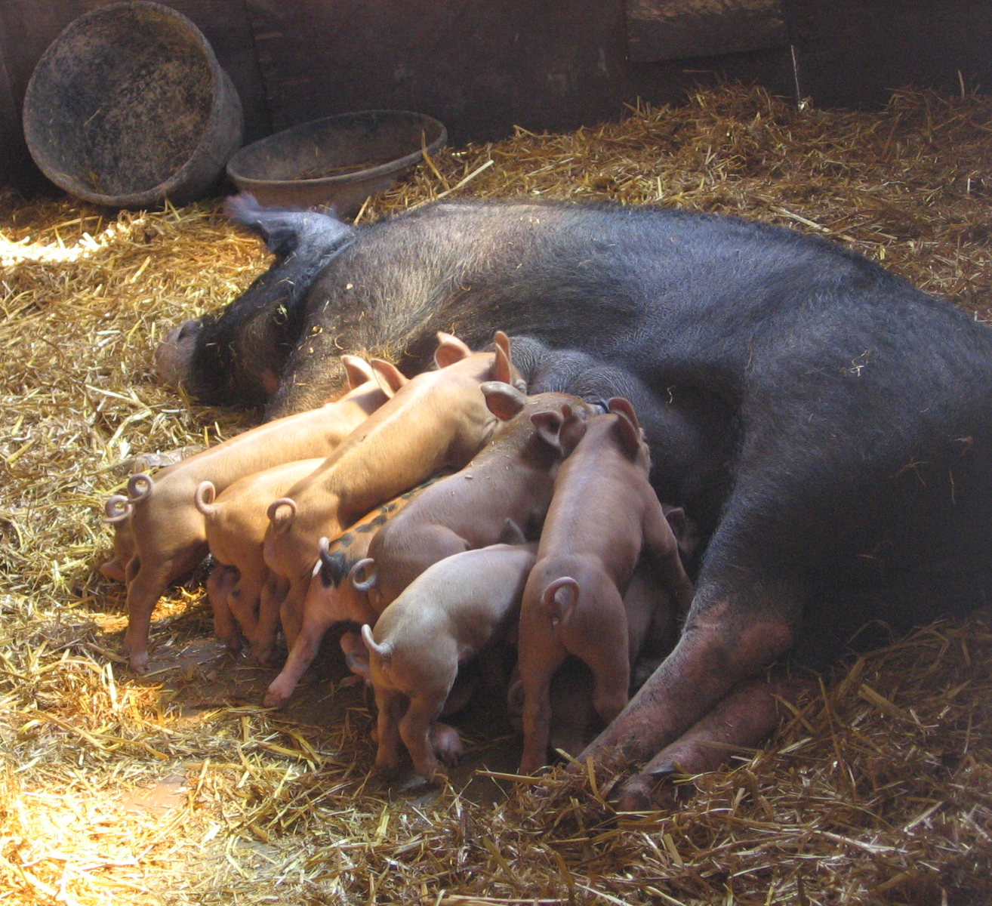
Qualitative & Quantitative Traits
E. Compare and contrast qualitative vs. quantitative animal traits
A sow who produced 8 piglets in a litter
Quantitative …. OR …. Qualitative?

Slide 36
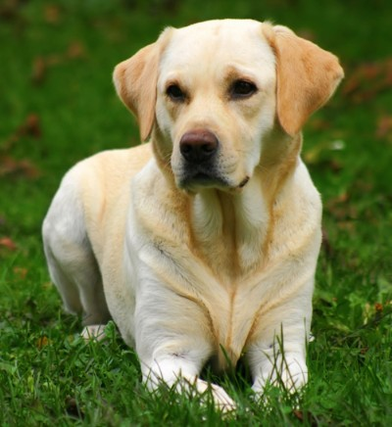
Qualitative & Quantitative Traits
E. Compare and contrast qualitative vs. quantitative animal traits
YELLOW
Labrador Retriever
Quantitative …. OR …. Qualitative?

Slide 37
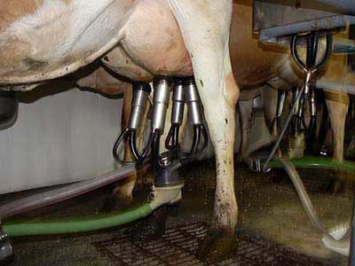
Qualitative & Quantitative Traits
E. Compare and contrast qualitative vs. quantitative animal traits
A cow producing 65 lbs of milk daily
Quantitative …. OR …. Qualitative?

Slide 38
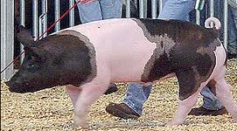
Qualitative & Quantitative Traits
E. Compare and contrast qualitative vs. quantitative animal traits
A pig with an Average Daily Gain of 2 lbs
Quantitative …. OR …. Qualitative?

Slide 39
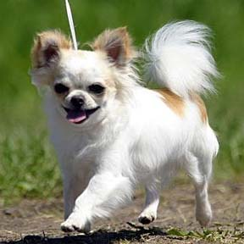
Qualitative & Quantitative Traits
E. Compare and contrast qualitative vs. quantitative animal traits
Long haired chihuahua
Quantitative …. OR …. Qualitative?

Slide 40
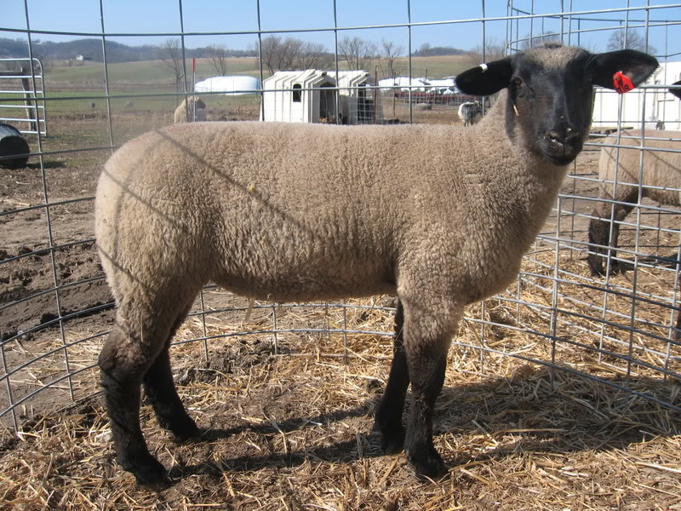
Qualitative & Quantitative Traits
E. Compare and contrast qualitative vs. quantitative animal traits
A lamb weaned at 65 lbs
Quantitative …. OR …. Qualitative?

Slide 41
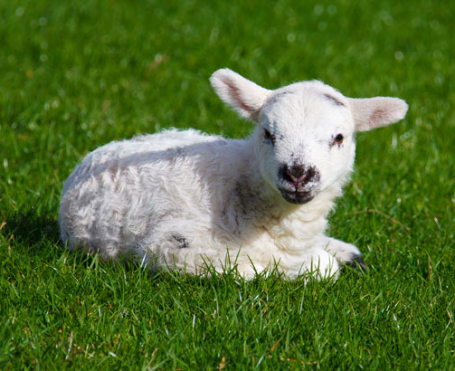
Qualitative & Quantitative Traits
E. Compare and contrast qualitative vs. quantitative animal traits
A lamb weighing 5 pounds at birth
Quantitative …. OR …. Qualitative?

Slide 42
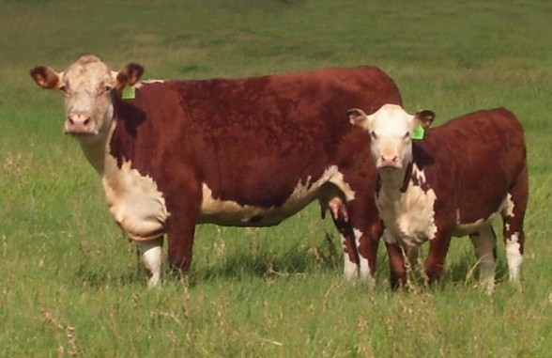
Qualitative & Quantitative Traits
E. Compare and contrast qualitative vs. quantitative animal traits
A polled Hereford cow
Quantitative …. OR …. Qualitative?

Slide 43
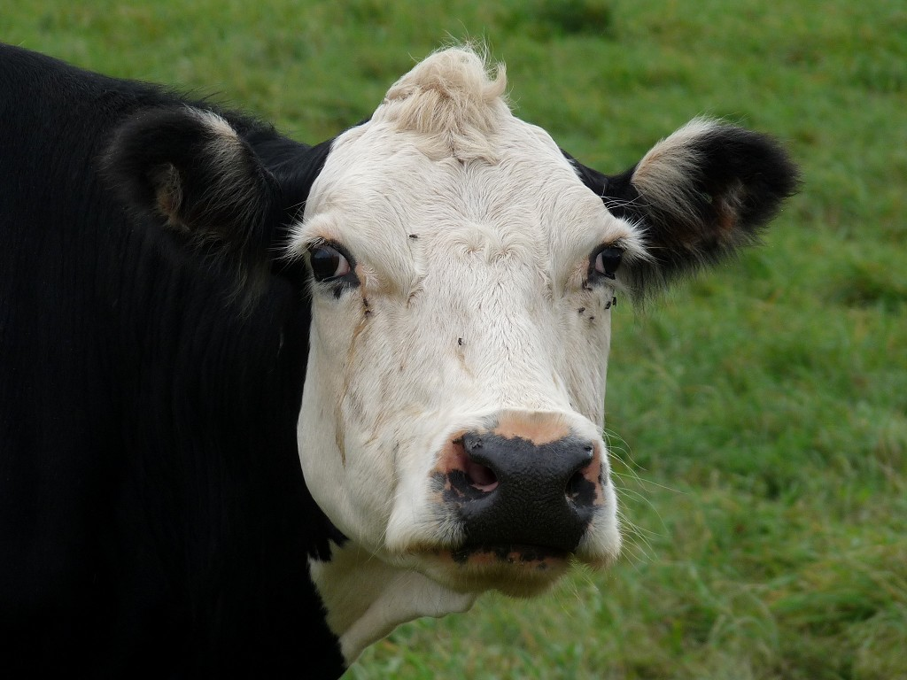
Qualitative & Quantitative Traits
E. Compare and contrast qualitative vs. quantitative animal traits
A White Faced Beef Cow
Quantitative …. OR …. Qualitative?

Slide 44
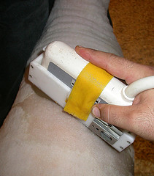
Qualitative & Quantitative Traits
E. Compare and contrast qualitative vs. quantitative animal traits
A lamb with 2.5 mm of backfat
Quantitative …. OR …. Qualitative?

Slide 45
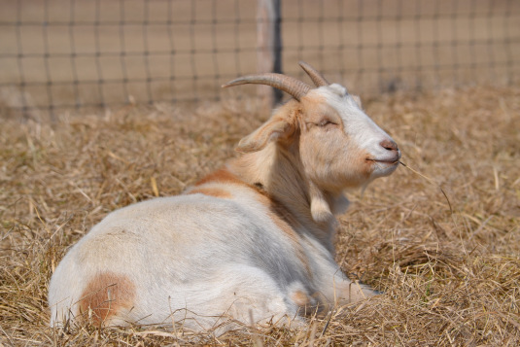
Qualitative & Quantitative Traits
E. Compare and contrast qualitative vs. quantitative animal traits
A goat with wattles
Quantitative …. OR …. Qualitative?

Slide 46
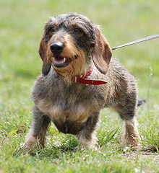
Qualitative & Quantitative Traits
E. Compare and contrast qualitative vs. quantitative animal traits
A wirehair dachshund
Quantitative …. OR …. Qualitative?

Slide 47
EPD’s
F. Use EPD’s to select quality sires
Estimated Progeny Difference
Indicates the genetic value of a specific sire compared to the average genetic value of it’s breed.
Expressed as a number
Used in the cattle industry
Are EPD’s Qualitative or Quantitative?

Slide 48
EPD’s
F. Use EPD’s to select quality sires
Example:
The average angus calf weighs 75 lbs at birth
The average birth weight of the offspring of “Denver,” an angus bull, is 80 lbs.
“Denver’s” birth weight EPD is 5
*The number can be positive or negative depending on if it is above or below breed average

Slide 49
EPD’s
F. Use EPD’s to select quality sires
Calculate an EPD:
The average maternal milk production for Herefords is 25 lbs
The average milk production for a bull’s daughters is 21 lbs
The maternal milk EPD for this bull is:
-4

Slide 50
EPD’s
F. Use EPD’s to select quality sires
Common EPD’s: Beef Cattle
CED: Calving Ease Direct
BW: Birth Weight
WW: Weaning Weight
YW: Yearling Weight
CW: Carcass Weight
RE: Rib Eye Area

Slide 51
EPD’s
F. Use EPD’s to select quality sires
Common EPD’s: Dairy Cattle
MILK: Total Milk Production (in pounds)
Protein: Milk’s protein content (in pounds)
Fat: Milk’s fat content (in pounds)
CE: Calving Ease
SCS: Somatic Cell Score

Slide 52
EPD’s
F. Use EPD’s to select quality sires
Benefits of using EPD’s
Use sire’s who are already proven to produce quality calves
Sires with EPD’s have likely already produced 100 or more calves
Pinpoint characteristics you want to improve in your herd

Slide 53
Breeding Systems
G. Compare common breeding systems used in the animal industry
Breeding systems are designed based upon:
Goals of breeding facility
Financial Goals
Specific markets you produce for
Terminal markets (meat)
Seedstock Markets
Show & Purebred industry markets

Slide 54
Breeding Systems
G. Compare common breeding systems used in the animal industry
Purebred
All animals are registered purebreds
Goal: Produce high quality animals to use as breeding and/or show stock

Slide 55
Breeding Systems
G. Compare common breeding systems used in the animal industry
Commercial
Breeding females are not purebred or registered
Sires are typically higher quality purebreds
Goal: Produce offspring of higher quality than the commercial female. (Sometimes called “Grading up”)

Slide 56
Breeding Systems
G. Compare common breeding systems & strategies used in the animal industry
Commercial
With each generation, offspring quality gets closer to the purebred sire with the benefits of crossbreeding and without the added cost and management of a purebred herd.
Purebred Sire Quality
Commercial Female Quality
Offspring
Quality

Slide 57
Breeding Strategies
G. Compare common breeding systems used in the animal industry
Crossbreeding
Mating animals of DIFFERENT breeds
Goal: Increase Hybrid Vigor in hopes that offspring will inherit the good traits of both parents

Slide 58
Breeding Strategies
G. Compare common breeding systems used in the animal industry
Inbreeding
Mating closely related animals
Necessary to create new breeds or isolate genes for specific traits
Negative Factors:
Deleterious genes may arise
Recessive genes will be expressed
Positive Factors:
More uniform offspring
Traits “breed true”
Notes:
Deleterious Gene= gene that could cause undesirable effects on an individual’s viability, productivity, and/or economic value.
“Breeding True” means that all offspring will have specific breed traits. For example, every purebred poodle should have curly hair, every hereford should have white markings, etc.

Slide 59
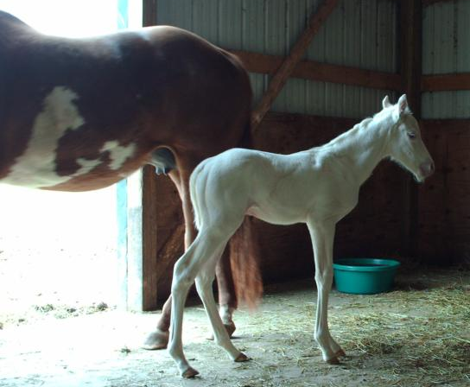
Breeding Strategies
G. Compare common breeding systems used in the animal industry
Inbreeding
“Lethal White” gene in Paints:
Foals carried full term
All white or mostly white coats
Look & Seem fine at birth, BUT colon is non functioning. They show symptoms of colic and die within 48 hours.
Gene is carried on the overo color gene
Recessive gene was perpetuated as overo paints were bred.

Slide 60
Breeding Strategies
G. Compare common breeding systems used in the animal industry
Linebreeding
Mating related animals
Half siblings
Grandsire x granddaughter (skip generation)
*Minor form of inbreeding, but not as extreme

Slide 61
Bell Quiz Objective A & B
Describe artificial selection and how it is used in agriculture
List 1 benefit of artificial selection
Complete the equation: Environment + Genetics =
List 3 HIGHLY heritable traits in livestock
List 3 traits that have LOW heritability in livestock

Slide 62
Bell Quiz Objective C & D
To produce quality animals, should all livestock be used for reproduction? Why?
List 3 genetic characteristics used to identify quality breeding stock.
Give an example of a homozygous dominant genotype
Give an example of a heterozygous genotype
Draw a punnet square for a cross between a black and white Holstein (Bb) and a red and white Holstein (bb)

Slide 63
Bell Quiz Objective E & F
What type of trait is inherited by a single pair of genes?
What type of trait s inherited by many genes and can usually be measured?
What does EPD stand for?
What benefit do EPD’s provide cattle breeders?
What does “CED” stand for on a EPD?

Slide 64
Bell Quiz Objective G
What is the benefit of using crossbreeding in your animal breeding system?
Describe a typical commercial breeding facility
Describe a typical purebred breeding facility
What is the purpose of linebreeding or inbreeding? Is it always bad?
What is the difference between inbreeding and linebreeding?

