Slide 1
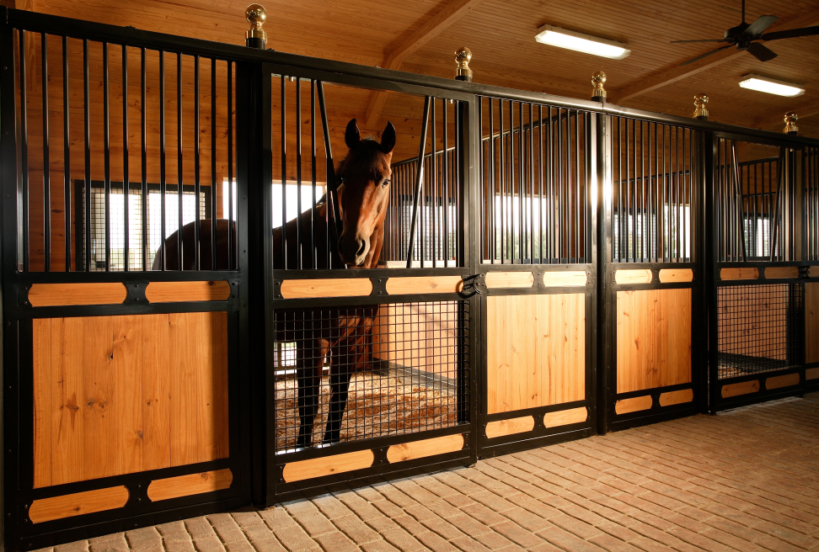
Horse
Group 1
6 Year old Quarter Horse Gelding
What will you feed your horse? (include name of feed & daily quantity)
How much will it cost to feed your horse for 1 year?
Hint: the average horse weighs 1000 pounds and eats 2.5 % of its body weight daily.

Slide 2
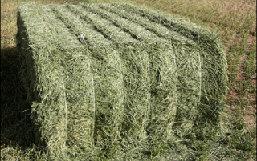
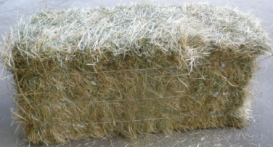
Feed Store
1 Ton Alfalfa Hay
$200
1 ton = 2000 pounds
1 Ton Grass Hay
$160
1 ton = 2000 pounds
Honor Show Chow Lamb: $19.39
Honor Show Chow Pig: $23.49
Honor Show Chow Steer: $25.42
Rabbit Pellets: $25.00
Purina Equine Adult: $22.39
Show Lamb: $15.49
Show Pig: $18.09
Beef Grower: $15.99
Rabbit Pellets: $16.69
Complete Horse: $16.09
Corn, Oats, Barley Grain: $15.79

Slide 3
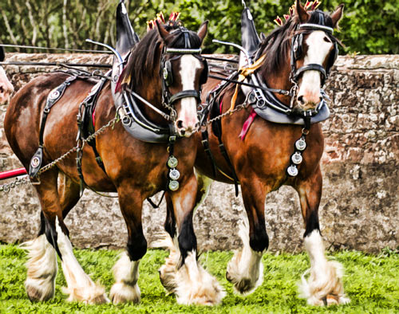
Draft Horse Team
Group 2
8 Year old Clydesdale mare team
What will you feed your horses? (include name of feed & daily quantity)
How much will it cost to feed your horses for 1 year?
Hint: the average draft horse weighs 1700 pounds and eats 2.5 % of its body weight daily.

Slide 4
Feed Store
1 Ton Alfalfa Hay
$200
1 ton = 2000 pounds
1 Ton Grass Hay
$160
1 ton = 2000 pounds
Honor Show Chow Lamb: $19.39
Honor Show Chow Pig: $23.49
Honor Show Chow Steer: $25.42
Rabbit Pellets: $25.00
Purina Equine Adult: $22.39
Show Lamb: $15.49
Show Pig: $18.09
Beef Grower: $15.99
Rabbit Pellets: $16.69
Complete Horse: $16.09
Corn, Oats, Barley Grain: $15.79

Slide 5
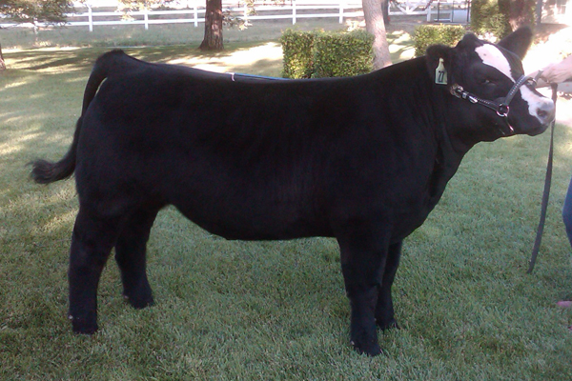
Market Steer
Group 3
Simmental/Maine Anjou Cross
What will you feed your steer? (include name of feed & daily quantity)
How much will it cost to feed your steer for 9 months?
Hint: the average steer eats 2.5 % of its body weight in hay per day and 8-15 pounds of grain daily. The first 4-5 months it’ll weigh 400-800 pounds, then 800-1200 pounds before it’s finished for market.

Slide 6
Feed Store
1 Ton Alfalfa Hay
$200
1 ton = 2000 pounds
1 Ton Grass Hay
$160
1 ton = 2000 pounds
Honor Show Chow Lamb: $19.39
Honor Show Chow Pig: $23.49
Honor Show Chow Steer: $25.42
Rabbit Pellets: $25.00
Purina Equine Adult: $22.39
Show Lamb: $15.49
Show Pig: $18.09
Beef Grower: $15.99
Rabbit Pellets: $16.69
Complete Horse: $16.09
Corn, Oats, Barley Grain: $15.79

Slide 7
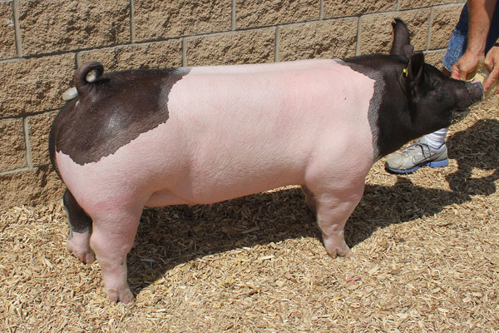
Market Hog
Group 4
Hampshire/Yorkshire Cross
What will you feed your hog? (include name of feed & daily quantity)
How much will it cost to feed your hog for 5 months? (from the time you acquire it after weaning, until you send it to market)
Hint: the average pig eats about 6 pounds of feed per day.

Slide 8
Feed Store
1 Ton Alfalfa Hay
$200
1 ton = 2000 pounds
1 Ton Grass Hay
$160
1 ton = 2000 pounds
Honor Show Chow Lamb: $19.39
Honor Show Chow Pig: $23.49
Honor Show Chow Steer: $25.42
Rabbit Pellets: $25.00
Purina Equine Adult: $22.39
Show Lamb: $15.49
Show Pig: $18.09
Beef Grower: $15.99
Rabbit Pellets: $16.69
Complete Horse: $16.09
Corn, Oats, Barley Grain: $15.79

Slide 9
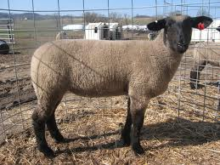
Market Lamb
Group 5
Suffolk Cross
What will you feed your lamb? (include name of feed & daily quantity)
How much will it cost to feed your lamb for 5 months? (from the time you acquire it after weaning, until you send it to market)
Hint: the average lamb eats 3.5 pounds of grain and about ¼ pound of alfalfa hay per day.

Slide 10
Feed Store
1 Ton Alfalfa Hay
$200
1 ton = 2000 pounds
1 Ton Grass Hay
$160
1 ton = 2000 pounds
Honor Show Chow Lamb: $19.39
Honor Show Chow Pig: $23.49
Honor Show Chow Steer: $25.42
Rabbit Pellets: $25.00
Purina Equine Adult: $22.39
Show Lamb: $15.49
Show Pig: $18.09
Beef Grower: $15.99
Rabbit Pellets: $16.69
Complete Horse: $16.09
Corn, Oats, Barley Grain: $15.79

Slide 11
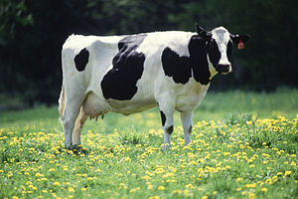
Dairy Cow
Group 6
3 Year old Lactating Holstein
What will you feed your cow? (include name of feed & daily quantity)
How much will it cost to feed your cow for 1 year?
Hint: the average dairy cow weighs 1200 pounds and eats 3.5% of it’s body weight in hay and grain.

Slide 12
Feed Store
1 Ton Alfalfa Hay
$200
1 ton = 2000 pounds
1 Ton Grass Hay
$160
1 ton = 2000 pounds
Honor Show Chow Lamb: $19.39
Honor Show Chow Pig: $23.49
Honor Show Chow Steer: $25.42
Rabbit Pellets: $25.00
Purina Equine Adult: $22.39
Show Lamb: $15.49
Show Pig: $18.09
Beef Grower: $15.99
Rabbit Pellets: $16.69
Complete Horse: $16.09
Corn, Oats, Barley Grain: $15.79

Slide 13
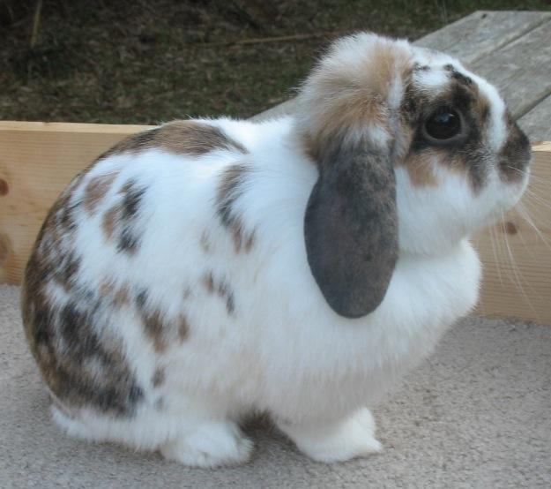
Rabbit
Group 7
Holland Lop Doe
What will you feed your Rabbit? (include name of feed & daily quantity)
How much will it cost to feed your rabbit for 1 year?
Hint: the average rabbit eats 3 oz of rabbit pellets twice per day. There are 16 oz in a pound.

Slide 14
Feed Store
1 Ton Alfalfa Hay
$200
1 ton = 2000 pounds
1 Ton Grass Hay
$160
1 ton = 2000 pounds
Honor Show Chow Lamb: $19.39
Honor Show Chow Pig: $23.49
Honor Show Chow Steer: $25.42
Rabbit Pellets: $25.00
Purina Equine Adult: $22.39
Show Lamb: $15.49
Show Pig: $18.09
Beef Grower: $15.99
Rabbit Pellets: $16.69
Complete Horse: $16.09
Corn, Oats, Barley Grain: $15.79

Slide 15
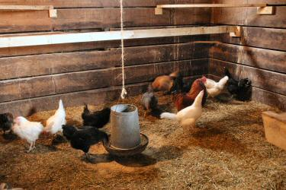
Chickens
Group 8
12 Mix Breed Laying Hens
What will you feed your chickens? (include name of feed & daily quantity)
How much will it cost to feed your hens for 1 year?
Hint: the average laying hen eats 2 pounds of feed per week.

Slide 16
Feed Store
1 Ton Alfalfa Hay
$200
1 ton = 2000 pounds
1 Ton Grass Hay
$160
1 ton = 2000 pounds
Honor Show Chow Lamb: $19.39
Honor Show Chow Pig: $23.49
Honor Show Chow Steer: $25.42
Rabbit Pellets: $25.00
Purina Equine Adult: $22.39
Show Lamb: $15.49
Show Pig: $18.09
Beef Grower: $15.99
Rabbit Pellets: $16.69
Complete Horse: $16.09
Corn, Oats, Barley Grain: $15.79

