Slide 1
Introduction to Livestock Judging & Selection
Explain the importance of animal selection in the success of a production enterprise
Discuss the importance of conformation in animal selection and how it is evaluated through the muscular and skeletal systems
Label external parts of agricultural animals
Describe the judging process and fill out a judging card correctly
Judge classes of livestock
Present oral reasons

Slide 2
Can you determine the quality of an animal?
Can one animal be better than another?

Slide 3
Importance of Animal Selection
Explain the importance of animal selection in the success of a production enterprise
When do you evaluate the quality of an animal?
1- Pre Purchase Exam
Determine if it will perform to the level you need
Be sure it is healthy & structurally sound
Confirm that the sale price matches the value

Slide 4
Importance of Animal Selection
Explain the importance of animal selection in the success of a production enterprise
When do you evaluate the quality of an animal?
2- Determining Sale Prices
Overpriced animals don’t usually sell
Underpriced animals lose potential profit

Slide 5
Importance of Animal Selection
Explain the importance of animal selection in the success of a production enterprise
When do you evaluate the quality of an animal?
3- Choosing Replacement Animals
Choose the best breeding animals to keep as replacements in your herd

Slide 6
Importance of Animal Selection
Explain the importance of animal selection in the success of a production enterprise
When do you evaluate the quality of an animal?
4- Selecting Show Animals
Pick the animal with the most show potential

Slide 7
Importance of Animal Selection
Explain the importance of animal selection in the success of a production enterprise
When do you evaluate the quality of an animal?
5- Judging Competitions
Learn skills in comparing animals quickly and ranking from top to bottom

Slide 8
Is it just a beauty contest?
Does each trait have a purpose for it’s value?

Slide 9
Importance of Animal Selection
Explain the importance of animal selection in the success of a production enterprise
MOST judging characteristics are related directly to efficiently producing agricultural products
In the show industry, a few characteristics are just for show

Slide 10
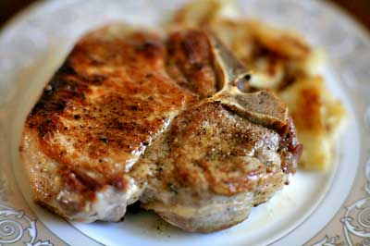
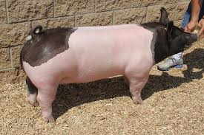
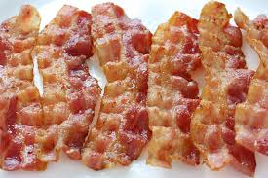
Importance of Animal Selection
Explain the importance of animal selection in the success of a production enterprise
For Example:
Pigs
More Pork Chops
=
More Bacon
A desirable characteristic in pigs is body length…
More Overall Weight
(Producers are paid per pound)

Slide 11
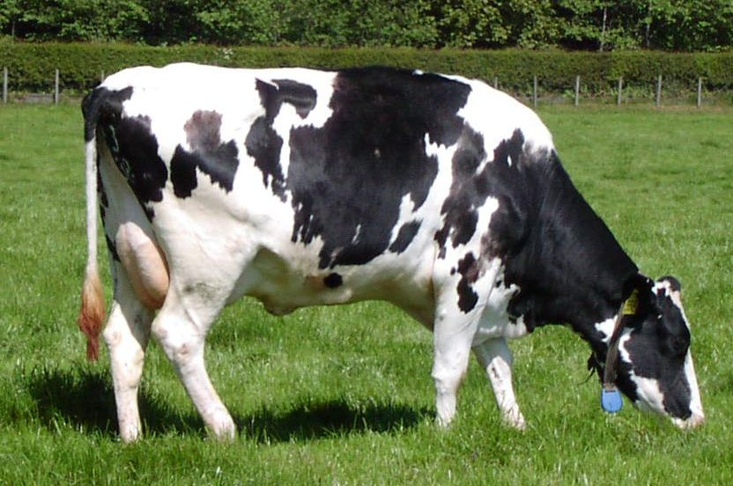
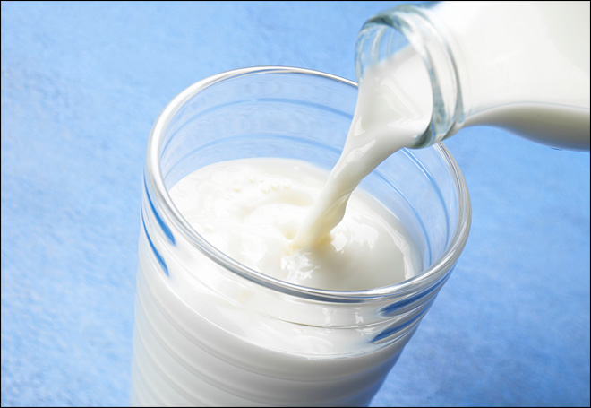
Importance of Animal Selection
Explain the importance of animal selection in the success of a production enterprise
For Example:
Dairy Cattle
500 gallons of blood must circulate through udder with water and nutrients for a cow to produce 1 gallon of milk!!
More heart & lung capacity
=
More milk production
A desirable characteristic in dairy cows is to be wide and deep in the chest to support a strong heart and lungs…
More Overall Profit
(Producers are paid per pound)

Slide 12
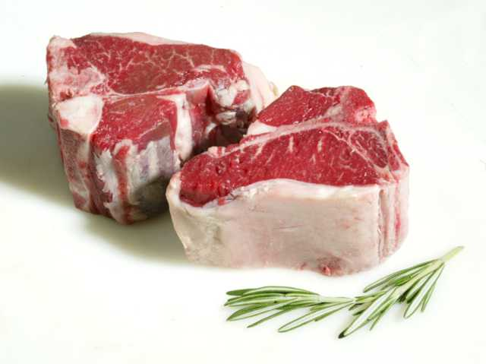
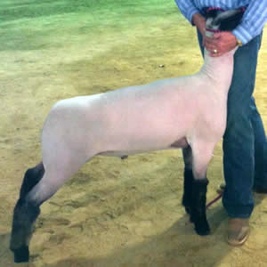
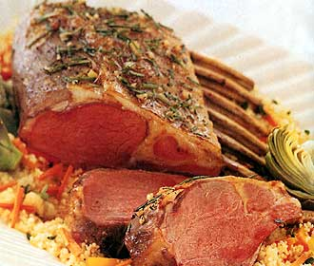
Importance of Animal Selection
Explain the importance of animal selection in the success of a production enterprise
For Example:
Sheep
=
More Loin Chops
A desirable characteristic in market lambs is length of loin.
Most tender & highest price per pound cut

Slide 13
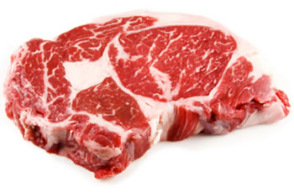
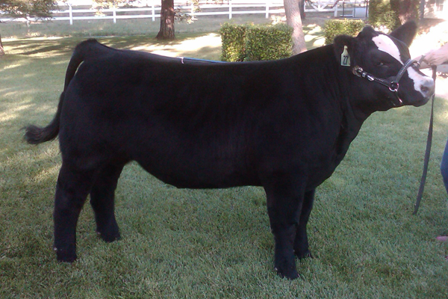
Importance of Animal Selection
Explain the importance of animal selection in the success of a production enterprise
For Example:
Beef Cattle
=
Adequate external fat will indicate greater chance of internal fat or “marbling”
A desirable characteristic in market steers is “finish” or fat cover.
High grades of meat yield higher price per pound

Slide 14
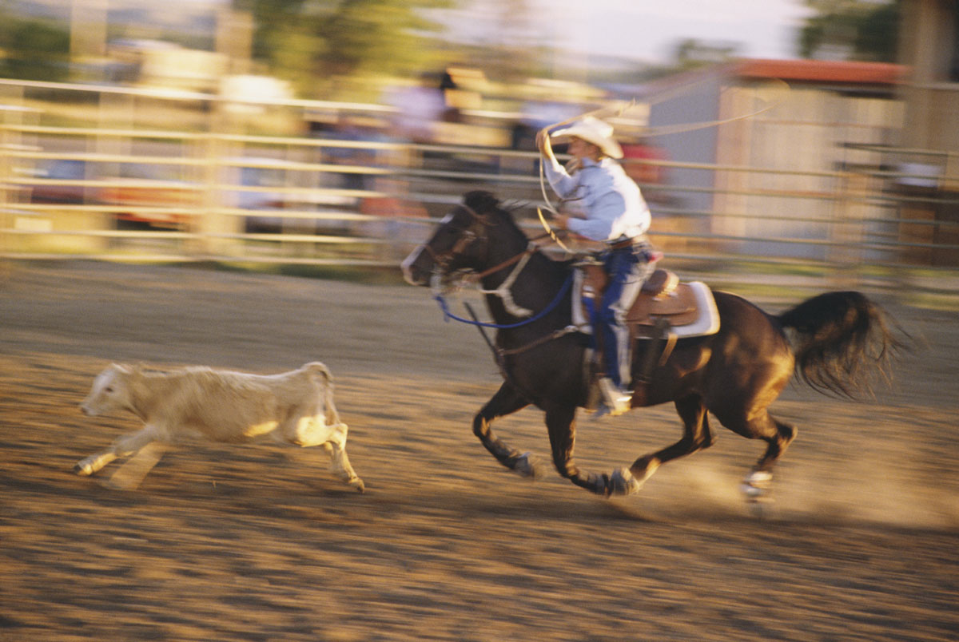
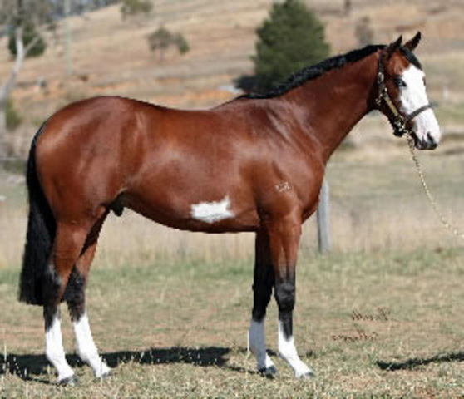
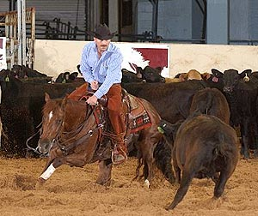
Importance of Animal Selection
Explain the importance of animal selection in the success of a production enterprise
For Example:
Horses
Power comes from the hind end for speed and power
=
A desirable characteristic in horses is to be short in the back and well muscled in the hind end
Shorter backs can have greater maneuverability for performance

Slide 15
Evaluating Conformation
B. Discuss the importance of conformation in animal selection and how it is evaluated through the muscular and skeletal systems
Terminology:
“Sound” in the animal industry is used to describe an animal without injury or structural fault.
“The sow is sound on her feet and legs”

Slide 16
Evaluating Conformation
B. Discuss the importance of conformation in animal selection and how it is evaluated through the muscular and skeletal systems
Skeletal System: provides structure and support to the body with:
Bones
Tendons (Connects bone to bone)

Slide 17
Evaluating Conformation
B. Discuss the importance of conformation in animal selection and how it is evaluated through the muscular and skeletal systems
Muscular System: provides ability for body to move
Moves Bones
Ligaments (Connect muscle to bone)

Slide 18
Evaluating Conformation
B. Discuss the importance of conformation in animal selection and how it is evaluated through the muscular and skeletal systems
Structural Incorrectness can cause “unsoundness”
Lameness or limping
Inability for animal to move freely (Stiff or post legged)

Slide 19
Evaluating Conformation
B. Discuss the importance of conformation in animal selection and how it is evaluated through the muscular and skeletal systems
Muscular AND Skeletal System work together
If 1 fails, the other will too

Slide 20
Evaluating Conformation
B. Discuss the importance of conformation in animal selection and how it is evaluated through the muscular and skeletal systems
Common Deformities of Front Legs:
Correct
Splay Foot
Pigeon Toe
Knock Kneed
Narrow Base
Wide Base

Slide 21
Evaluating Conformation
B. Discuss the importance of conformation in animal selection and how it is evaluated through the muscular and skeletal systems
Common Deformities of Rear Legs:
Correct
Sickle Hocked
Post Legged
Camped Under

Slide 22
Evaluating Conformation
B. Discuss the importance of conformation in animal selection and how it is evaluated through the muscular and skeletal systems
Common Deformities of Rear Legs:
Correct
Cow Hocked
Cow Hocked & Splay Footed
Pigeon Toed
Narrow Base
Wide Base

Slide 23
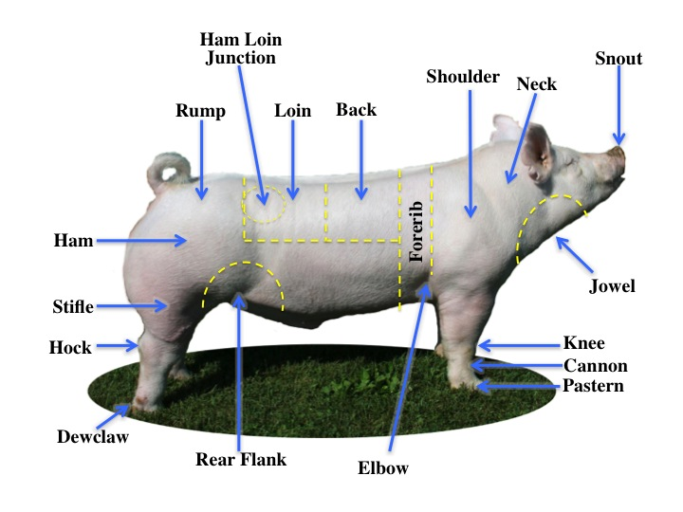
External Parts
C. Label external parts of agricultural animals

Slide 24
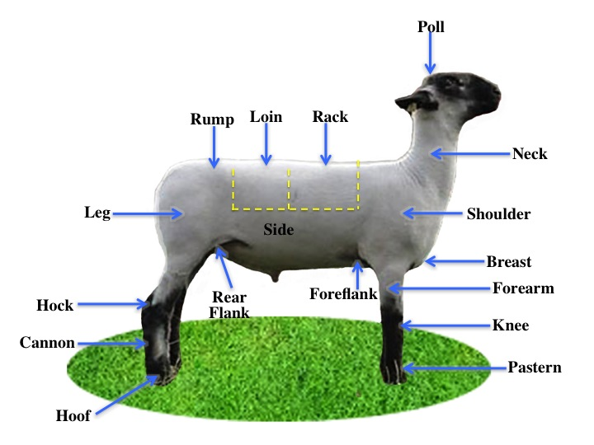
External Parts
C. Label external parts of agricultural animals

Slide 25
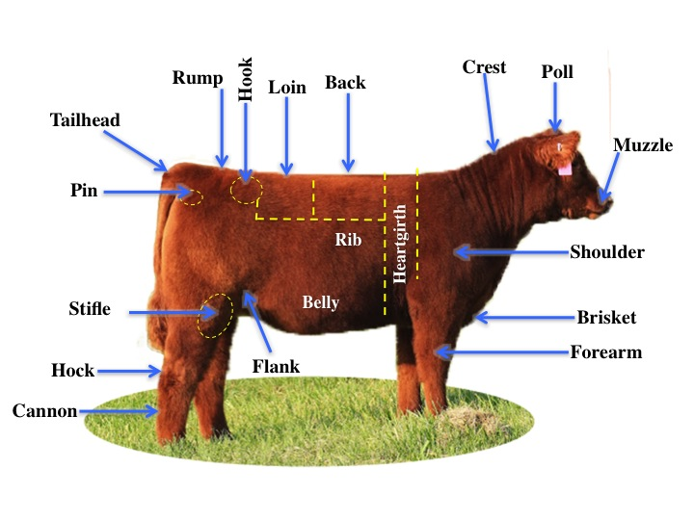
External Parts
C. Label external parts of agricultural animals

Slide 26
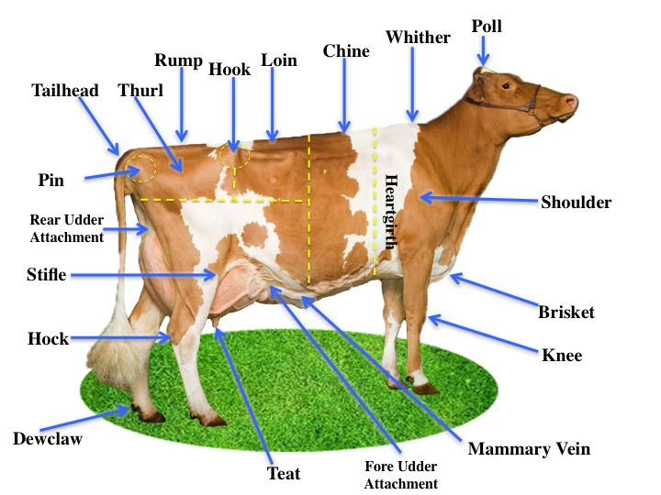
External Parts
C. Label external parts of agricultural animals

Slide 27
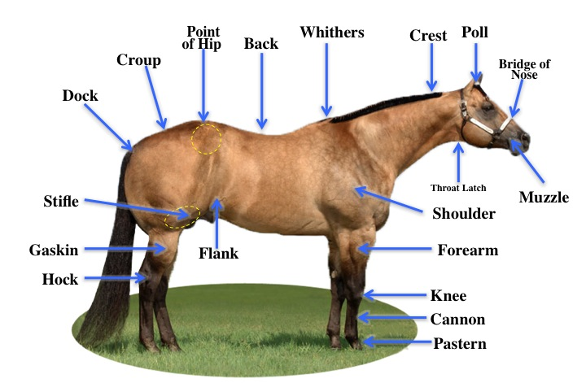
External Parts
C. Label external parts of agricultural animals

Slide 28
Livestock Judging
Describe the judging process and fill out a judging card correctly
Steps:
Identify ideal characteristics
Compare each animal to the ideal
Rank from best to worst

Slide 29
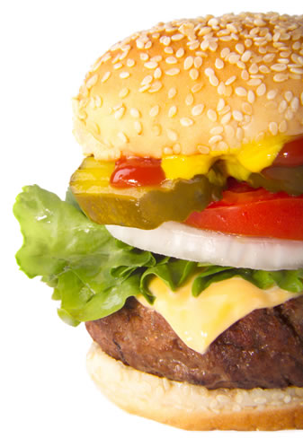
Livestock Judging
Describe the judging process and fill out a judging card correctly
Example:
An Ideal Hamburger has:
Hamburger patty
Sesame seed bun
Lettuce
Tomatoes
Ketchup
Mustard
Onions
pickles

Slide 30
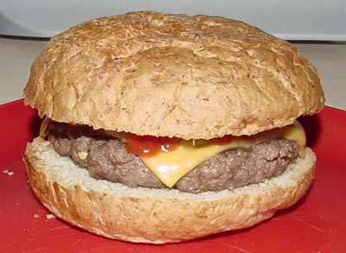
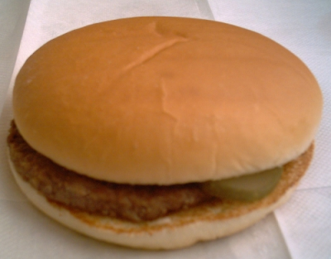
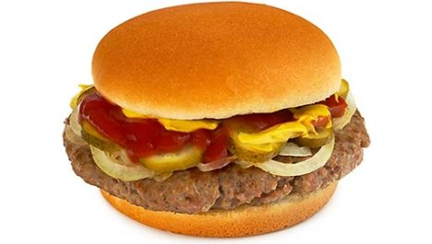
Livestock Judging
Describe the judging process and fill out a judging card correctly
Example: Class of Hamburgers
#1
Bun
Patty
Pickle
Ketchup
#2
Bun
Patty
Pickle
#3
Bun
Patty
Ketchup
Mustard
Pickles
Onions
#4
Sesame seed bun
Patty
Tomatoes,
Pickles
Lettuce
Ketchup
Mustard

Slide 31
Livestock Judging
Describe the judging process and fill out a judging card correctly
I PLACE THIS CLASS: ______ - ______ - ______ - _____
4
3
1
2

Slide 32
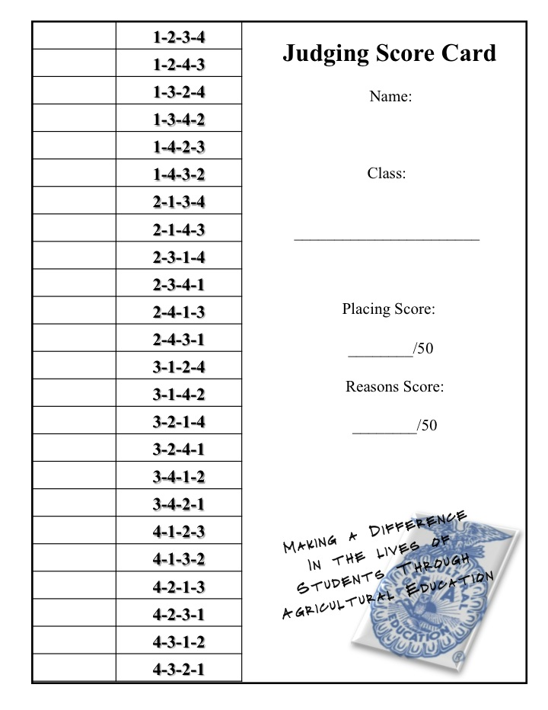
Livestock Judging
Describe the judging process and fill out a judging card correctly
Sam Jones
Market Steers
48
40
X

Slide 33
Judge a Class
Judge classes of livestock
Market = Animals being judged for immediate slaughter
Feeder = Animals that still have time to grow and finish
Breeding = Male or Female Animals evaluated for their breeding quality

Slide 34
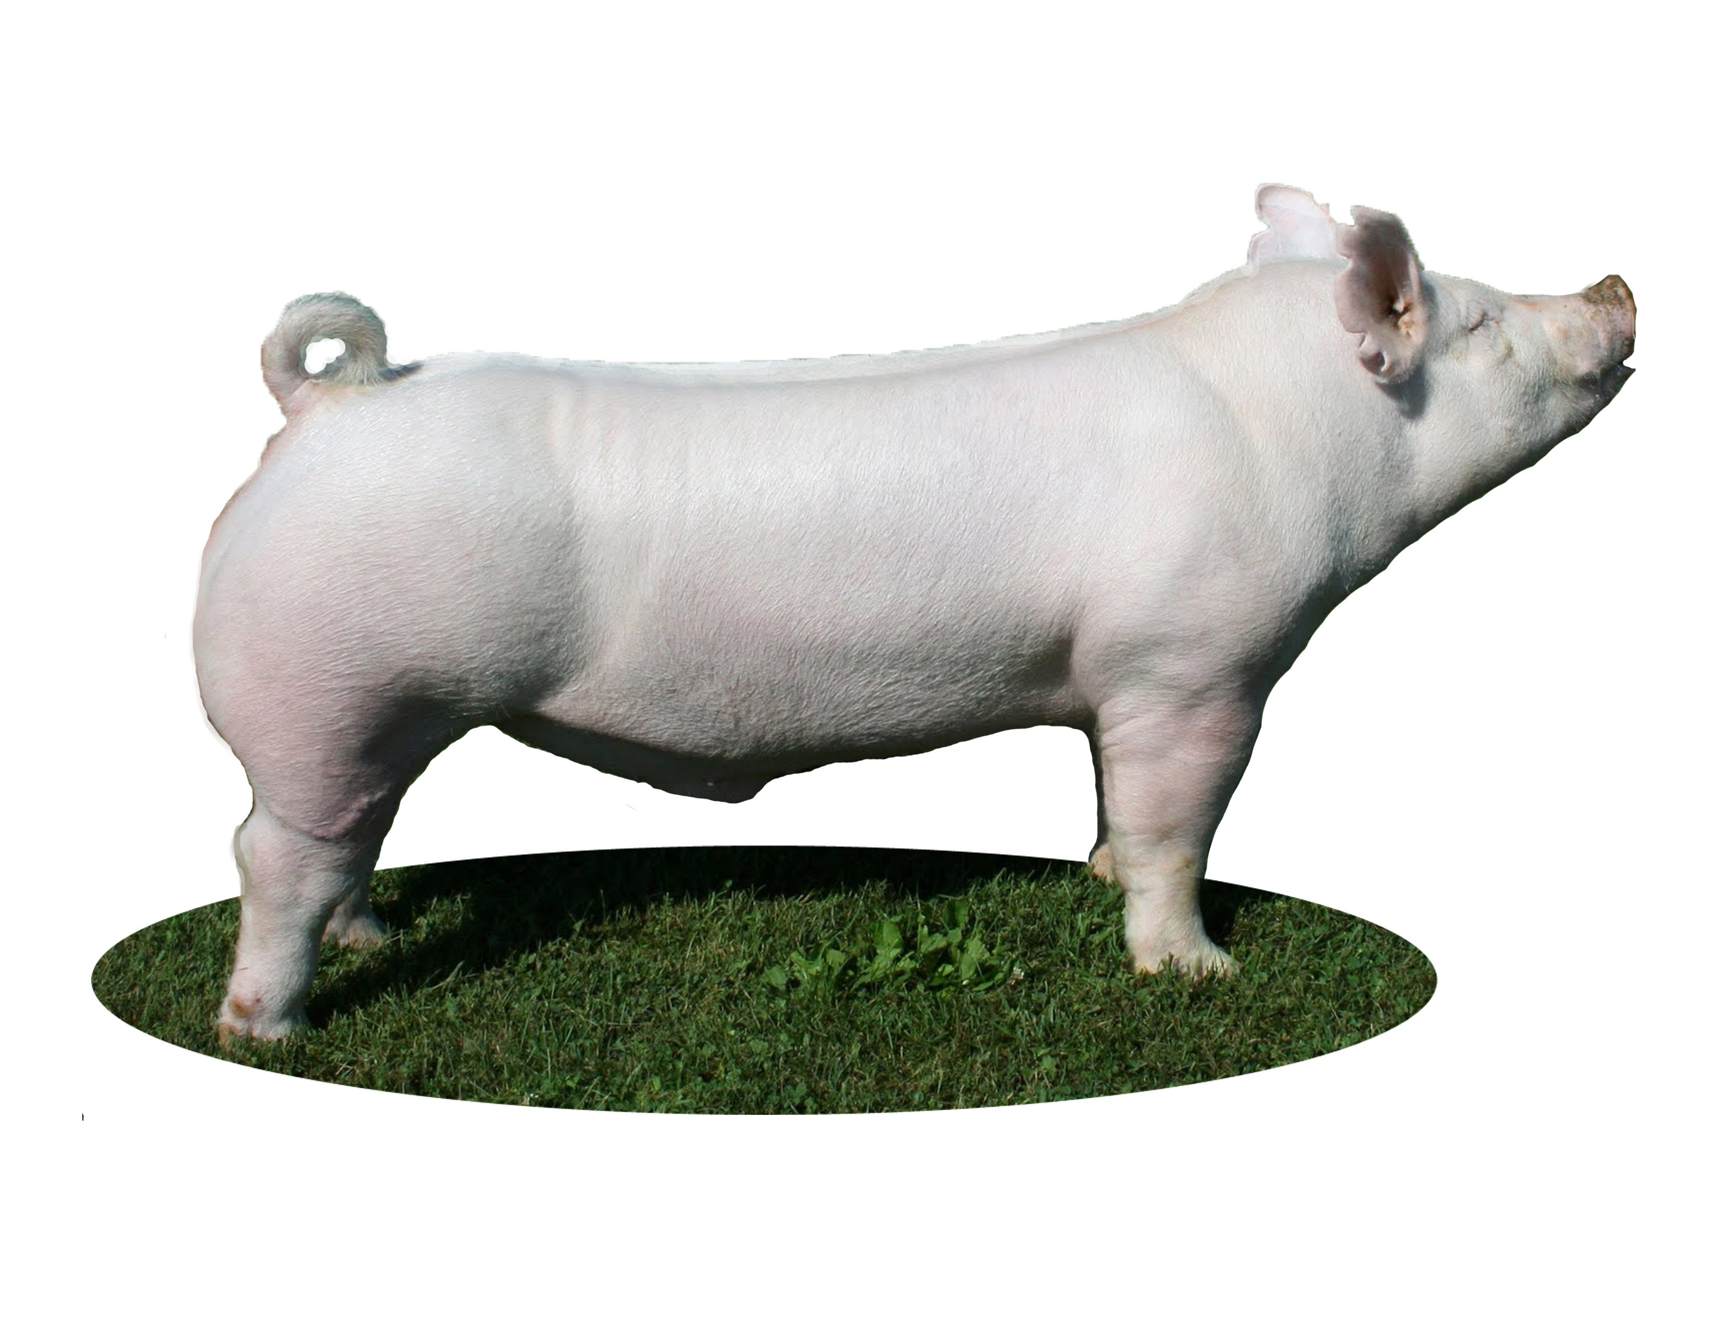
Judge a Class
Judge classes of livestock
Market Hogs
Long
Shape & Definition to Muscle
Structural Correctness

Slide 35
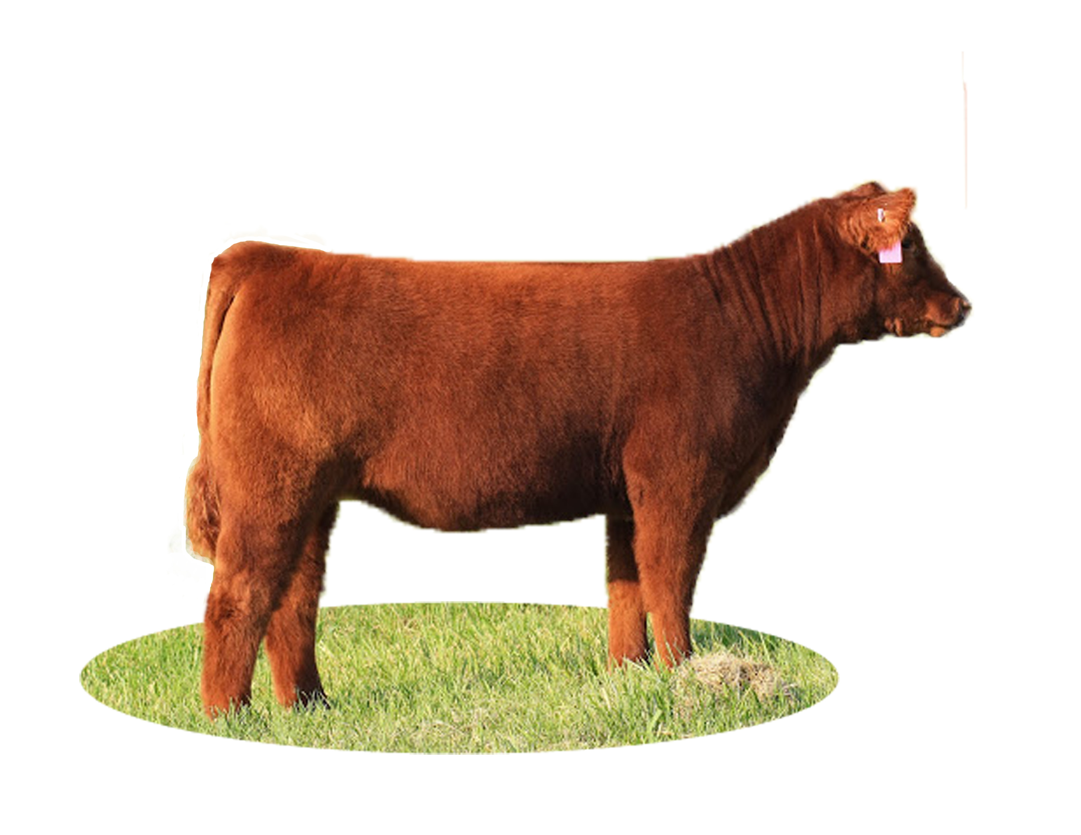
Judge a Class
Judge classes of livestock
Market Steers
Size and width (muscling)
Strong & level topline
Square on feet and legs

Slide 36
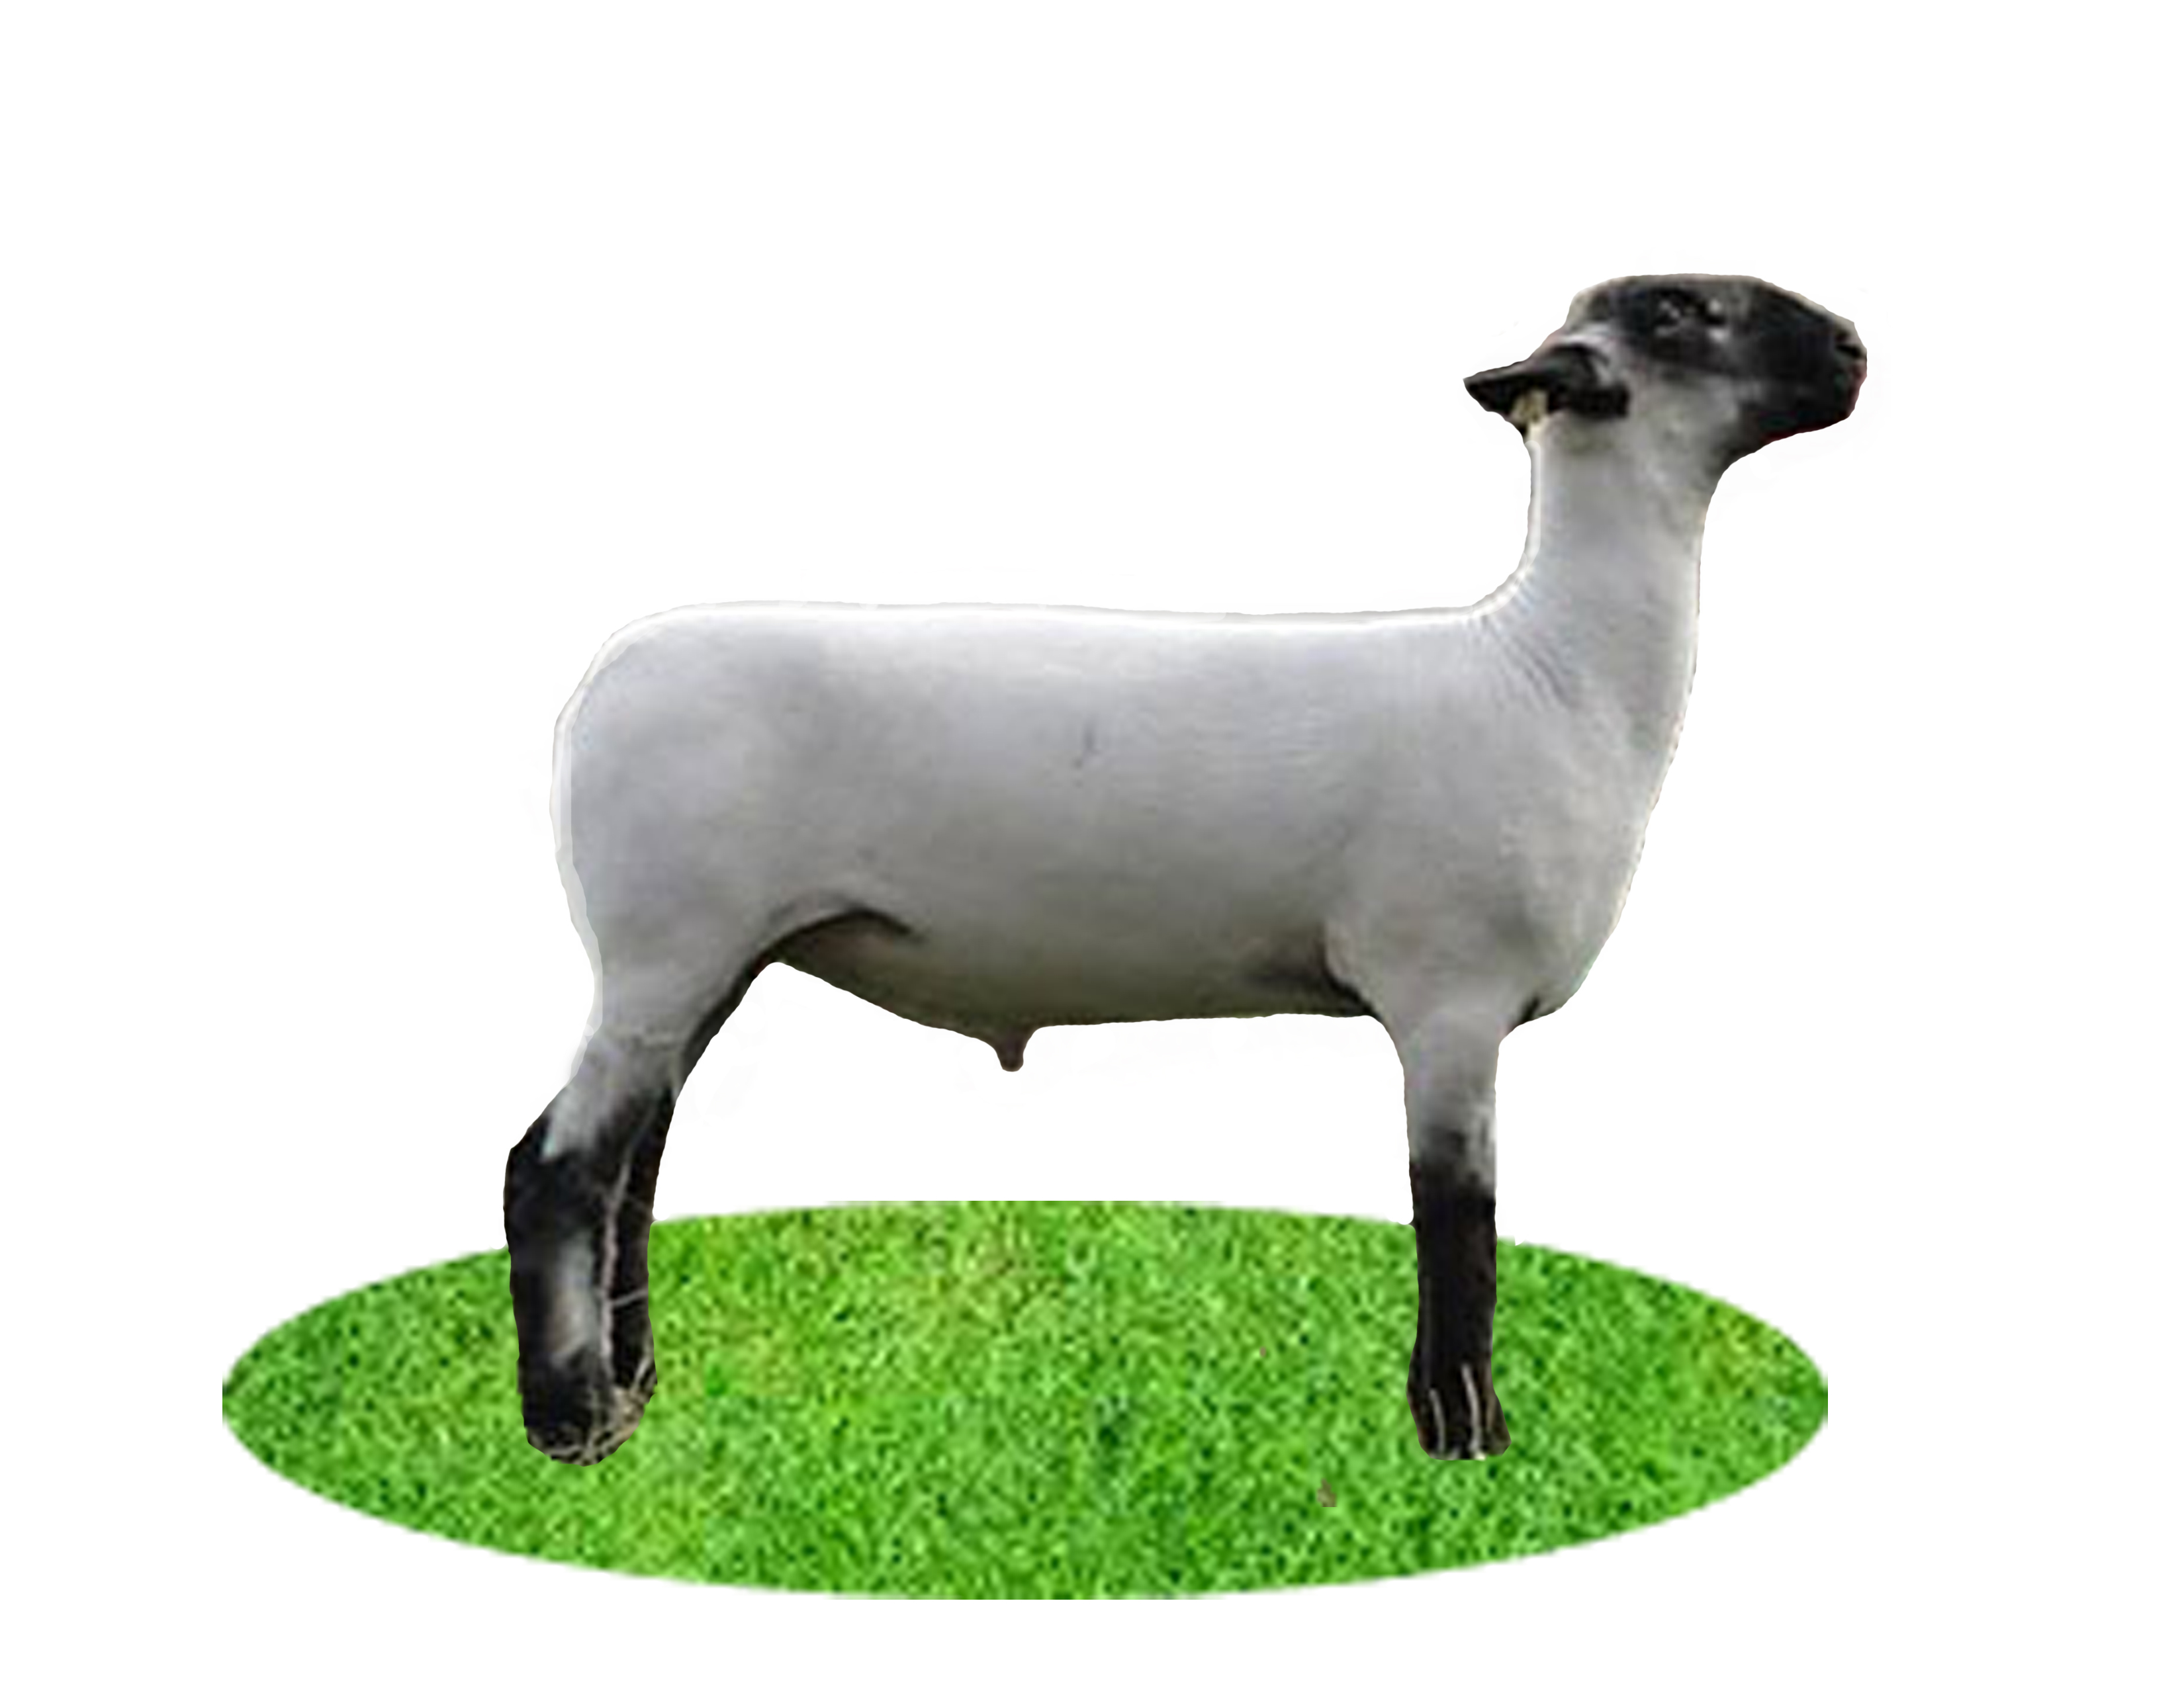
Judge a Class
Judge classes of livestock
Market Sheep
Length of Loin
Size & Shape of leg
Width of shoulder and breast

Slide 37
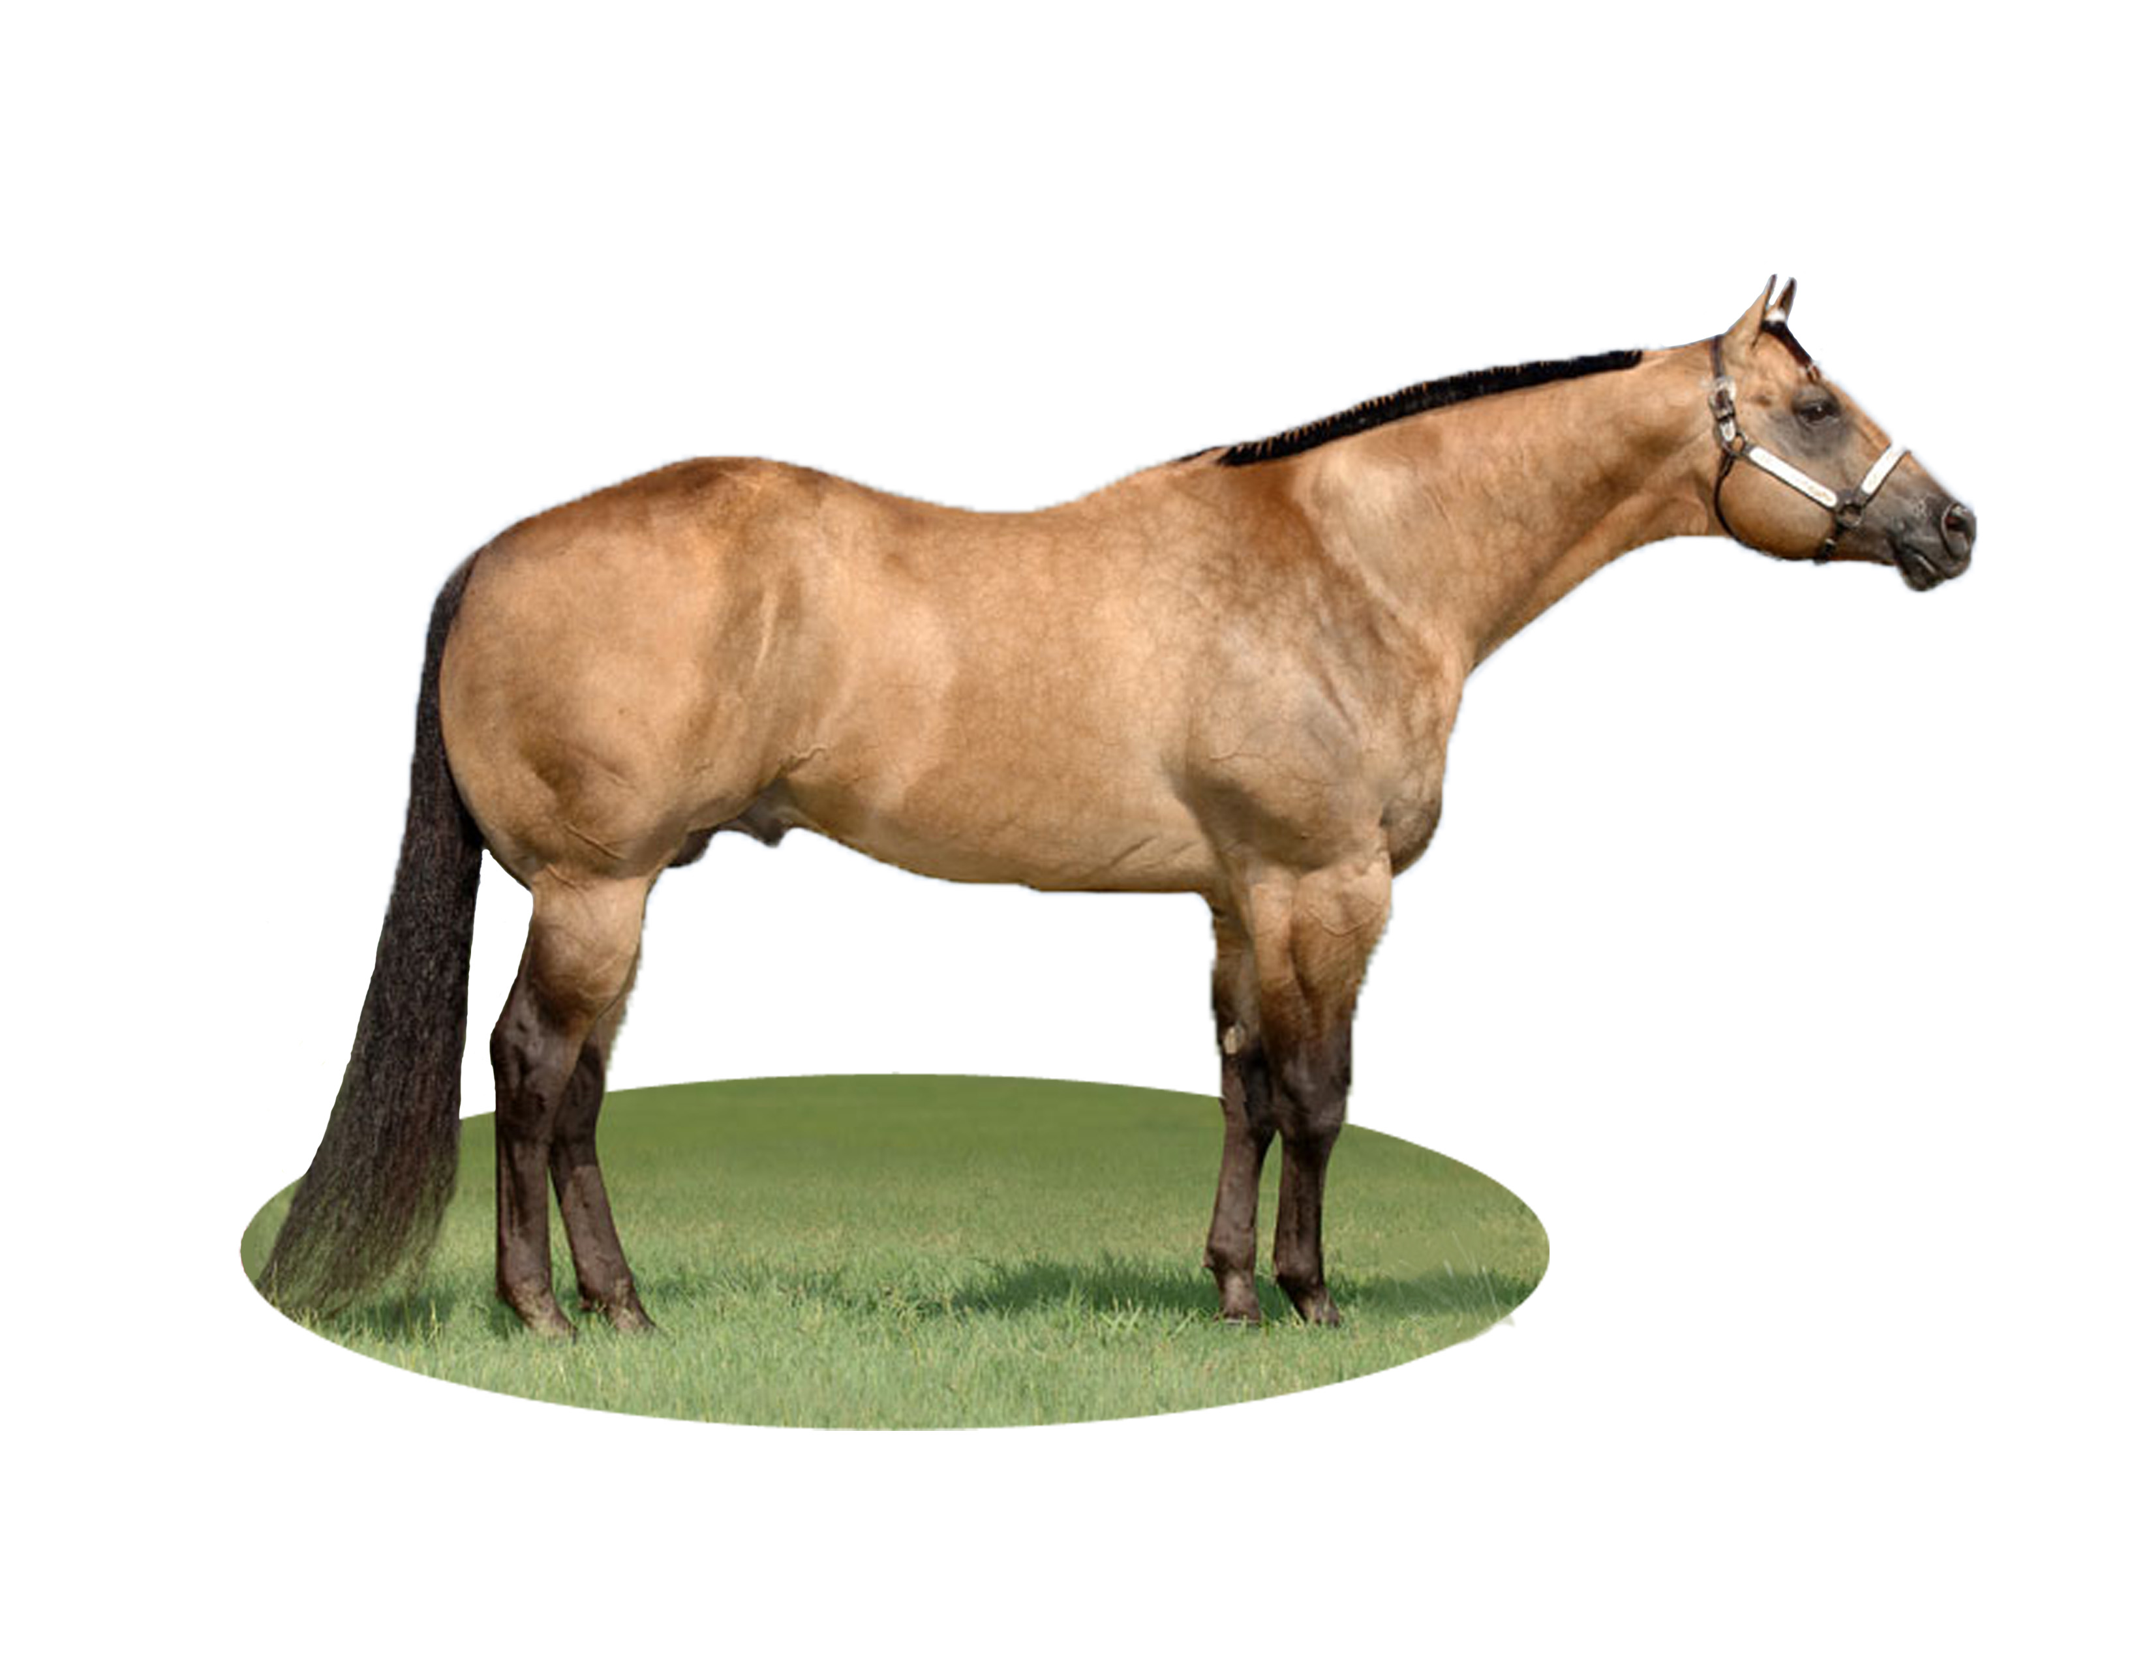
Judge a Class
Judge classes of livestock
Horses
Balance
Muscling
Structural Correctness

Slide 38
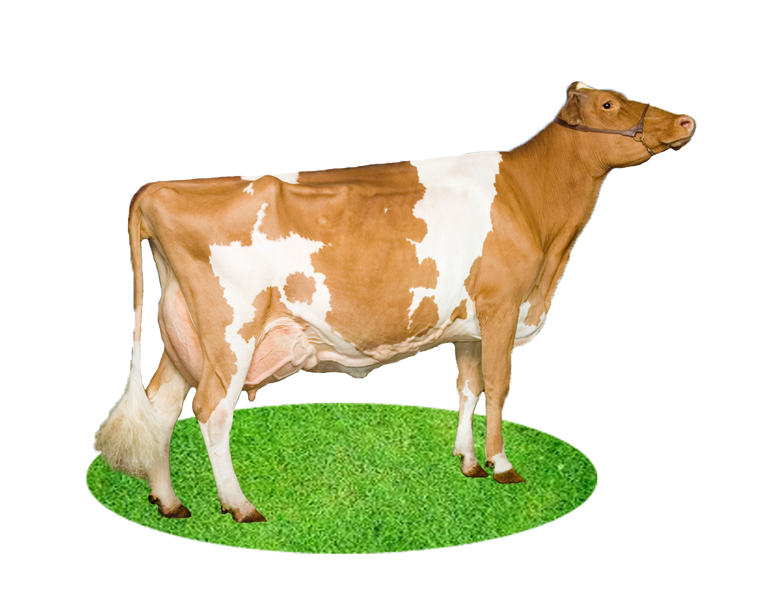
Judge a Class
Judge classes of livestock
Dairy Cattle
Size (Height, Depth, Width)
Dairyness & Femininity
Mammary Structure

Slide 39
Oral Reasons
Present oral reasons
An explanation of why you ranked the class as you did
Provide backup for your judgment
2 min or less

Slide 40
Oral Reasons
Present oral reasons
“# 4 wins this class because… | (another good thing about 1st place) | “ # 3 places second. I recognize that it (something good about 2nd that was better than 1st)
Good thing about 2nd place | (Another good thing about 2rd place) | “# 1...places 3rd. I realize it… (something about 3rd place that was better than 2nd)
Good thing about 3rd place | Good thing about 3rd place | “# 2 places last in the class today… (something about last place that was better than 3rd)
 |  | “# 2placed last because…”
“…along with tomatoes, pickles, lettuce, and ketchup.”
…it resembles the ideal hamburger the closest. Although it doesn‘t have onions, it is the only hamburger that has a sesame seed bun…”
…has onions, it lacks the overall completeness found in hamburger #4.”
“#3 is a good looking hamburger and displays the “bigger than the bun” characteristic… ”
…and has all of the desired condiments except the sesame seed bun and lettuce.
“…has a unique look., but just doesn’t have the overall quality of the top two hamburgers”
“…it places 3rd in the class. It has a quality patty…
“..along with cheese and ketchup,
“Granted, this would be quite tasty to a child with a simple palette, it the least quality hamburger”
“…it simply does not posses the overall quality and completeness of this class of hamburgers today.
Therefore I place this class of hamburgers,
4 – 3 – 1 – 2 “
1st | 2nd | 3rd | 4th

Slide 41
Bell Quiz
Objective A & B
Give an example of 1 good pre purchase question
Describe what a replacement heifer is in a cow/calf operation and how they are chosen
What is the definition of “sound” when used to describe animals?
How does the muscular and skeletal system effect an animal’s structure?
Draw a picture of an animal with pigeon toes

Slide 42
Bell Quiz
Objective C, D, & E
What is the bony anatomical part between an animal’s ears?
How many points are possible in a typical judging class?
What is the difference between a “feeder” class and a “market” class?
Describe an ideal market hog.
What is the purpose of oral reasons?

Slide 43
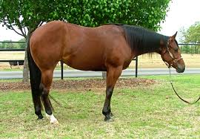
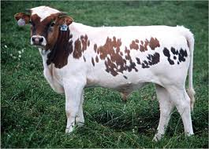
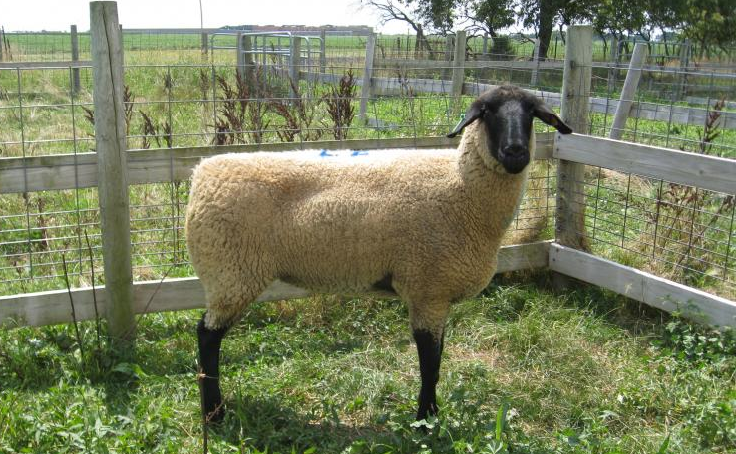
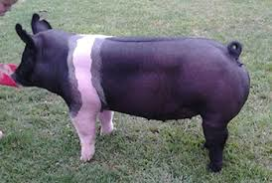
1st
3rd
2nd
Introduction to Livestock Judging

