Slide 1
Meats
Identify the differences between beef, pork, and lamb cuts;
Diagram and identify the wholesale cuts of beef, pork, and lamb;
List retail meat cuts and identify the wholesale cut that it came from;
Explain the yield and quality grades of meat;
List signs and causes of meat spoilage; and
Judge a class of meat cuts.

Slide 2
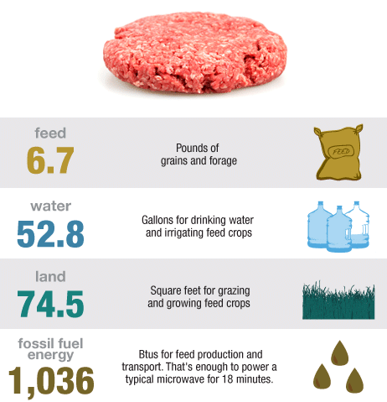
What does it take to produce a ¼ Pounder?
Notes:
Source: http://www.npr.org/blogs/thesalt/2012/06/27/155527365/visualizing-a-nation-of-meat-eaters

Slide 3
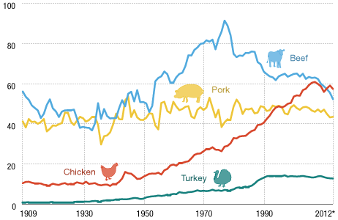
Average U.S. Meat Consumption Per Person in Pounds
Notes:
Source: http://www.npr.org/blogs/thesalt/2012/06/27/155527365/visualizing-a-nation-of-meat-eaters

Slide 4
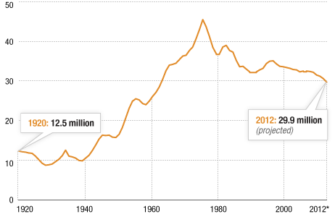
Cattle Inventory in Millions
Notes:
Source: http://www.npr.org/blogs/thesalt/2012/06/27/155527365/visualizing-a-nation-of-meat-eaters

Slide 5
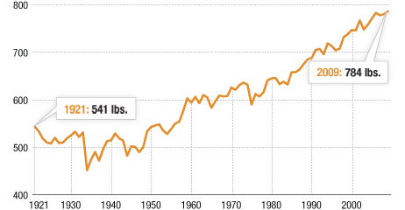
Average dressed weight (meat) of cattle in Pounds
Notes:
Source: http://www.npr.org/blogs/thesalt/2012/06/27/155527365/visualizing-a-nation-of-meat-eaters

Slide 6
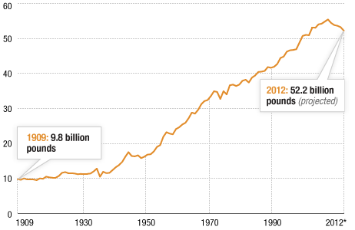
U.S. Meat Consumption
Notes:
Source: http://www.npr.org/blogs/thesalt/2012/06/27/155527365/visualizing-a-nation-of-meat-eaters

Slide 7
World Wide Meat Consumption
Notes:
Source: http://www.npr.org/blogs/thesalt/2012/06/27/155527365/visualizing-a-nation-of-meat-eaters

Slide 8
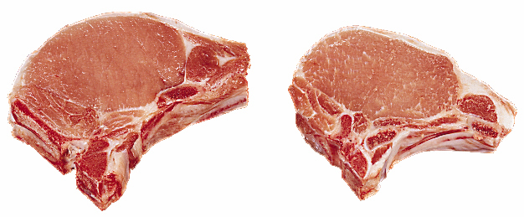
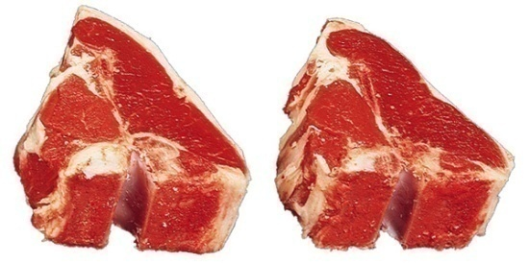
A. Identify the differences between beef, pork, and lamb cuts
Identifying Species
Beef: Cherry Red color, white fat, larger size
Pork: Pale pink color and white fat
Lamb: Darker red color, white fat, small size

Slide 9
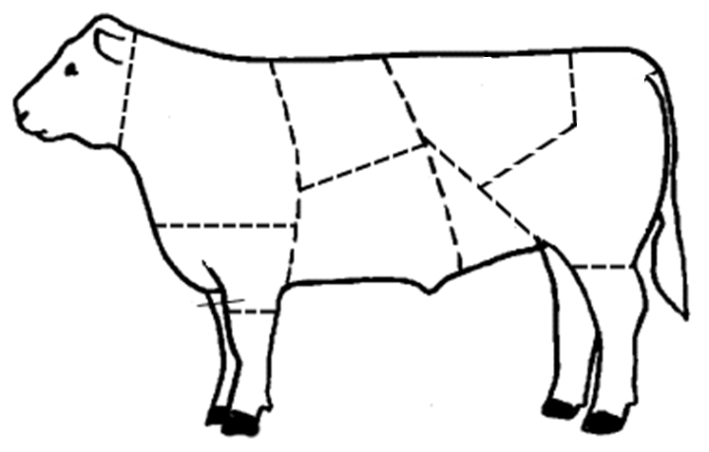
B. Diagram and identify the wholesale cuts of beef, pork, and lamb
Wholesale Cuts
Loin
Rib
Chuck
Round
BEEF
Plate
Flank
Brisket
Shank

Slide 10
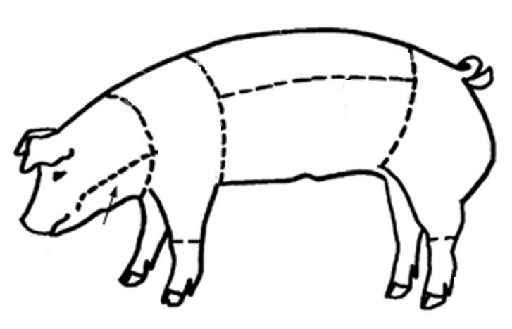
B. Diagram and identify the wholesale cuts of beef, pork, and lamb
Wholesale Cuts
Loin
Side
Pork
Shoulder
Ham
Jowel

Slide 11
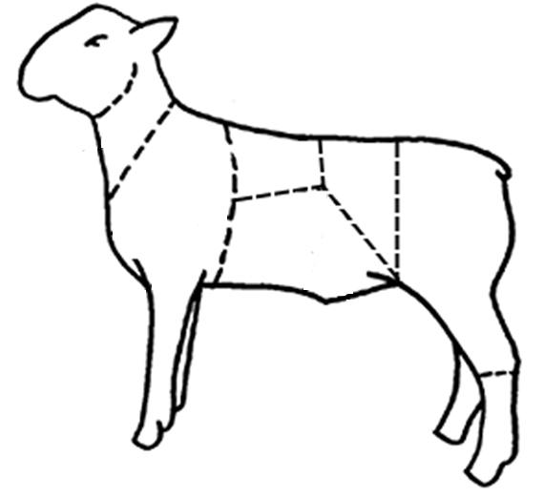
B. Diagram and identify the wholesale cuts of beef, pork, and lamb
Wholesale Cuts
Rib
Loin
Shoulder
Lamb
Leg
Breast

Slide 12
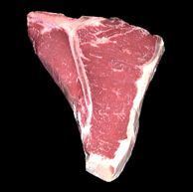
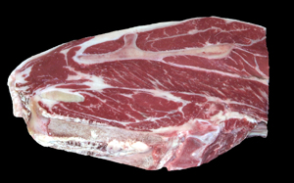
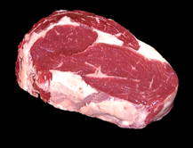
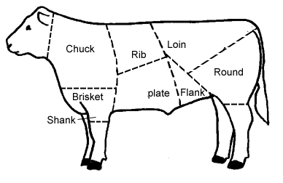
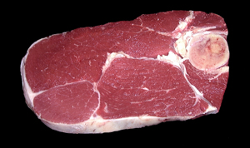
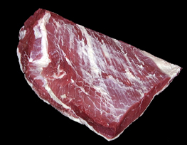
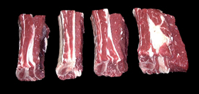
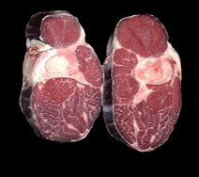
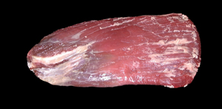
C. List retail meat cuts and identify the wholesale cut that it came from
Retail Cuts
Eye Steak
T Bone Steak
7 Bone Steak/Roast
Brisket
Round Steak/Roast
Short Ribs
Cross Cuts
Flank Steak

Slide 13
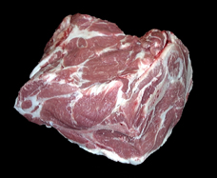
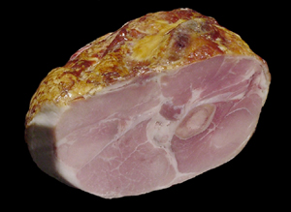
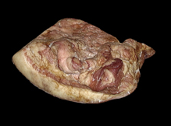
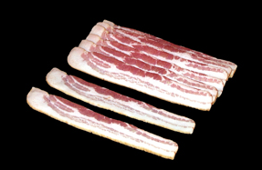
C. List retail meat cuts and identify the wholesale cut that it came from
Retail Cuts
Loin Chop
Boston Blade
Loin
Side
Ham
Ham
Shoulder
Bacon
Jowel

Slide 14
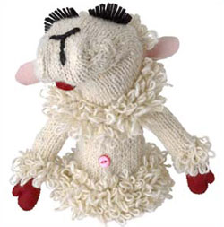
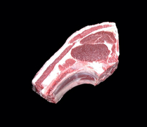
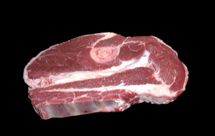
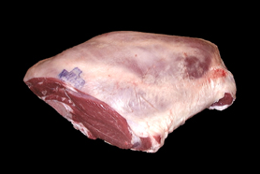
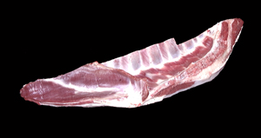
C. List retail meat cuts and identify the wholesale cut that it came from
Retail Cuts
Rib Chop
Loin Chop
Arm Chop
Rib
Loin
Shoulder
Leg
Breast
American Style Roast
Breast

Slide 15
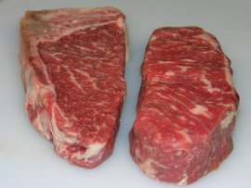
D. Explain the yield and quality grades of meat
Quality Grade
Quality Grade: based on two factors:
1- Maturity of the carcass
- determined by observing bone and cartilage.
2- Amount of Marbling
“Marbling”- intramuscular fat or flecks of fat in the lean muscle that gives it taste

Slide 16
How Age is Determined
D. Explain the yield and quality grades of meat
Quality Grade
Young carcasses have cartilage “buttons”
Shiny, white cartilage
Old carcasses have bones that are completely ossified

Slide 17
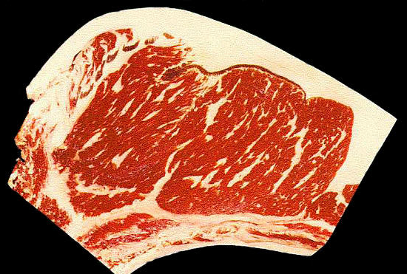
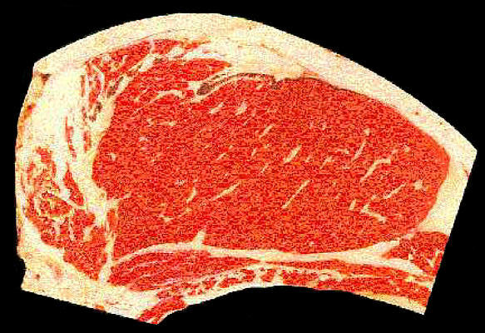
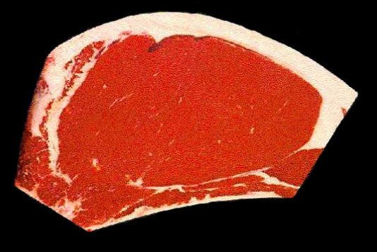
Example Marbling Grades
D. Explain the yield and quality grades of meat
Quality Grade
PRIME
CHOICE
SELECT
Most Marbeling………….. Least

Slide 18
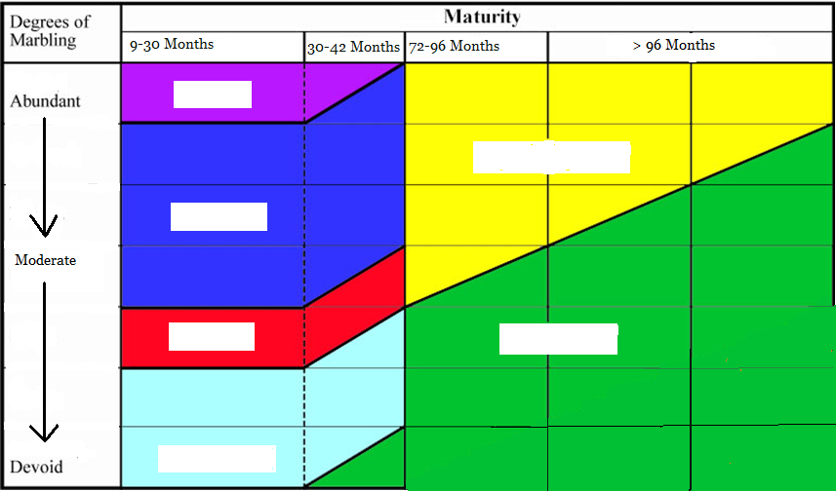
Seven Quality Grades:
D. Explain the yield and quality grades of meat
Quality Grade
Prime
Commercial
Choice
Select
Utility
Standard
1-Prime 4-Standard
2-Choice 5-Commercial
3-Select 6-Utility

Slide 19
D. Explain the yield and quality grades of meat
Yield Grade
measure of the boneless, closely trimmed retail cut
also known as “cutability”
a scale of 1 to 5 is used to judge Yield
- 1 is the highest, 5 is the lowest

Slide 20
E. List signs and causes of meat spoilage
Meat Spoilage
Meat is considered “spoiled” when it is unfit for human consumption.
The major causes of spoiling are:
Microorganisms
Bacteria
Yeast
Mold

Slide 21
E. List signs and causes of meat spoilage
Meat Spoilage
Signs of Spoilage:
Odor
Slime
Mold Growth
Discoloration

Slide 22
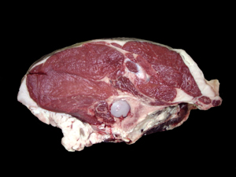
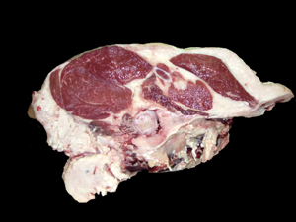
F. Judge a class of meat cuts
Meat Judging
Observe and Rank According to:
1. Lean Meat
Highest amount of lean meat
vs

Slide 23
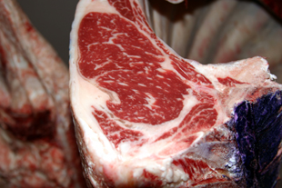
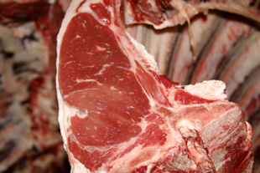
F. Judge a class of meat cuts
Meat Judging
Observe and Rank According to:
Fat
Least amount of exterior fat
Highest content of intramuscular fat or “Marbling”
vs

Slide 24
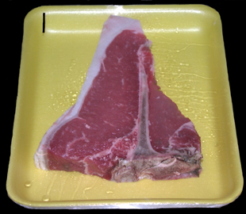
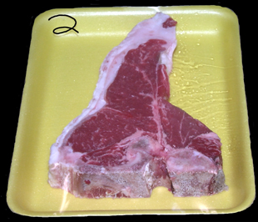
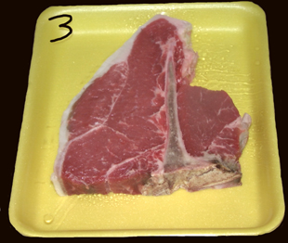
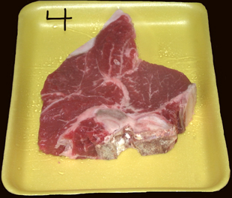
F. Judge a class of meat cuts
Meat Judging

Slide 25
I place this class: \ ______ - ______ - ______ - _____
4
3
1
2
Reasons:
1st Place
I place #4 at the top of the class because: It has the most meat and marbling, with the least amount of fat
2nd Place
#3 places 2nd because: It has a good amount of meat, but slightly less marbling and more fat than #4.
3rd Place
#1 places 3rd because: It has less meat and much less marbling than #3 and #4.
4th Place
#2 places last because: It has the least amount of meat and the most fat.
Official Cuts: 3 - 6 - 3

Slide 26
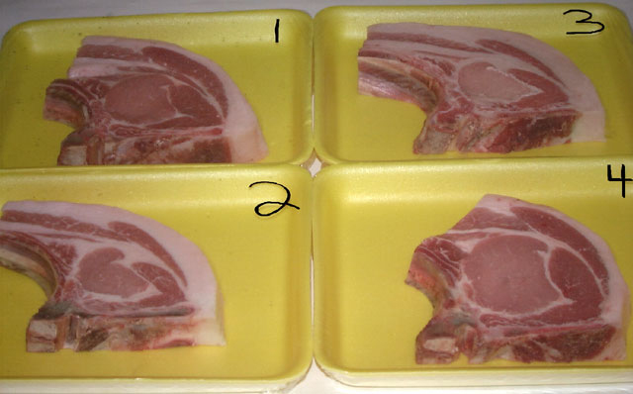
F. Judge a class of meat cuts
Meat Judging
Official Placing 4 – 1 – 3 – 2
Official Cuts 4 – 6 – 3

Slide 27
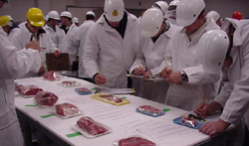
FFA Application: Meat Evaluation and Technology
Meat Cut ID
Written Test
Quality and Yield Grading
Carcass placing
Team Activity

Slide 28
Bell Quiz Objective A, B, C
What are the primary differences between beef, pork, and lamb?
What is the difference between a wholesale and retail cut of meat?
Name a retail cut from a beef round.
Name a retail cut from the pork side.
What is the difference between fresh pork and smoked pork? Give examples of each.

Slide 29
Bell Quiz Objective D, E, F
What 2 factors determine a beef quality grade?
How can age be determined by looking at a beef carcass?
What is another word for yield grade?
List 2 signs of meat spoilage
What 2 factors are considered when judging a class of meat?

