Slide 1
Animal Diseases & Parasites
Categorize diseases by their cause
List common diseases found in animals
Identify common animal parasites and their symptoms
Perform an animal health check
Identify & describe zoonotic diseases

Slide 2
Types of Disease
Categorize diseases by their cause
Disease diˈzēz (noun)
A disorder of structure or function that produces signs and symptoms

Slide 3
Types of Disease
Categorize diseases by their cause
Physiological
Organs or glands don’t function properly
Diabetes: Pancreas doesn’t produce insulin to regulate blood sugar
Hyper/Hypothyroidism: Thyroid doesn’t produce thyroxin to regulate metabolism

Slide 4
Types of Disease
Categorize diseases by their cause
Nutritional
Caused by inadequate nutrition
Ricketts: Insufficient iron in diet causes bones to weaken
Milk Fever: Caused when a lactating animal becomes deficient in calcium

Slide 5
Types of Disease
Categorize diseases by their cause
Morphological
Physical defect caused by an accident or neglect
Cuts
Bruises
Scratches
Broken Bones

Slide 6
Types of Disease
Categorize diseases by their cause
Pathogenic
Caused by a virus, bacteria, protozoa, or fungus
Parvovirus: Virus mostly effecting puppies that is transmitted through vomit & diarrhea of other sick puppies
Rabies: Virus transmitted through bite wounds

Slide 7
Types of Disease
Categorize diseases by their cause
Parasitic
Caused by parasites (internal or external)
Heartworm Disease: Mosquitos transmit worms from animal to animal that grow and multiply in the bloodstream and will eventually cause heart failure.
West Nile Virus: Disease affecting birds, horses, and humans. Spread by mosquito bites

Slide 8
Types of Disease
Categorize diseases by their cause
Congenital
Acquired through genetic inheritance
Hip Dysplasia: Commonly seen in large breed dogs. Condition is genetic and causes the hip sockets to be too loose and to degenerate quickly causing pain and lameness.

Slide 9
Common Diseases
B. List common diseases found in animals
How many animal diseases can you name?

Slide 10
Parasites
C. Identify common animal parasites and their symptoms
Parasite:
Any organism that lives on/in another organism
Causes the host harm
Parasites will die without a host

Slide 11
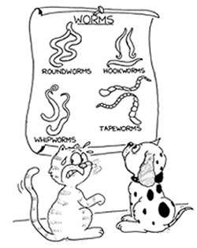
Parasites
C. Identify common animal parasites and their symptoms
Internal Parasite:
Live INSIDE it’s host

Slide 12
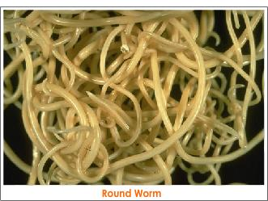
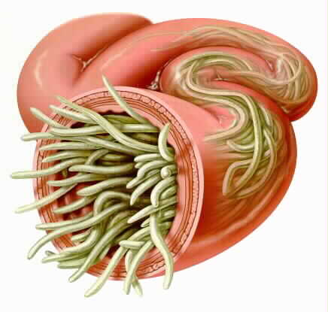
Parasites
C. Identify common animal parasites and their symptoms
Internal Parasite: Roundworm
Looks like spaghetti
Found in intestines

Slide 13
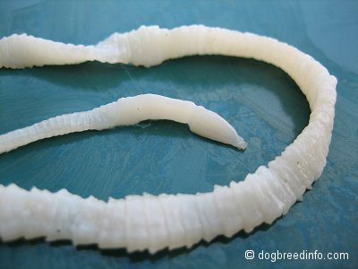
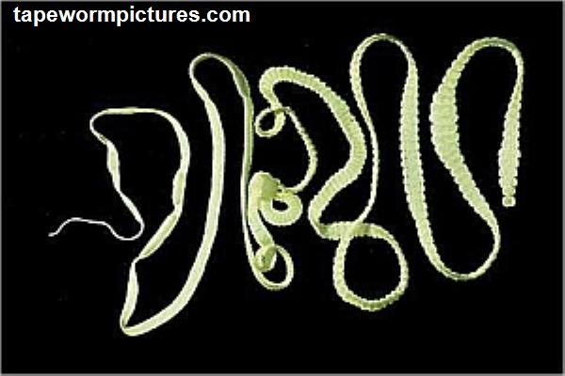
Parasites
C. Identify common animal parasites and their symptoms
Internal Parasite: Tape Worm
Long and flat in intestines
Break off in sections which look like rice in the stool

Slide 14
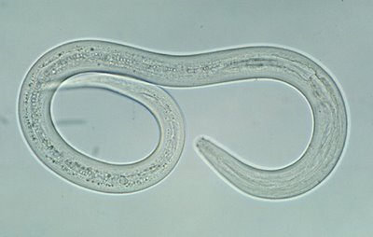
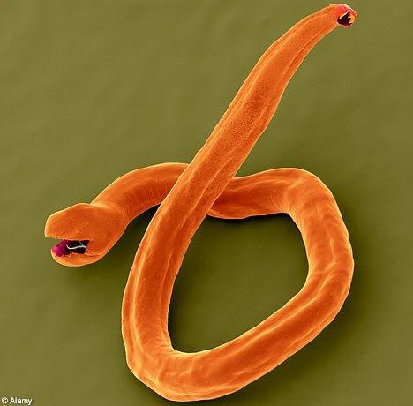
Parasites
C. Identify common animal parasites and their symptoms
Internal Parasite: Hook Worm
Small, hook shape
Attaches to walls of intestine

Slide 15
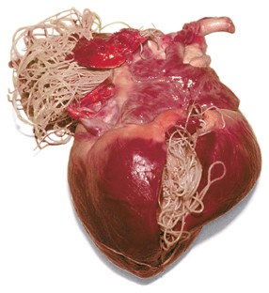
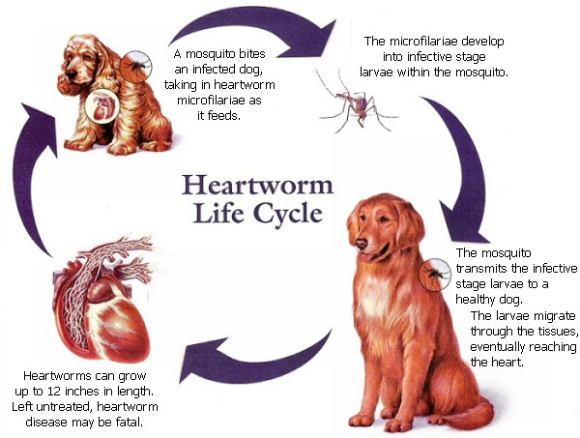
Parasites
C. Identify common animal parasites and their symptoms
Internal Parasite: Heartworm
Found in circulatory system
Eventually blocks heart valves

Slide 16
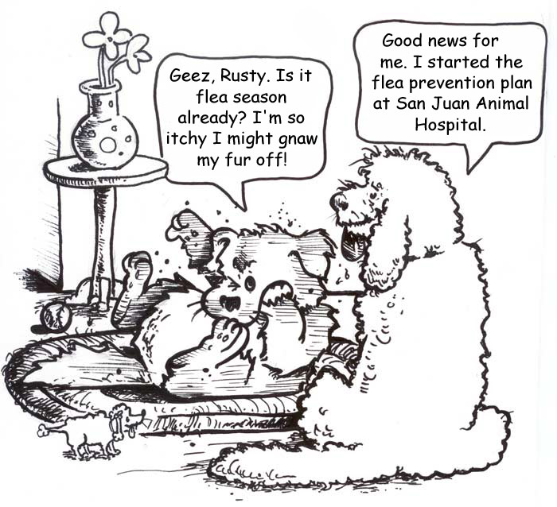
Parasites
C. Identify common animal parasites and their symptoms
External Parasite:
Lives OUTSIDE it’s host

Slide 17
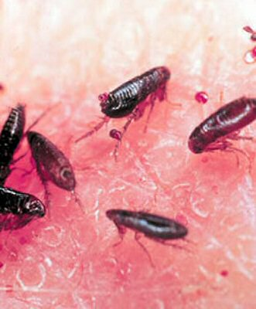
Parasites
C. Identify common animal parasites and their symptoms
External Parasite: Flea
Causes extreme Itching
Not found in Utah!
(They don’t survive the winters here)
Can infect houses, live in couches, etc

Slide 18
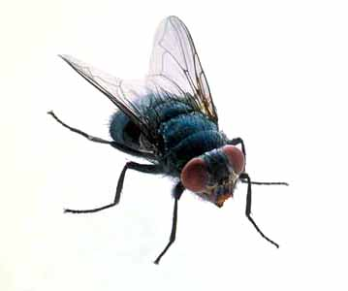
Parasites
C. Identify common animal parasites and their symptoms
External Parasite: Flies
Problem in the late summer & early fall
Flies are attracted to animals
Flies are annoying, but biggest problem is that they transmit disease

Slide 19
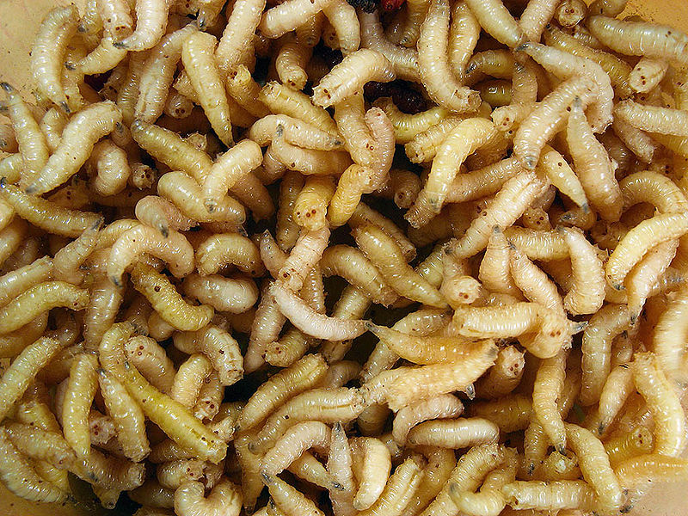
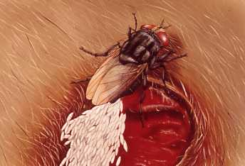
Parasites
C. Identify common animal parasites and their symptoms
External Parasite: Maggots
Fly larvae (eggs)
This parasite begins as external and then becomes internal

Slide 20
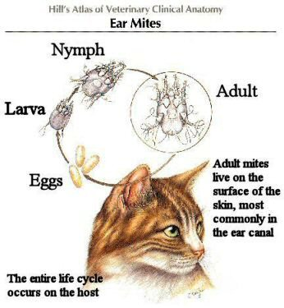
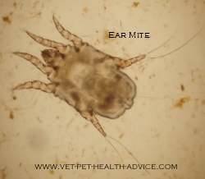
Parasites
C. Identify common animal parasites and their symptoms
External Parasite: Mites
Live on surface of skin
Attracted to warm, moist places such as the ear

Slide 21
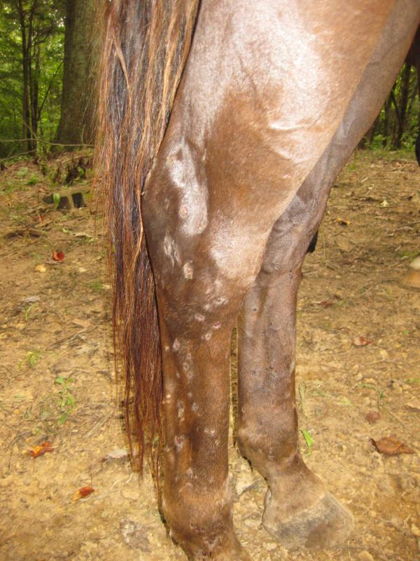
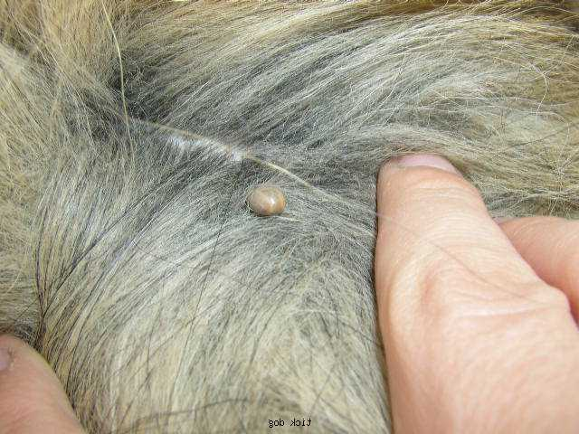
Parasites
C. Identify common animal parasites and their symptoms
External Parasite: Ticks
Attach themselves to body and suck blood
Can transmit Lyme Disease

Slide 22
Parasites
C. Identify common animal parasites and their symptoms
How are Parasites Transmitted?
Ingesting infected feces
From mother to fetus
Mosquitos (heartworm)
Eating flesh of infected animal
Ie: Cat eating mouse

Slide 23
Parasites
C. Identify common animal parasites and their symptoms
How are Parasites Transmitted?

Slide 24
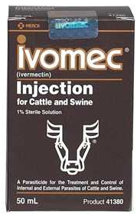
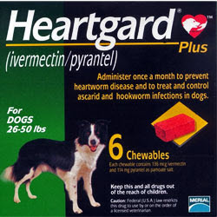
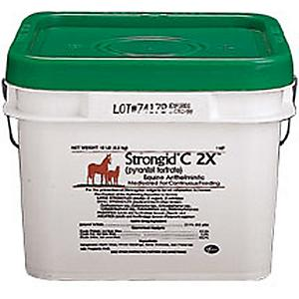
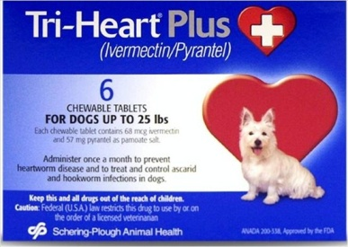
Parasites
C. Identify common animal parasites and their symptoms
Preventing Parasites
Internal:
Pills
Pastes
Crumbles
Injections

Slide 25
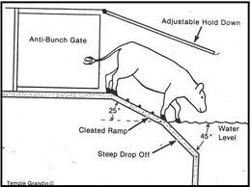
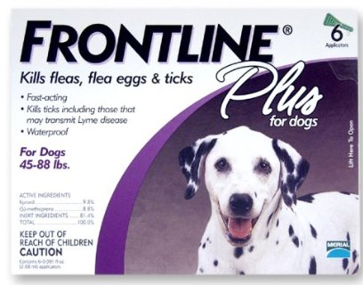
Parasites
C. Identify common animal parasites and their symptoms
Preventing Parasites
External:
Topical Medications
Anti parasitic dips
Sprays & Powders

Slide 26
Parasites
C. Identify common animal parasites and their symptoms
External = Stand Internal = Sit

Slide 27
Parasites
C. Identify common animal parasites and their symptoms
Name that Parasite

Slide 28
Health Checks
D. Perform an animal health check
Healthy Animals:
Bright Eyes
Socialize with other animals and people as usual
Shiny Coat
Healthy Weight
Normal body functions (urination, defecation, etc)

Slide 29
Health Checks
D. Perform an animal health check
Sick Animals:
Weight loss
Reduced Performance
Vomiting
Diarrhea
Dull eyes/drooped ears
Dull coat
High Temperature

Slide 30
Can you figure it out??
E. Identify & describe zoonotic diseases
Colorado State's department of public health was alerted to an unusual cluster of diarrheal illness in Denver. Thus far, 26 cases have been associated with this outbreak. All of the cases submitted fecal samples and cultured positive for the pathogen Salmonella Serotype Infantis. 83% of these cases are children.

Slide 31
Can you figure it out??
E. Identify & describe zoonotic diseases
Clue….
They all visited 1 place

Slide 32
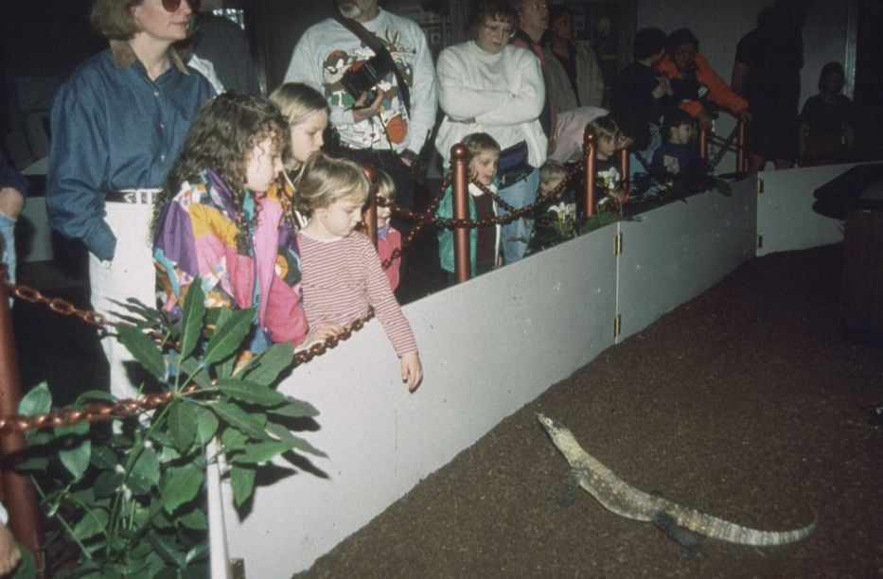
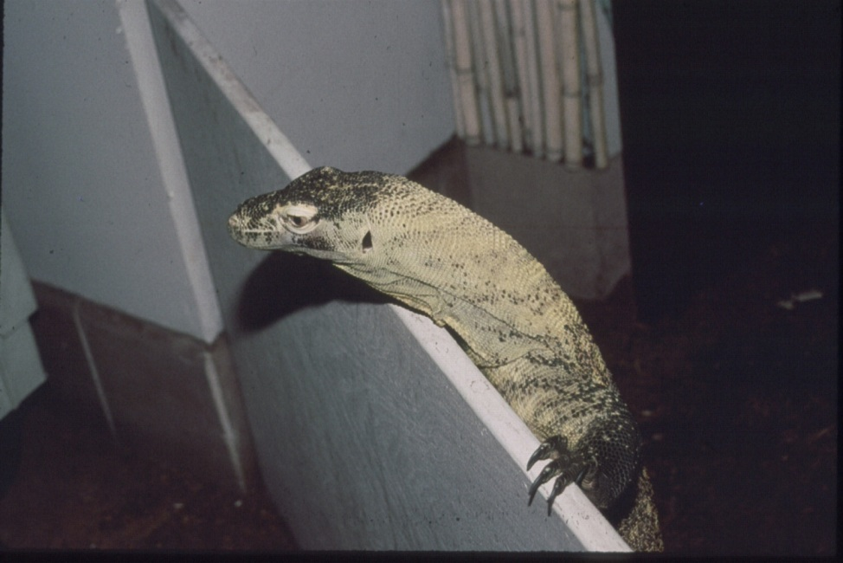
Can you figure it out??
E. Identify & describe zoonotic diseases
Clue….
And saw the same Komodo Dragon

Slide 33
Can you figure it out??
E. Identify & describe zoonotic diseases
Answer….
Many of the children visiting the exhibit placed their hands upon the wooden barrier. You can see the Komodo Dragon also placing its claws upon the same barrier. When the investigators tested the wooden barrier, they cultured Salmonella Serotype Infantis. Additionally, they also found that persons were significantly less likely to become ill if they washed their hands after visiting the exhibit.
This outbreak demonstrated the following three things: 1) people can acquire salmonellosis from reptiles, 2) salmonellosis from animals can be transmitted indirectly, and 3) washing hands is protective against illness.

Slide 34
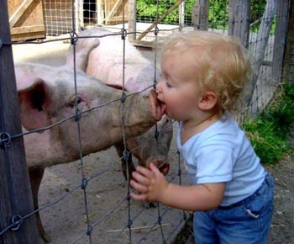
Zoonotic Disease
E. Identify & describe zoonotic diseases
Zoonotic Disease=
An infectious disease that is transmitted from one species to another
-Example: From animal to human

Slide 35
Zoonotic Disease
E. Identify & describe zoonotic diseases
Preventing Zoonotic Disease=
Wash your hands!
Keep animals healthy and dewormed regularly

Slide 36
Bell Quiz Objectives A & B
What are 3 causes of disease? (There are 6 total)
What type of disease is diabetes where the body does not produce adequate insulin?
Give an example of a disease caused by nutritional deficiency.
Give an example of a parasitic disease
Describe a pathogenic disease

Slide 37
Bell Quiz Objectives C, D, & E
What are the 2 types or classifications of parasites?
List 3 internal parasites
What are 5 common signs that an animal is healthy?
What is a zoonosis?
What is the first and best line of defense against zoonotic diseases?

