Slide 1
Why is understanding animal nutrition important?
Divide into 8 groups. Each group needs 1 sheet of paper
You have 10 minutes to work with your group to answer the 2 questions on your paper.
When you are done, write your answers on the board

Slide 2
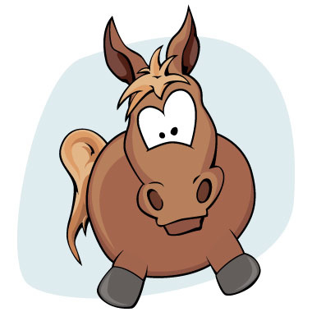
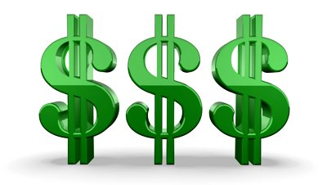
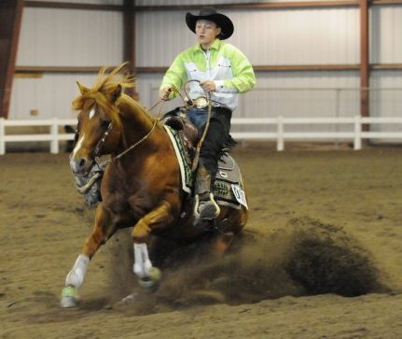
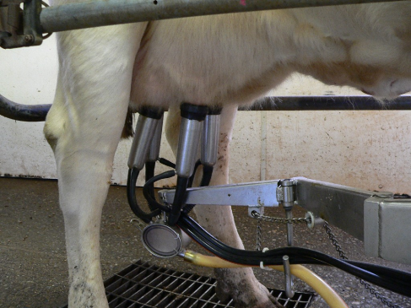
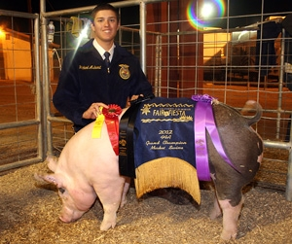
Why is understanding animal nutrition important?
Animal Feed is Expensive!
Improper diet can lead to death or unsoundness
Feeding will make or break an animal’s performance

Slide 3
Animal Nutrition & Feeding
List essential nutrients & their function
Identify factors effecting nutrition requirements in animals
Classify feed types and identify animal feeds
Compare & contrast common feeds according to species, age, and energy requirements
Interpret a feed label
Balance a ration

Slide 4
A. List essential nutrients & their function
The Six Essential Nutrients
Protein
Carbohydrates
Fats
Minerals
Vitamins
Water

Slide 5
A. List essential nutrients & their function
The Six Essential Nutrients
Protein
Needed for growth and repair
Helps form MUSCLES, internal organs, skin, hair, wool, feathers, hoofs and horns

Slide 6
A. List essential nutrients & their function
The Six Essential Nutrients
Carbohydrates
ENERGY
The largest portion of the food supply
Includes sugars, starch, and cellulose

Slide 7
A. List essential nutrients & their function
The Six Essential Nutrients
Fats
STORED Energy
Insulation & Protection

Slide 8
A. List essential nutrients & their function
The Six Essential Nutrients
Vitamins
Organic substance
CAN be broken down
Needed in small quantities
Examples: Vitamin A, B, C, D, E, Folic Acid, etc

Slide 9
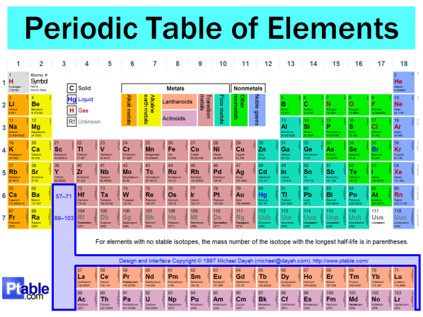
A. List essential nutrients & their function
The Six Essential Nutrients
Minerals
Naturally occurring
Inorganic substance
Can’t be broken down further
Needed in small quantities
Necessary for:
Building bones
Growth
Overall Health
Examples: Calcium, Magnesium, Iron, Manganese, Phosphorus, Potassium, etc

Slide 10
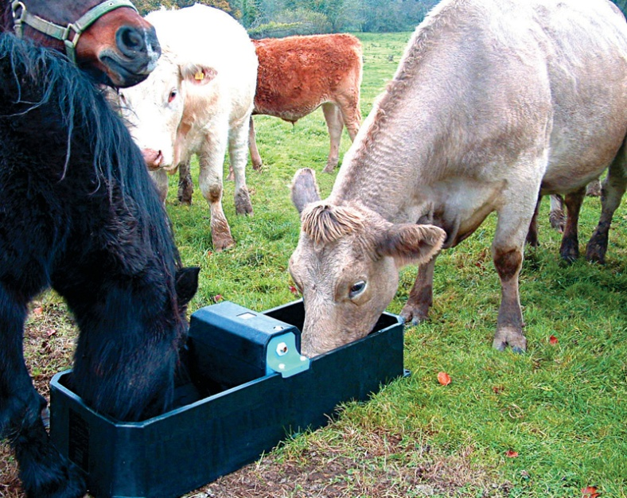
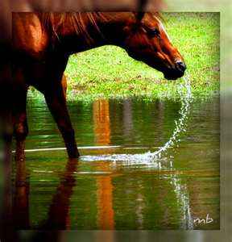
A. List essential nutrients & their function
The Six Essential Nutrients
Water
Animal’s body is made up of 70% water
Necessary for proper organ function
Vital to sustaining life

Slide 11
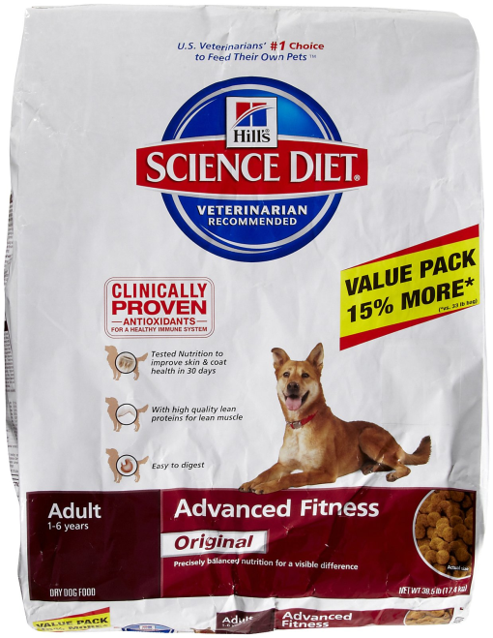
A. List essential nutrients & their function
Where can you find Nutrient Contents of animal feed?
Nutrient | Dry Matter (%)
Protein | 24.5
Fat | 15.8
Carbohydrate (NFE) | 52.8
Crude Fiber | 1.8
Calcium | 0.78
Phosphorus | 0.7
Sodium | 0.30
Potassium | 0.75
Magnesium | 0.096
Taurine | 0.13
Vitamin C | 291 mg/kg
Vitamin E | 785 IU/kg
Minerals
Vitamins

Slide 12
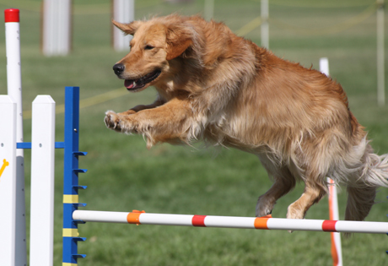
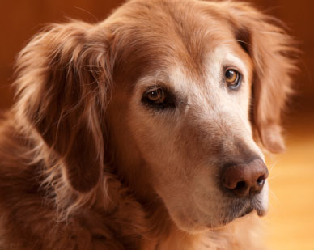
B. Identify factors effecting nutrition requirements in animals
Are all animal’s dietary requirements equal?......
NO!

Slide 13
B. Identify factors effecting nutrition requirements in animals
Factors effecting nutritional needs:
1- Maintenance
Energy required to simply keep animal alive
-Every second an animal is alive it takes energy
No loss or gain of weight
Known as Basal Maintenance Requirement
50% of animal’s diet is used for maintenance

Slide 14
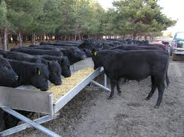
B. Identify factors effecting nutrition requirements in animals
Factors effecting nutritional needs:
2- Growth
Young animals who are not fully grown
Extra energy required to grow bones, support organ systems, develop muscle, etc.
Need high levels of fats
and carbohydrates

Slide 15
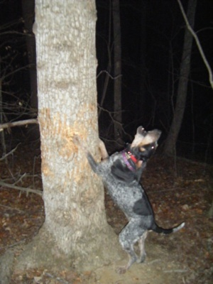
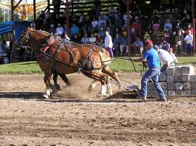
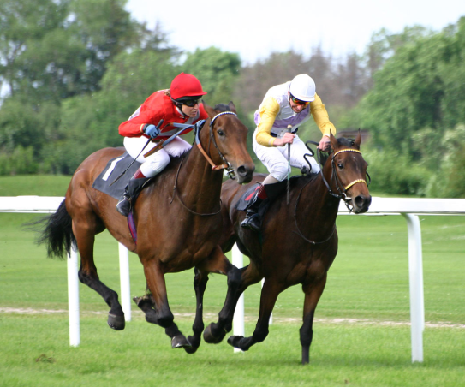
B. Identify factors effecting nutrition requirements in animals
Factors effecting nutritional needs:
3- Work
Animals used for heavy work, require more energy
For Example: hunting dogs, draft horses, race horses, etc.

Slide 16
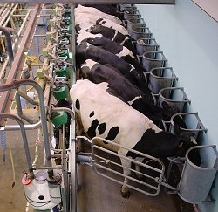
B. Identify factors effecting nutrition requirements in animals
Factors effecting nutritional needs:
4- Gestation & Lactation
(Gestation = Pregnancy, Lactation= milk production)
Nutrition deficiencies are the most common cause of reproductive failures
Pregnancy requires higher levels of nutrition and energy intake
(Especially at the end of pregnancy when the fetus is growing rapidly)
Milk production requires
even more energy
(Especially calcium, phosphorus, protein)

Slide 17
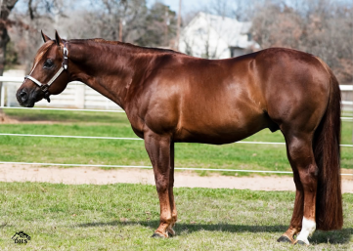
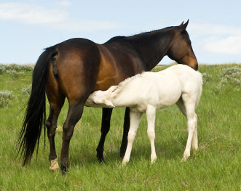
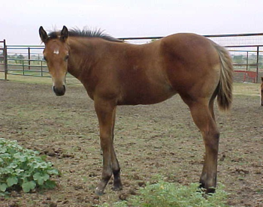
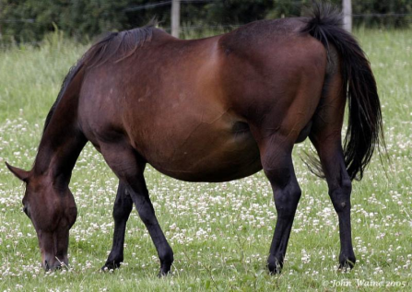
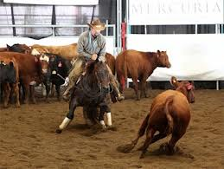
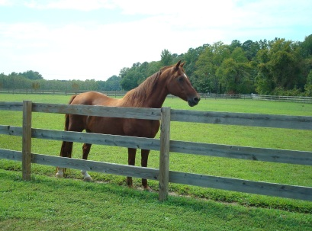
B. Identify factors effecting nutrition requirements in animals
Rank these animals from the HIGHEST energy (calorie) requirement to the lowest
Breeding Stallion
Lactating Brood Mare
Weanling Colt
2
1
4
18,800 Cal/day
27, 400 Cal/day
15,100 Cal/day
Pregnant Mare
Heavy Work Performance
Full Grown Horse, minimum use
3
5
6
17,500 Cal/day
14,500 Cal/day
8,300 Cal/day

Slide 18
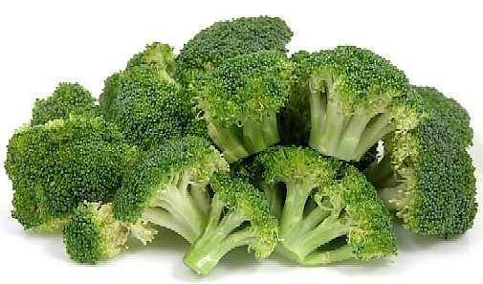
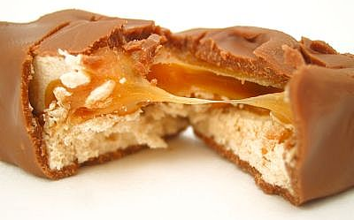
Which would you choose?
C. Classify feed types and identify animal feeds
Which would FILL YOUR STOMACH??
- 1 snickers bar (266 calories)
OR
9 cups of broccoli (270 calories)
Which serving would have the most CALORIES?
1 Snickers bar = 266 calories
1 cup broccoli = 30 calories
Which one would TASTE better?

Slide 19
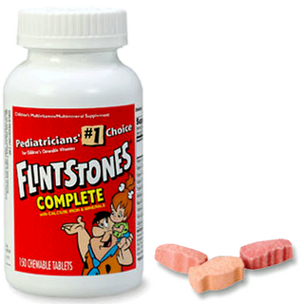
C. Classify feed types and identify animal feeds
3 Types of Feed:
Roughage
Concentrates
Supplements

Slide 20
Roughage
C. Classify feed types and identify animal feeds
Contains MORE than 18% Crude Fiber
Fed in HIGH quantities
Contains MINIMAL energy per pound of feed

Slide 21
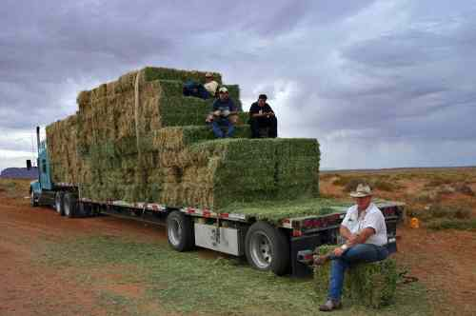
C. Classify feed types and identify animal feeds
Examples…
Roughage
Dry Hay

Slide 22
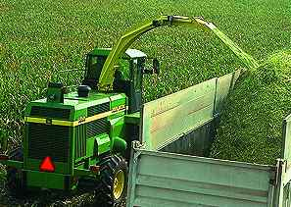
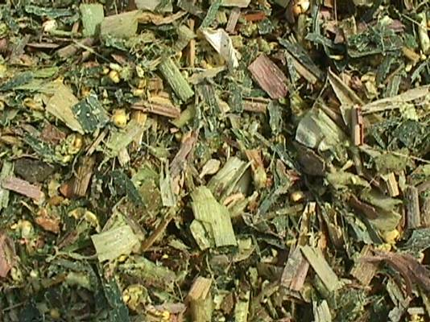
C. Classify feed types and identify animal feeds
Examples…
Roughage
Corn Silage

Slide 23
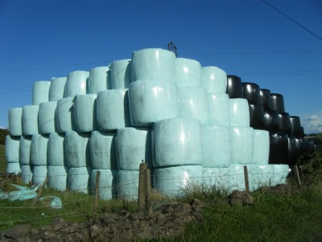
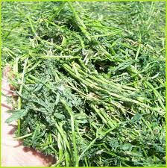
C. Classify feed types and identify animal feeds
Examples…
Roughage
Haylage

Slide 24
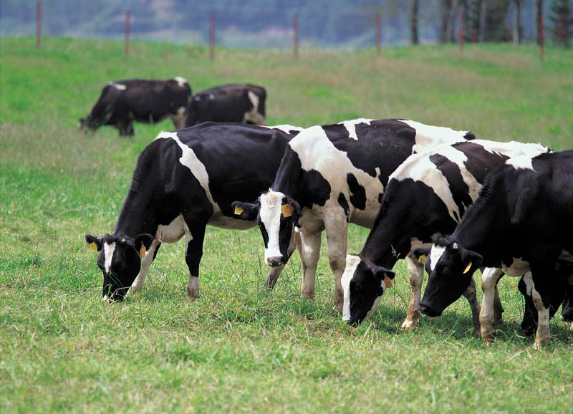
C. Classify feed types and identify animal feeds
Examples…
Roughage
Grass & Pasture

Slide 25
C. Classify feed types and identify animal feeds
Concentrates
Contain LESS than 18% Crude Fiber
Feed in SMALL quantities
Contains HIGH amounts of energy per pound of feed

Slide 26
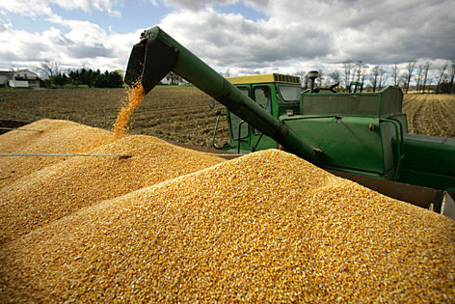
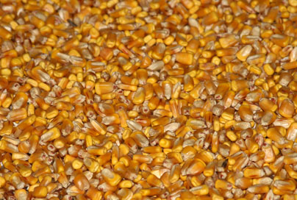
C. Classify feed types and identify animal feeds
Examples…
Concentrates
Corn

Slide 27
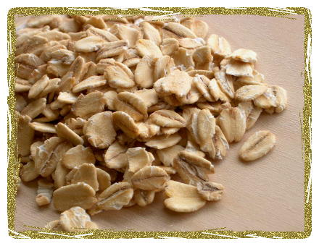
C. Classify feed types and identify animal feeds
Examples…
Concentrates
Oats

Slide 28
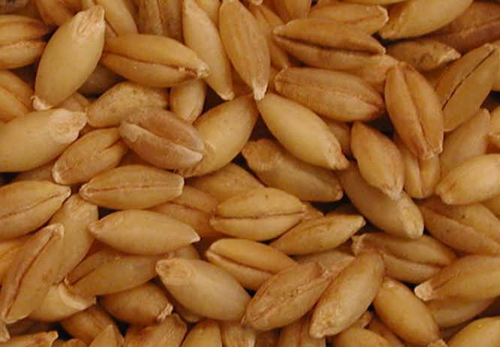
C. Classify feed types and identify animal feeds
Examples…
Concentrates
Barley

Slide 29
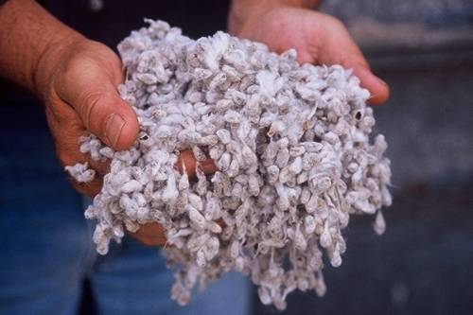
C. Classify feed types and identify animal feeds
Examples…
Concentrates
Cotton Seed

Slide 30
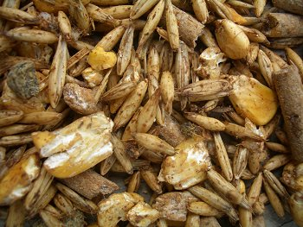
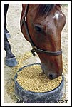
C. Classify feed types and identify animal feeds
Examples…
Concentrates
Grain
FYI: “Grain” is a general term for a mixture of specific grains such as corn, oats, barley, etc.

Slide 31
C. Classify feed types and identify animal feeds
Supplements
Nutritional Boost to a ration:
Usually vitamins, minerals, or protein in form of:
Powders
Lick blocks

Slide 32
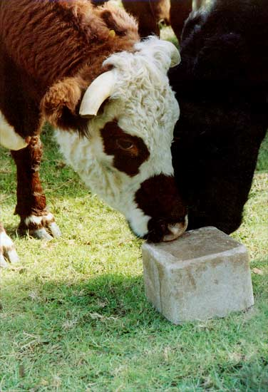
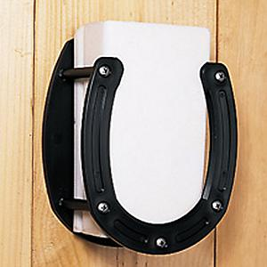
C. Classify feed types and identify animal feeds
Examples… Supplements
Salt or mineral block

Slide 33
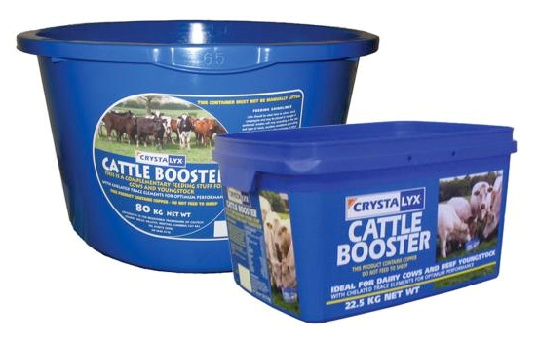
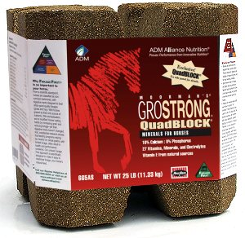
C. Classify feed types and identify animal feeds
Examples… Supplements
Protein Licks

Slide 34
C. Classify feed types and identify animal feeds
Feed ID
Directions: There are 20 feed samples that will be passed through the class. As you receive each sample, list the name of the feed in EVERY category that it applies to. It may apply to zero, one, or more categories. Do your best to memorize the name and characteristics of each feed.

Slide 35
C. Classify feed types and identify animal feeds
Feed ID
Minute-To-Win-It Challenge
2 Teams
1 minute to accomplish the challenge successfully
Each challenge will require completion of 3 tasks by 3 team members
1 Point for every successful challenge

Slide 36
C. Classify feed types and identify animal feeds
Feed ID
Minute-To-Win-It Challenge
Challenge #1
Touch the sample of WHOLE BARLEY
Team Member 1:
Team Member 2:
Team Member 3:
On the board, list 3 plants on the board that are used for animal feeds
On the board, correctly spell the name of the liquid sugar used to sweeten feed… BACKWARDS
Notes:
1- Touch whole barley feed sample
2-Alfalfa, Corn, Barley, Wheat, Oats…etc
3-sessalom

Slide 37
C. Classify feed types and identify animal feeds
Feed ID
Minute-To-Win-It Challenge
Challenge #2
Touch the feed sample that is a pelleted by-product of the sugar beet
Team Member 1:
Team Member 2:
Team Member 3:
On the board, list 2 forms that the supplement SALT is found in
On the board, list all of the feeds that come from the alfalfa plant
Notes:
1-Touch Beet Pulp Pellets
2-Block and granulated
3-Haylage, Alfalfa hay

Slide 38
C. Classify feed types and identify animal feeds
Feed ID
Minute-To-Win-It Challenge
Challenge #3
Touch a feed sample that is a natural, inorganic compound
Team Member 1:
Team Member 2:
Team Member 3:
On the board, list 1 animal feed that comes from an animal
On the board, sketch the machine that separates grain from the stalk and label it with the proper name
Notes:
1- Mineral Block or salt
2- Blood meal or bone meal
3-Combine

Slide 39
C. Classify feed types and identify animal feeds
Feed ID
Minute-To-Win-It Challenge
Challenge #4
Touch 2 feeds that have been processed by rolling them
Team Member 1:
Team Member 2:
Team Member 3:
On the board, list 3 different feeds that come from the corn plant
On the board, correctly spell the name of the feed that is a by-product of the same plant that made your t-shirt
Notes:
1- Rolled corn, rolled barley, etc
2-Whole corn, Steam Flaked Corn, Ground Corn, etc
3-Cotton seed

Slide 40
C. Classify feed types and identify animal feeds
Feed ID
Minute-To-Win-It Challenge
Challenge #5
Touch the feed that was COOKED as part of the processing
Team Member 1:
Team Member 2:
Team Member 3:
On the board, draw an accurate sketch of a wheat or barley plant
On the board, draw a picture of a field with the only livestock feed that is eaten directly from the ground.
Notes:
1-Steam flaked corn
2-
3-Pasture

Slide 41
C. Classify feed types and identify animal feeds
Feed ID
Minute-To-Win-It Challenge

Slide 42
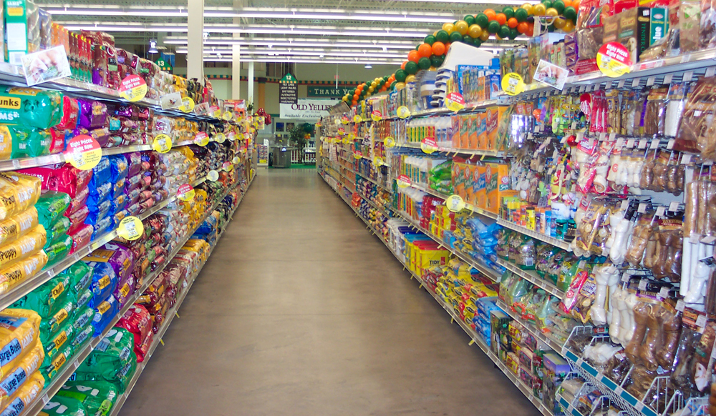
D. Compare & contrast common feeds according to species, age, and energy requirements
Comparing Feeds
How do you choose?

Slide 43
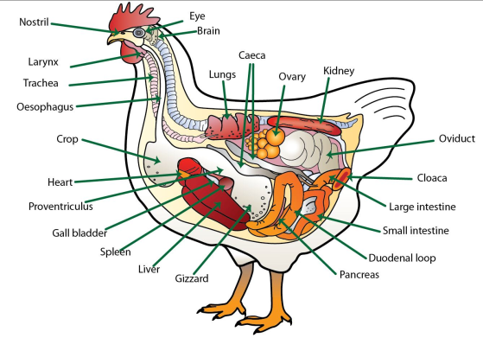
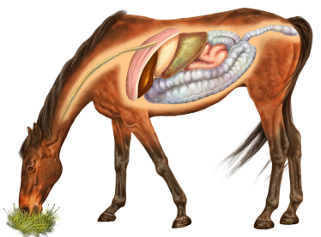
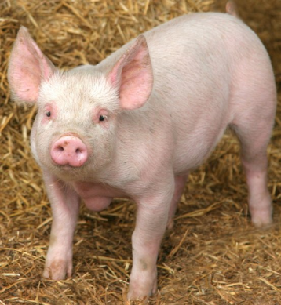
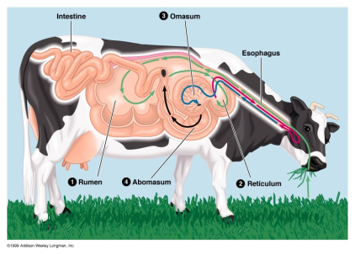
D. Compare & contrast common feeds according to species, age, and energy requirements
Comparing Feeds
What body system has a HUGE impact on what type of feed an animal can digest??
Modified Monogastric
Avian
Ruminant
Monogastric

Slide 44
D. Compare & contrast common feeds according to species, age, and energy requirements
Comparing Feeds
Things to consider…
1- Species
Premixed feeds are formulated specifically for the nutrient requirements of each species
Type of digestive system determines which feeds an animal can digest
Ruminants can digest roughages
Monogastrics cannot break down roughage

Slide 45
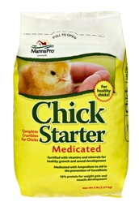
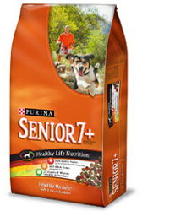
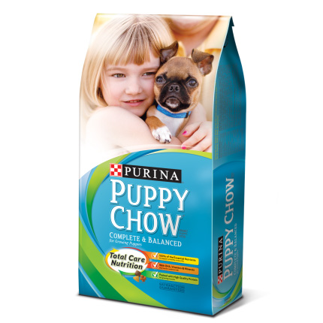
D. Compare & contrast common feeds according to species, age, and energy requirements
Comparing Feeds
Things to consider…
2- Age
Young, Adult, Senior?

Slide 46
D. Compare & contrast common feeds according to species, age, and energy requirements
Comparing Feeds
Things to consider…
3- Energy Requirement
Lactating/Gestation
Heavy Work

Slide 47
D. Compare & contrast common feeds according to species, age, and energy requirements
Comparing Dog & Cat Foods

Slide 48
E. Interpret a feed label
Name of Feed
List of Nutrients
% Contained
List of ingredients
Feeding directions
Feed company

Slide 49
E. Interpret a feed label
Feed Labels
Guaranteed analysis
Lists nutrients contained in feed
Lists minimum % of each nutrient
Ingredients listed
Usually have some feeding instructions

Slide 50
E. Interpret a feed label
Feed Label Shuffle
Directions: Each student should have 1 feed label. As a class we will establish a pattern of rotating the feed labels. With each pass you will record the name of the feed, crude fiber, protein content, type of feed, and list the first 3 ingredients. Note that the labels are color coded according to species.
If the feed is MEDICATED, put a star by the name of the feed.

Slide 51
F. Balance a ration
2 Volunteers…
Make a list on the board of 1 days’ worth of food that would represent a healthy diet.

Slide 52
F. Balance a ration
How to Balance a Ration
Ration = Daily Intake of food
Successful ration must:
Fill them up
Taste Good
Provide required nutrients/energy
Be cost effective

Slide 53
F. Balance a ration
How to Balance a Ration
A few hints:
Rations vary by species and energy requirement
Some rations mix roughage, concentrates, and supplements
Some rations meet all dietary requirements with 1 feed

Slide 54
F. Balance a ration
Example Ration
Full grown, 6 year old horse, minimum use:
Ration #1:
Free choice grass pasture
Salt/mineral block
Ration #2:
11 lbs hay
2.75 lbs Purina Strategy
*This ration mixes a roughage (hay) and concentrate (Strategy) to meet all dietary requirements
Ration #3:
11.25 lbs Purina Equine Adult
*This is a “Complete” feed which means it has roughage and concentrate mixed together. It meets all dietary requirements in 1 feed

Slide 55
F. Balance a ration
Example Ration
Laying Hens
Ration #1:
Free choice Lay Mash or Pellets
*This is a complete feed, premixed to exact nutrition requirements
Notes:
Point at that some rations don’t need to be mixed. Everything they need is in one bag. Complete feeds can be found for almost any species… dog food, cat food, etc.

Slide 56
F. Balance a ration
Example Ration
5 Month old Market Lamb
Ration #1:
Show Lamb Grain Mix
Hay

Slide 57
F. Balance a ration
Protein content is an important factor in most rations
How is protein content calculated when mixing feeds?

Slide 58
F. Balance a ration
Example…
A bred gilt requires a 13% protein ration.
You have available-
Corn with 9% protein
Cotton Seed Meal with 40 % protein
Find the number of pounds of corn and CSM needed to make a 100lb ration with 13% protein

Slide 59
F. Balance a ration
Pearson Square
Feed #1
Feed #1
Feed 2 - % CP Desired=
% Crude Protein Desired
Feed #2
Feed #2
Feed 1 - % CP Desired=

Slide 60
F. Balance a ration
Pearson Square-Steps
Feed #1:
Corn
9% CP
Feed #2
Cotton Seed Meal
40% CP
#1: Label Feed Names & %

Slide 61
F. Balance a ration
Pearson Square-Steps
Feed #1:
Corn
9% CP
Corn
Feed #2
Cotton Seed Meal
40% CP
Cotton Seed Meal
#2: Transfer feed name straight across

Slide 62
F. Balance a ration
Pearson Square-Steps
Feed #1:
Corn
9% CP
Corn
13%
Feed #2
Cotton Seed Meal
40% CP
Cotton Seed Meal
#3: Fill in desired CP%

Slide 63
F. Balance a ration
Pearson Square-Steps
Feed #1:
Corn
9% CP
Corn
13%
Feed #2
Cotton Seed Meal
40% CP
Cotton Seed Meal
9-13= |4|
#4: Find Absolute value of feed #1 and desired CP

Slide 64
F. Balance a ration
Pearson Square-Steps
Feed #1:
Corn
9% CP
Corn
40-13=27
13%
Feed #2
Cotton Seed Meal
40% CP
Cotton Seed Meal
9-13= |4|
#5: Find Absolute value of feed #2 and desired CP

Slide 65
F. Balance a ration
Pearson Square-Steps
Corn
40-13=27
To mix a ration
Using Corn & Cotton Seed Meal…
Use:
27 parts Corn
4 parts Cotton Seed Meal
31 Total Parts
Cotton Seed Meal
9-13= |4|
#6: Determine Total Parts

Slide 66
F. Balance a ration
Pearson Square-Steps
100 lbs / 31 total parts =
3.22 Pounds per part
#7: Translate “Parts” to “Pounds”

Slide 67
F. Balance a ration
Pearson Square-Steps
27 parts Corn
27 x 3.22= 86.94 Pounds Corn
4 parts Cotton Seed Meal
4 x 3.22= 12.88
#8: Determine pounds of each feed

Slide 68
F. Balance a ration
Your turn…
A 1400-pound cow in the second trimester of pregnancy needs 8% protein.
She is fed grass hay (6% protein) and soybean meal (49% protein)
Calculate how many pounds of each feed is required to mix a 100 pound ration of feed with 8% protein

Slide 69
Bell Quiz
Objective A & B
What are 3 reasons it’s important to have a good understanding of animal nutrition & feeding?
Which essential nutrient builds and repairs muscle?
Name the 6 essential nutrients
List 4 factors that effect an animals nutrition requirement.
Which essential nutrients are needed in the smallest amounts?

Slide 70
Bell Quiz
Objective C & D
What is the difference between a roughage and a concentrate?
Give 2 examples of a roughage.
When comparing animal feeds, what 3 things should you consider when choosing a feed?
Which body system has a huge effect on what types of feed an animal can digest?
Give an example of an animal supplement.

Slide 71
Bell Quiz
Objective E & F
What is a guaranteed analysis?
List 3 things that can be found on a feed label.
What is a ration?
Sam wants to make 1 ton of a 16% protein ration using alfalfa hay (18.7%) and oats (13.3%). How much of each will she have to mix together?
If you should feed 1½ lbs of hay per 100 lbs of your horse’s body weight, how much should you feed a 1200 lb horse?

