Slide 1
Companion, Recreation, & Therapy Animals
Identify the benefits provided by companion animals
Describe the role of specialty & exotic pets in the animal industry
Compare & contrast the use of animals in recreational activities
Describe the use of animals in service & therapy programs

Slide 2
Benefits of Companion Animals
Identify the benefits provided by companion animals
Companion Animals
“Pets”
Don’t typically earn money
vs
Production
Animals
Produce our food and fiber
Usually part of a business that provides an income for a family

Slide 3
Benefits of Companion Animals
Identify the benefits provided by companion animals
Companion Animal Benefits
from A to Z
What are they?
Give kids more confidence in “R”eading through k9 reading programs
Help people get more “E”xercise!
Provides “P”rotection by alerting owner of visitors

Slide 4
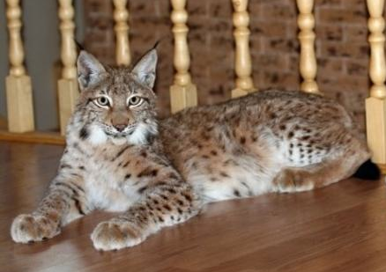
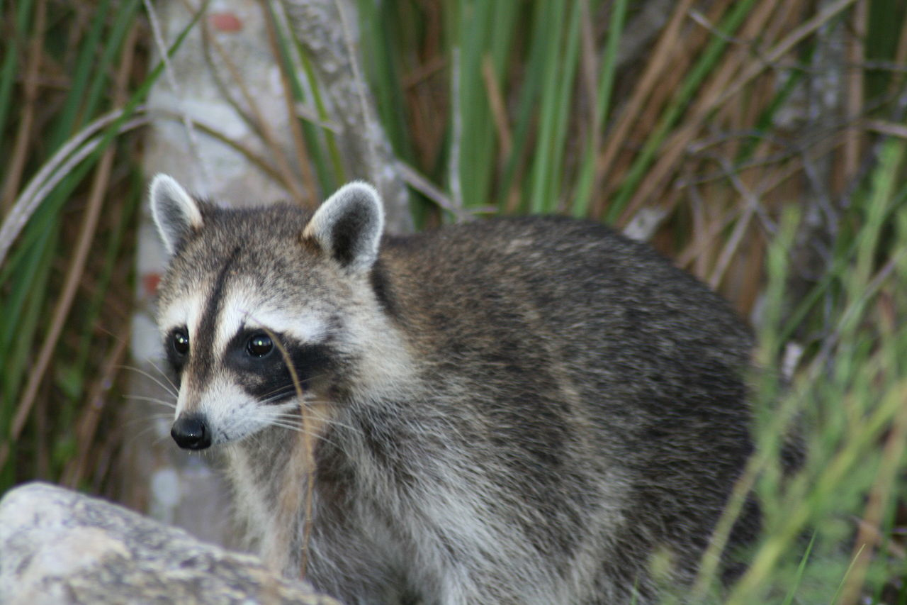
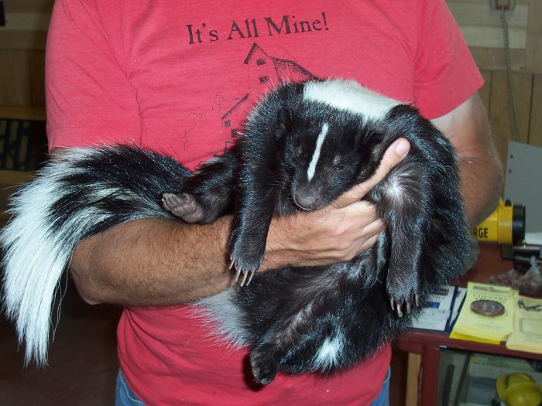
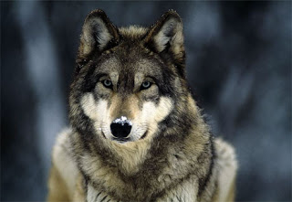
Specialty & Exotic Pets
B. Describe the role of specialty & exotic pets in the animal industry
Exotic Animals =
A rare or unusual pet that is generally considered a wild animal
*There are exotic pets and exotic livestock
*Exotic animals are illegal in many states & cities
Skunk
Wolf
Lynx
Raccoon

Slide 5
Specialty & Exotic Pets
B. Describe the role of specialty & exotic pets in the animal industry
Exotic Pet Laws =
Most states have specific laws about exotic pets
To ensure safety of animals & people
Some animals are legal with a license
Protect indigenous animals in the area
Its more likely for an exotic animal to become unwanted. If it was released, it might cause problems
Notes:
Example of protecting indigenous animals: Owning piranha fish is illegal in Utah. Once the piranha’s get too big for the fish tank and to care for, if the owner dumped them in a pond, lake, or reservoir, they would do significant damage to the existing fish and ecosystem even if they didn’t live through the winter.

Slide 6
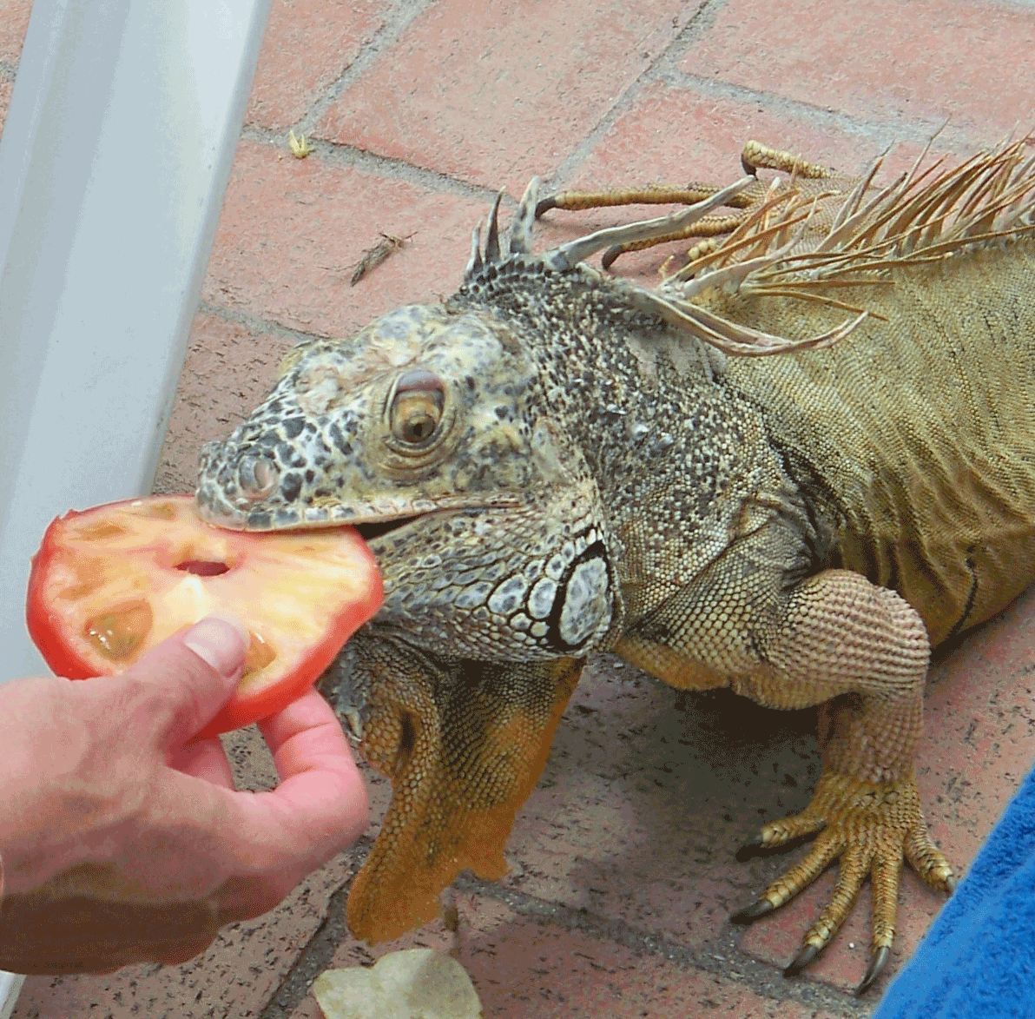
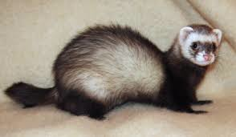
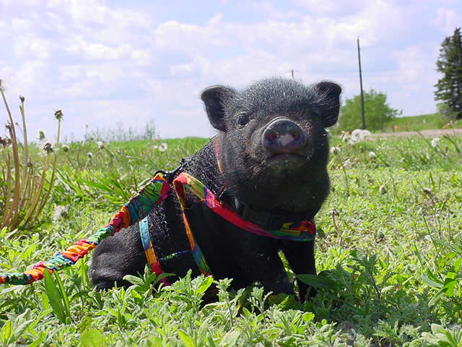
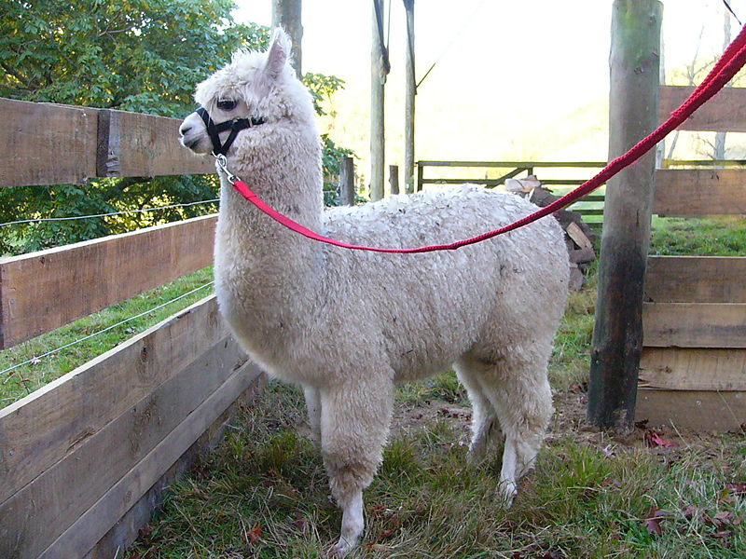
Specialty & Exotic Pets
B. Describe the role of specialty & exotic pets in the animal industry
Specialty =
Pets or animals outside of the most common domestic animals
*Most anything except dogs, cats, horses, sheep, goats, cattle, pigs etc.
Pot Belly Pig
Llama
Ferret
Iguana

Slide 7
Specialty & Exotic Pets
B. Describe the role of specialty & exotic pets in the animal industry
Specialty Pet Laws=
Laws governing ownership of these animals are rare unlike exotics
Provide more people the opportunity to have animals
Big yard or animal property isn’t necessary to own a ferret, guinea pig, or other small pet
Many specialty pet owners enjoy having a unique pet

Slide 8
Specialty & Exotic Pets
B. Describe the role of specialty & exotic pets in the animal industry
How do specialty & exotic animals effect the animal industry?

Slide 9
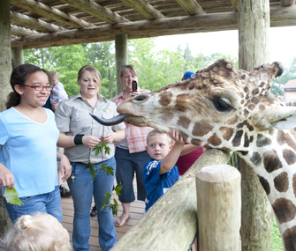
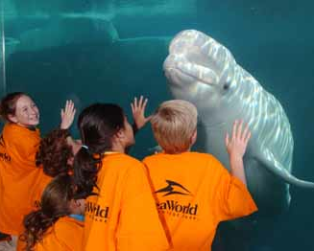
Specialty & Exotic Pets
B. Describe the role of specialty & exotic pets in the animal industry
1- Education
Exotic animals in zoos provide educational opportunities most people would never experience if animals were only in the wild

Slide 10
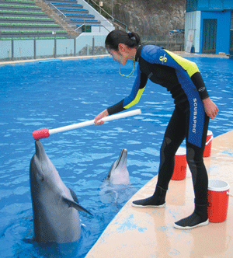
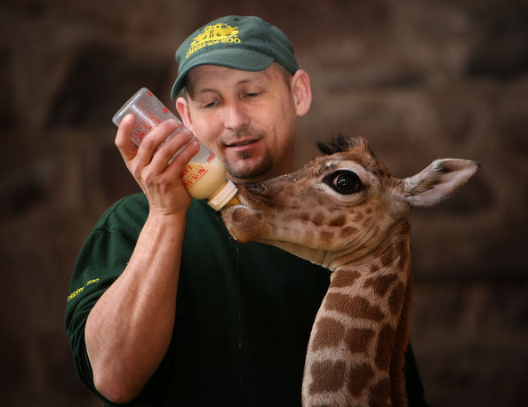
Specialty & Exotic Pets
B. Describe the role of specialty & exotic pets in the animal industry
2- Careers
The exotic animal industry provides many jobs to care for the animals in specialty zoos and exhibits as well as educate the public.

Slide 11
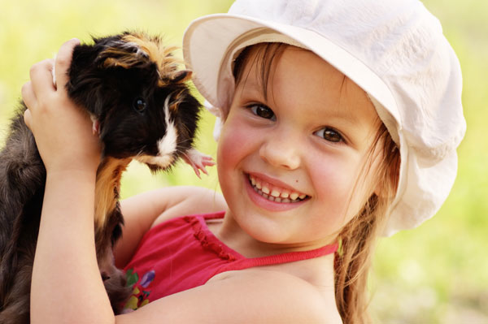
Specialty & Exotic Pets
B. Describe the role of specialty & exotic pets in the animal industry
3- Increased Animal Exposure
Some specialty animal owners wouldn’t or can’t own a typical dog, cat, or livestock animal. Specialty animals provide more opportunities for people to experience the benefits of pet ownership.

Slide 12
Recreation
C. Compare & contrast the use of animals in recreational activities
Rec-re-a-tion (noun):
Activity done for enjoyment when one is not working
What kind of animals are used for recreation?

Slide 13
Service & Therapy Animals
D. Describe the use of animals in service and therapy programs
Service Animals:
Provide physical assistance to people
Guide Dogs For Blind
Police Dogs
Medical Alert Dogs
Seizures & diabetes
Search Dogs
Avalanches, natural disasters, bombings

Slide 14
Service & Therapy Animals
D. Describe the use of animals in service and therapy programs
Therapy Animals:
Provide emotional bonding, confidence, and motivation
Physical Therapy
Animal bond helps patients heal after accidents and illness
Psychotherapy (mental health)
Troubled youth
ADHD
Autism
Prisons

