Slide 1
Meat, Poultry and Eggs Processing
Ag Processing Technology
Unit 3

Slide 2
Objectives
Describe the production of meat from cattle, pigs and poultry
Identify meat products from cattle, pigs and poultry
List five factors affecting meat tenderness
Describe the cooking of meat
Discuss the production of meat substitutes
Identify quality grading of meat
Describe egg production
Identify factors affecting egg quality
Discuss egg grading

Slide 3
Key Terms To Know
Aging
Albumen
Antemortem
Blood spot
Bromelin
By-products
Cold shortening
Curing
Deboning
Electrical stimulation
Eviscerated
Ficin
Integrated
Julian date
Marinating
Mechanically separated
Myoglobin
Offal
Papain
Postmortem
Processed meats
Rigor mortis
Smoking
Textured protein
Vitelline membrane
Yield grade

Slide 4
Introduction
First meat packers in the United States were the colonial New England farmers
  They packed meat in salt to preserve it
Then the beef industry moved to be near the commercial feedlots in the central United States—Kansas, Oklahoma, Texas
Pork Industry—The Midwest; Iowa, Illinois, Minnesota, Michigan, Nebraska
Poultry industry is characterized by rapid growth and vertical integration

Slide 5

Meat and Meat By-Products

Slide 6
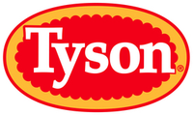

Slaughter and Processing
Livestock are slaughtered and processed in federally inspected plants
A few large packers dominate the industry
Swift Foods, Tyson, Hormel, Smithfield Foods
Notes:
IBP is owned by Tyson Fresh Meats.

Slide 7
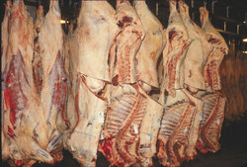
Beef Processing
62% of beef is consumed as beef cuts
24% is ground into hamburger
14% is processed into meat products

Slide 8
Pork Processing
More than 65% is consumed as processed meats such as ham, bacon, and sausage

Slide 9
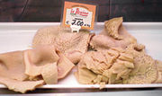
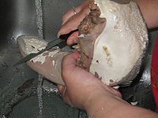

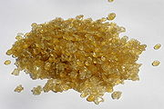
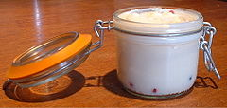

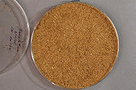
By-Products of the Meat Industry
Cosmetics
Glues
Gelatins
Tallow
Variety Meats
Meat and Bone-meal
Notes:
McD used to cook ff in a tallow cottonseed oil mix up until 1990.

Slide 10
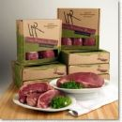
Selling Meat
Traditionally sold as sides, quarters or wholesale cuts
Today meat is sold as “boxed beef”

Slide 11
Boxed Beef
Prepared at the packing plant by removing more bone and fat and cutting it into smaller pieces
It is vacuum-packed to reduced spoilage and shrinkage
Put into boxes that are easier to ship and handle than quarters
Reduces shipping and labor costs and increased value of the fat and bone to the packer

Slide 12

Government Surveillance
Inspection takes place at every step
  Attempts to ensure that the meat is free of harmful ingredients and additives, that animals are not sick and that misleading labeling and packing are not used

Slide 13
Meat Inspection Act 1906
Authorizes federal meat inspection
Administered by the Food Safety and Inspection Service (FSIS) of USDA
Meat that is going to be used entirely within a state may only be inspected by that state’s department of agriculture
Meat entering interstate commerce must be federally inspected

Slide 14
Grading
Voluntary
Offered by the Agricultural and Marketing Service (AMS) of the USDA
Operated on a self-supporting basis
Funded by fees paid by the users

Slide 15

Grading
Establishes and maintains uniform trading
Aids in the determinination of the value of various cuts of meat
Both quality and yield grades are used

Slide 16
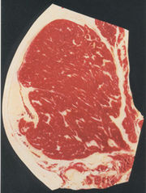
Quality Grades
Prime, Choice, Good, Standard, Commercial, Utility, Cutter, Canner
Grades are assigned on the basis of
  Marbling-fat flecks or streaks in the lean
  Color and texture of the lean
  Maturity- which is determined by the color, size, and texture of the cartilage bones
Was not originally intended to provide estimates of palatability for the consumer, but is now a consumer rating for beef.

Slide 17
Quality Grades

Slide 18






Quality Grades—Degrees of Marbling
Mod. Abundant
Slightly Abundant
Moderate
Modest
Small
Slight to None

Slide 19
Quality Grades
Carcasses below choice grade have rarely been graded because they are thought to be less palatable
However, due to consumers beliefs turning to the idea that leaner meat is more healthful the demand for select grade meat is increasing

Slide 20
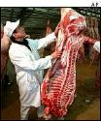
Yield Grades
Classify carcasses on the basis of the proportion of useable meat to bone and fat
Used in conjunction with quality grades to determine the monetary value of the carcass

Slide 21
Slaughtering Practices: The Humane Slaughter Act of 1960
Requires that prior to slaughter the animals be rendered completely unconscious with a minimum of excitement and discomfort by mechanical, electrical or chemical (CO2 gas) methods

Slide 22
Slaughtering Practices
After being bled, skinned and eviscerated the carcass is chilled for 24-48 hours
It is then graded and processed
Meat items such as the brains, kidneys, sweetbreads, tail and tongue do not accompany the carcass
They are considered by-products and are sold separately as specialty items
These and all other parts removed from the animal (feed, hide, intestines) are called offal and are an important source of income for meat packers

Slide 23
Structure and Composition of Meat
Meat
  Generally refers to the skeletal muscle from the carcasses of animals
Make-up (approx)
  70% water
  21% protein
  8% fat
  1% ash (mineral)

Slide 24
Meat as a Food Source
Complete protein source
Excellent source of iron
Fat, makes the product juicy, tender, and adds flavor
Fat also reduces formulation costs

Slide 25

Regulating Fat Content
USDA regulates fat content for processed products
Hot Dogs- can not contain more than 30% fat
Specialty Loaf items (SPAM) may contain more than 30% fat
However, due to consumer demand most processed meat items are considerable leaner

Slide 26
Chilling
After slaughter many biological changes take place in the muscle that convert it to meat
Chilling is used to prevent spoilage
If chilling occurs to rapidly the result is cold shortening
  Occurs when the muscle is chilled to less than 60 degrees F before rigor mortis is complete
If the carcass is frozen before rigor is complete the result is “thaw rigor” and the result is extremely tough meat

Slide 27
Rigor Mortis
Contraction and stiffening of the muscle
Muscle is very tender at the time of slaughter but become progressively less tender until rigor is complete
Beef requires 6-12 hours
Pork 1-6

Slide 28
Aging
Holding of beef in a cooler or refrigerator
Increases tenderness due to natural enzymatic changes taking place in the muscle
Increase in tenderness only continues for 7-10 days after slaughter when the beef is held at approximately 35 degrees F
Beef held at higher temperatures will age more rapidly but may spoil or develop off flavors
Lamb and pork are rarely aged

Slide 29

Tenderizing
Tenderness, juiciness and flavor are components of meat palatability
Tenderness can vary greatly from one cut to the next
Beef is the most variable
Followed by lamb, pork veal
Variatiations are caused by
  Genetics
  Species
  Age
  Feeding
  Muscle type
  Suspension of the carcass
  Electrical stimulation
  Chilling rate
  Aging
  Mechanical tenderizing
  Chemical tenderizing
  Freezing and thawing
  Cooking
  carving

Slide 30

Tenderizing: Genetics
Accounts for about 45% of observed variation in tenderness of cooked beef

Slide 31
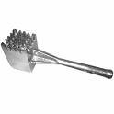
Tenderizing: Species & Age
Variation from species to species is due to chronological age of the animal at time of slaughter
Beef approximately 20 months of age
Lamb 8 months
Pork 5 months
Veal approximately 2 months
As the animal gets older the meat becomes progressively less tender
  This is due to the changing nature of the connective tissue protein found in meat

Slide 32

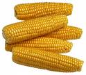
Feeding
Feed does not directly influence tenderness
In the case of beef an indirect effect of feeding on tenderness may be observed
Animals finished on grain tend to reach slaughter weight sooner than animals finished on pasture

Slide 33
Muscle to Muscle
Variation exists among muscles
Difference is due to the amount of connective tissue in the various cuts
Amount of connective tissue present is due to the function of the muscle

Slide 34
Suspension of Carcass
Stretching of muscles during chilling affects tenderness
Has different effects on different muscles according to their anatomical location in the carcass
Most carcasses are hung from the hind leg
However a new method of hanging the carcass from the pelvic or hip bone changes the tension applied to some muscles

Slide 35

Electrical Stimulation
Immediately after slaughter increase tenderness
Beef carcasses subjected to approximately one minute of high-voltage electrical current improves tenderness of many cuts of the carcass

Slide 36
Chilling Rate
Chill to rapidly and the result is cold shortening and subsequent toughness
Cold shortening occurs when the muscle is chilled to less than 60 degrees F before the completion of rigor mortis

Slide 37
Quality Grade
Age plays a major role in tenderness as it applies to quality grading in beef
USDA quality grades are
  Prime
  Choice
  Select
  Standard
  Utility
  Commercial
Young animals (up to 40 months of age) are eligible for USDA Prime, Choice, Select, Standard and Utility
Over 40 months are only eligible for Commercial and Utility
Quality grades are not used for pork
Yield grades are given the designation of 1, 2, 3, 4, 5

Slide 38
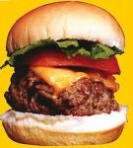
Mechanical
Grinding is very popular
Cubing increase tenderness as well

Slide 39

Chemical
Salt increases tenderness because it softens the connective tissue
Vegetable enzymes such as papain, bromelin, and ficin also tenderize meat
These tenderizers dissolve or degrade the connective tissues, collagen and elastin
Vegetable enzymes are limited though in that their action is sometimes restricted to the surface of the meat

Slide 40

Marinating
A way consumers can tenderize and add flavor

Slide 41
Freezing
Plays a small role in tenderness
Fast freezing forms small ice crystals
Slow freezing forms large ice crystals
  Large ice crystals disrupt components of the muscle fibers
  Also increase the loss of juices upon thawing

Slide 42
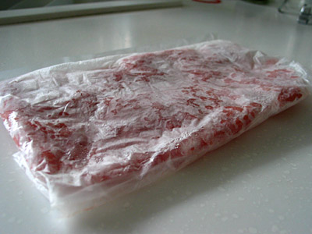
Thawing
Slow thawing generally results in greater tenderness

Slide 43
Cooking and Carving
Cooking
  As cooking progresses the contractile proteins in meat become less tender
Carving
  Meat is cut at right angles or against the grain
  This achieves maximum tenderness

Slide 44
Curing
Once used a preservative method
Now used to add more flavor

Slide 45
Color
Primary color pigment is a protein called myoglobin
Function is to store oxygen in the muscle tissue
  When oxygen is present meat is bright red, when it is absent the meat is a purplish color
Myoglobin is denatured by prolonged exposure to air or by cooking
  It turns _________________.

Slide 46
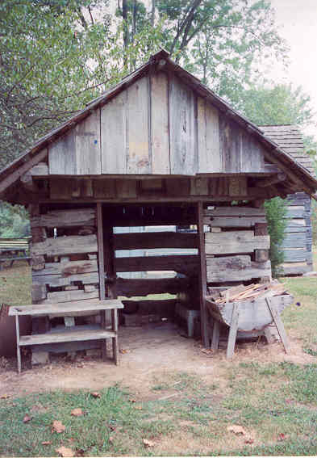
Smoking
Has been practiced since the beginning of recorded history
Smoke effectively inhibits microbial growth
Creates unique flavor

Slide 47
A NEW JELL-O???
Gelatin is made from animal collagen that has been extracted from skin, bone, and connective tissue
Purdue University Students in a the “Innovative Uses for Soybeans Contest” created a new vegetarian JELL-O
The new dessert is made from a gel base made of water, fructose, high-gelling soy protein and carrageenan (made from seaweed)
The new product is called NuSoy Gel
For more information on this new product visit
www.welovesoy.com

Slide 48
Poultry

Slide 49
Poultry
Production is dominated by large integrated companies
These companies control hatching, egg production, hatching, growing, processing, marketing
They often mill their own feed and render the offal and feathers to produce feed ingredients
Any of these steps may be controlled by contract
The company owns all functions except live production

Slide 50
Production Contracts
Farmer may provide the growing facility, equipment, litter, brooder, fuel, electricity and labor
The company provides the chicks, feed, medication, bird loading and hauling, and some grow out supervision
Contract payments are based on a set amount per pound of chicken marketed

Slide 51
Growing Houses
40-50’ wide, 400-500’ long
Modern facilities control air entering the sides of the building
Exhaust fans blow air over the birds in hot weather
Overhead fogger lines cool chickens in hot weather
Space allowance range from 0.7-1.0 square foot per bird depending on season, house type and age marketed

Slide 52
Feeding
Feed is moved on conveyors that drop the feed into attached pans
Water is supplied by bird activated nipples attached to water pipes running the length of the building
Three diets are used: starter, grower, undmediacated or withdrawal feed

Slide 53
Processing
Meat chickens are marketed as broiler, roasters or game hens
Commercial meat strains reach an average live weight of 4 lbs at 42 days or 4.8 lbs at 49 days
Turkey hens are marketed between 14-16 weeks age and weigh from 14.7-17.5 pounds
Toms are marketed between 17-20 weeks of age and weight 26.4-32.3 lbs
16% of turkeys are processed for the whole body market

Slide 54
Processing Steps
Assembly line operation conducted under sanitary conditions
Inspecting, classifying and grading are a part of the processing

Slide 55
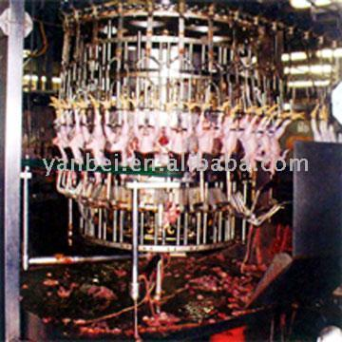
Processing Steps
Antemortem inspection
Suspension and shackling of each bird by the legs
Stunning with electrical shock
Bleeding
Scalding
Picking
Removal of pinfeathers
Evisceration
Chilling in ice water
Postmortem inspection
Grading
packaging

Slide 56
Properties of Poultry
High in protein
Low in fat
Excellent source of essential amino acids
Also a good source of
  Phosphorus, iron, copper, zinc, B vitamins (12 & 6)
Dark meat and skin are higher in fat than white

Slide 57
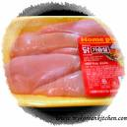
Concerns of the Industry and Consumer
Color
Texture
Flavor

Slide 58
Appearance
Color
Important because consumers associate it with freshness
Poultry is unique because it is sold both with and without skin
Poultry also has extremes in meat color-white or breast meat and dark or thigh and leg meat

Slide 59


Factors That Affect Poultry Meat Color
Bird age
Sex
Strain
Diet
Intramuscular fat
Moisture content (meat)
Pre-slaughter conditions
Processing variables

Slide 60
Meat Color
Depends on presences of muscular pigments myoglobin and hemogolobin
Discoloration can be related to the amount of these pigments that are present, the chemical state of the pigments or the way that the light is reflected off the meat
Discolorations can occur in the whole muscle or limited to a specific area

Slide 61
Muscle Discoloration
When a whole muscle is discolored it is frequently the breast
This is due to the breast muscle accounting for a large portion of the live weight of the bird, making it more sensitive to factors that contribute to discoloration
The light color of the meat also makes color differences more noticeable

Slide 62
Other Factors that Contribute to Discoloration
Extreme environmental temperatures can cause boiler and turkey breast meat to be discolored
Bruising
  29% of all carcasses processed in the US are downgraded a majority of the time due to bruising
  The industry generally tries to determine where, how and when these injuries occur but it is often difficult to determine

Slide 63
Texture
Also related to quality
Tenderness depends upon rate and extent of chemical and physical changes occurring in the muscle as it becomes meat

Slide 64
Factors that Affect Poultry Tenderness
Anything that disrupts rigor mortis and the following softening of the muscle
Birds that struggle before or during slaughter cause rigor to set in to quickly
Exposure to environmental stresses before slaughter will cause a similar situation
High pre-slaughter stunning temperatures
High scalding temperatures
Longer scalding times
Machine picking
Can all contribute to poultry being tougher

Slide 65
Factors that Affect Poultry Tenderness
Tenderness of boneless cuts are influenced by the time between death (postmortem) and deboning
To avoid toughening meat can be aged for 6-24 hours before deboning
This is costly for the processor

Slide 66
Fighting Tough Meat
Post slaughter electrical stimulation to hasten rigor development and reduce aging time before deboning
Using this method meat can be deboned within 2 hours postmortem instead of 4 to 6

Slide 67
Flavor
Also used to determine acceptability by consumers
Both taste and odor contribute to flavor
Few factors during processing affect this
Age of the bird at slaughter affect flavor
Other minor effects on flavor are related to bird strain, diet, environmental conditions, scalding temperatures, chilling, product packaging and storage
Overall these effects are too small for the consumer to notice

Slide 68
Most Important Aspect of Poultry Quality
Eating Quality
  Combined effects of appearance, texture and flavor
Live production affects poultry meat quality by determining the state of the animal at slaughter
Processing affects meat quality by establishing the chemistry of the muscle constituents and the interactions within the muscle structure
Producer, processor, retailer and consumer all have specific expectations for the quality attributes of poultry

Slide 69
Grading
Chickens, Turkeys, Ducks, Geese, Guineas, Pigeons are all eligible for grading and certification services provided by the USDA’s Agricultural Marketing Service (AMS) Poultry Programs Grading Branch
These services are provided in accordance with federal poultry grading regulations

Slide 70
Grading
Chickens and turkeys are often sold as value-added products
Poultry parts and increasing number of skinless and/or boneless products are meeting consumer demand for convenient, lower-fat, portion controlled items
This shift away from whole carcass birds creates special challenges for buyers and sellers whether they are poultry producers or processors, wholesalers, food manufacturers, food service operators, food retailers or consumers
All depend on USDA’s poultry grading services to ensure that their requirements for quality, weight, condition and other factors are met

Slide 71
Grading and USDA Quality Standards
Grading provides a standardized means of describing the marketability of a particular food product
To be eligible for an official USDA grade
  each carcass or part must be individually graded by a plant grader
  a sample must be certified by a USDA grader

Slide 72
Poultry Grades
After passing the examination and evaluation process the product is eligible for a grade shield
USDA Grades are A, B or C
Poultry standards are frequently reviewed, revised and updated as needed to keep pace with changes in processing and merchandising

Slide 73
Contract Acceptance Certification
Ensures the integrity and quality of poultry and further processed poultry products bought by quantity food buyers such as food manufactures, food service operators and food retailers
USDA specialists help institutional buyers develop and prepare explicit specifications tailored to their requirements
USDA graders then provide certification that purchases comply with these specifications

Slide 74
Contract Acceptance Certification
Specific items that may be part of a product specification include
  Kind and class (species and age)
  Type (frozen, chilled) and style (cut-up parts, whole muscle)
  Formula, processing, fabrication
  Laboratory analysis
  Net weight
  Labeling and marketing, packing and packaging
  Storage and transportation
Products meeting specified requirements are eligible for the Contract Compliance identification mark
The official grading certificate accompanies each shipment to the receiving agency

Slide 75

Products
Per capita consumption of poultry has been increasing
Due to increased availability of poultry and also the large variety of products made from poultry meat
Often these products are similar to traditional red meat products
  Hot dogs, hams, sausages, bologna, salami, pastrami & other lunch meats
Many new products use mechanically separated poultry meat which is ground to a fine emulsion for curing, seasoning, smoking and processing

Slide 76
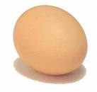
Eggs
THE INCREDIBLE EDIBLE EGG!!

Slide 77
Production of Top Quality Eggs
Starts with a closely controlled breeding program emphasizing favorable genetic factors
Industry is dominated by White-Leghorn type
In major egg producing states flocks of 100,000 laying hen are not unusual and some flocks number more than 1 million
Each of the 235 million laying birds in the US produce from 250 to 300 eggs a year

Slide 78
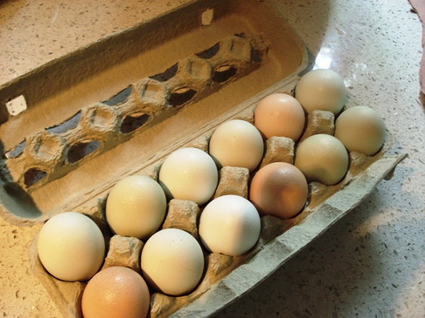
Today’s Egg Facilities
Temperature, humidity, light are controlled and air is circulated
Building is well insulated and windowless
Force-ventilated
Industry favors the cage system because of its sanitation and efficiency
Automation is used whenever possible

Slide 79
Processing
The moment an egg is laid physical and chemical changes begin to reduce freshness
In most production facilities automated gathering belts gather and refrigerate eggs frequently
Gathered eggs are moved into refrigerated holding rooms where the temperature is maintained between 40-45 degrees F
Humidity is relatively high to minimize moisture loss

Slide 80
Carton Dates
Egg cartons from USDA inspected plants must display a Julian date
  Julian Date is a number 1-365 indicating the date the eggs were packed
Although not required they may also carry an expiration date beyond which the eggs should not be sold

Slide 81
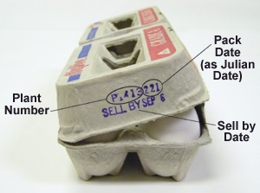
Julian Date

Slide 82
Carton Dates
In USDA inspected plants the sell by date can not exceed 30 days after the pack date
Plants not under USDA inspection are governed by state law
Fresh shell eggs can be stored in their cartons in the refrigerator for 4-5 weeks beyond their Julian date with insignificant quality loss

Slide 83

Formation and Structure
Structure and characteristics of an egg include its color, shell, white, yolk, air cell, chalazas, germinal disc and membrane

Slide 84
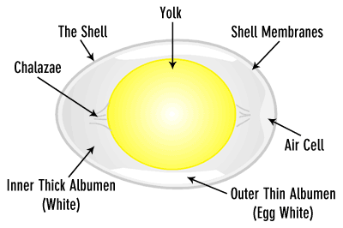
THE EGG

Slide 85

Color
Shell and yolk color may vary
Has nothing to do with quality, flavor, nutritive value, cooking characteristics or shell thickness

Slide 86
Shell
Color comes from pigments in the outer layer of the shell
May range in various breeds from white to deep brown
Breed of hen determines the color of shell
9-12% of the eggs total weight depending on egg size
First line of defense against bacterial contamination
Largely composed of calcium carbonate (94%), calcium phosphate, other organic matters including protein

Slide 87
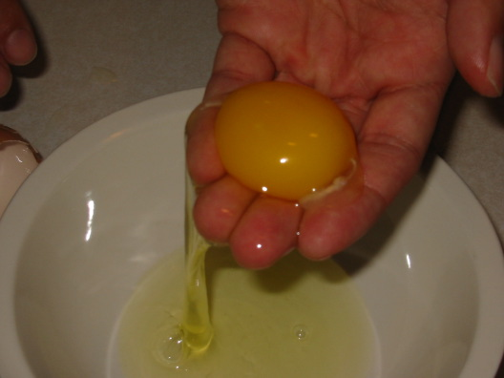
White
Albumen
In raw eggs appears opalescent
Does not appear white until it is beaten or cooked
Yellow or greenish cast in raw eggs may indicate the prescience of riboflavin
Cloudiness of the raw white is due to the presence of carbon dioxide that has not had time to escape through the shell and thus indicates a very fresh egg

Slide 88

Yellow
Color depends on the diet of the hen
Artificial color additives are not permitted
Gold or lemon-colored yolks are preferred by most buyers in the US
Yolk pigments are stable and are not lost or changed in cooking

Slide 89
Air Cell
Empty space between the white and the shell at the large end of the egg
When an egg is first laid it is warm, as it cools the contents contract and the inner shell membrane separates from the outer shell membrane, forming the air cell

Slide 90
Chalazas
Ropey strands of egg white that anchor the yolk in place in the center of the thick white
They are neither imperfections nor beginning embryos
The more prominent the chalazae the fresher the egg

Slide 91
Germinal Disc X
Channel leading to the center of the yolk
When the egg is fertilized sperm enter by the way of the germinal disc and travel to the center and a chick embryo starts to form

Slide 92
Membranes
2
Just inside the shell, inner and outer
After the egg is laid and begins to cool, an air cell forms between these two layers at the large end of the egg
The vitelline membrane is the covering of the yolk, its strength protects the yolk from breaking
The vitelline membrane is weakest at the germinal disc and tends to become more fragile as the egg ages

Slide 93
Composition (start)
Yolk (yellow)
  33% of the liquid weight of an egg
  Contains all the fat
  Little less than half the protein
  With the exception of riboflavin and niacin the yolk contains a higher proportion of the egg’s vitamins than the white
  Also contains more phosphorus, manganese, iron, iodine, copper and calcium

Slide 94
Composition
White
  More than half the protein, niacin, riboflavin, chlorine, magnesium, potassium, sodium, sulfur

Slide 95
Grading
Classification is determined by interior and exterior quality
Designated by the letters AA, A, B
In many packing plants USDA provides a grading service for shell eggs
Not mandatory

Slide 96
Grading Process
Eggs are examined for both interior and exterior quality
Sorted according to weight (size)
Grade quality and size are not related
No difference in nutritive value exists between different grades
However almost no grade B eggs find their way to the retail supermarket, they go to egg users such as bakeries or food service operations and to egg breakers for use in egg products

Slide 97
Grade AA
When cracked onto a surface a grade AA egg will stand up tall
Yolk is firm
Area covered by the while is small
Large proportion of thick white to thin white exists
The shell approximates the usual shape for an egg
Generally clean and unbroken
Ridges/rough spots that do not affect the shell strength are permitted

Slide 98
Grade A
When cracked covers a relatively small area
Yolk is round and upstanding
Thick white is large in proportion to the thin white and stands fairly well around the yolk
Shell approximates the usual shape for an egg
Generally clean and unbroken
Rideges/rough spots that do not affect the shell strength are permitted

Slide 99
Grade B
When cracked, spreads out more
Yolk is flattened
About as much (or more) thin white as thick white
Shell has an abnormal shape
Some slightly stained eggs are permitted
Unbroken
Pronounced ridges/thin spots are permitted

Slide 100
Size
Several factors influence size
Major factor is the age of the hen
  As hens age their eggs increase in size
Breed is the second factor
Weight of the bird
Environmental factors
Egg sizes are: Jumbo, Extra Large, Large, Medium, Small and Peewee
Medium, Large and Extra Large are the sizes most commonly available

Slide 101
Weight Classes for Shell Eggs
Size | Weight per Dozen (oz)
Jumbo | 30
Extra Large | 27
Large | 24
Medium | 21
Small | 18
Peewee | 15

Slide 102
Blood Spots
Occasionally found on yolk
Do not indicate a fertilized egg
Caused by the rupture of a blood vessel on the yolk surface during the formation of the egg or by a similar accident in the wall of the oviduct
Less than 1% of all eggs produced have blood spots

Slide 103

Storing Eggs
Can be stored at 30 degrees F for up to 6 months in the shell
They can be frozen out of the shell for extended storage

Slide 104
Salmonella
Inside of the egg was once considered sterile
Recently Salmonella enteritidis has been found inside some eggs
FDA now warns consumers that eggs are perishable and should be kept refrigerated and sanitary handling methods used

Slide 105

Fertile Eggs
Can be incubated and will develop into chicks
Not more nutritious than nonfertile eggs
Do not keep as well as nonfertile eggs
More expensive to produce

Slide 106
Organic Eggs
Come from hens that are fed rations that were grown with pesticides, fungicides, herbicides or commercial fertilizers
No commercial laying hen rations ever contain hormones
Due to higher production costs and lower volume per farm organic eggs are more expensive
Nutrient content is not affected by whether or not the ration is organic

Slide 107
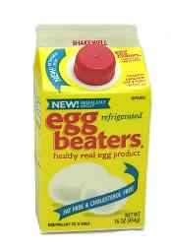
Egg Substitutes
Industry’s response to consumer concerns over cholesterol
Have taken the approaches to reducing the cholesterol in the eggs from physically separating the cholesterol to formulating yolks from other products and combining them with albumen
Also working on changing the genetics of chickens so that they produce the type of egg desired

