Slide 1
Plant anatomy and growth

Slide 2
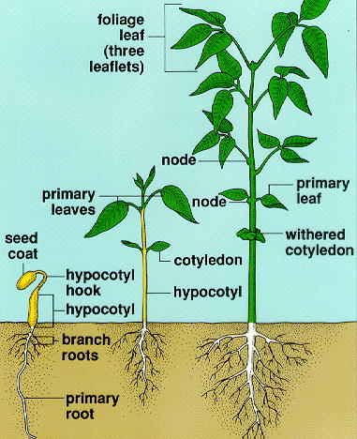
STAGES OF PLANT GROWTH & DEVELOPMENT
Seed germination
Vegetative
Reproduction

Slide 3
GOOD SEED GERMINATION REQUIREMENTS
Proper temperature
Sufficient moisture
Ample supply of oxygen

Slide 4
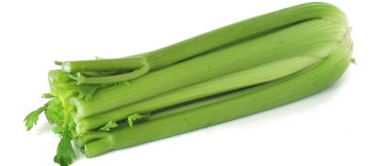
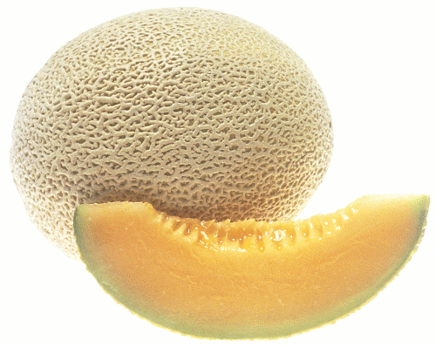
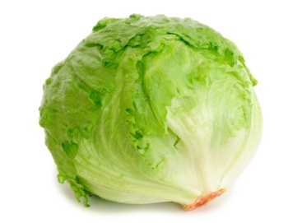
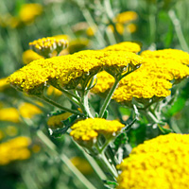
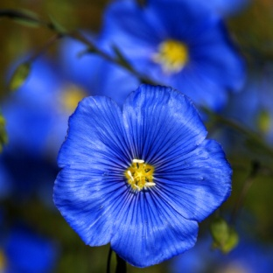
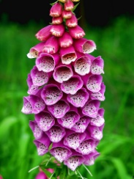
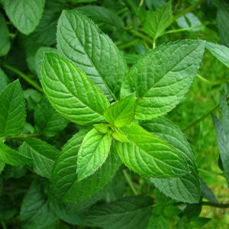
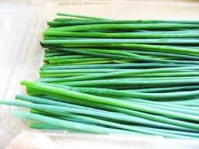
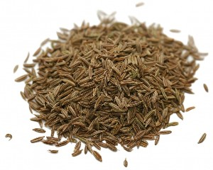
Types of seeds
Vegetable seeds
Examples: Celery, Cantaloupe, lettuce
Flower seeds
Examples: Foxglove, Gold Yarrow, Blue Flax
Herbs seeds
Examples: Peppermint, Cumin, Chives

Slide 5
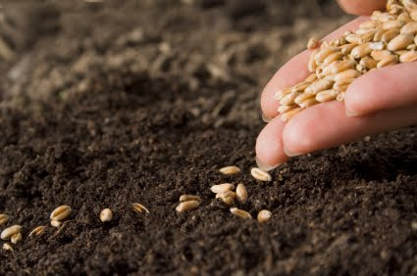
Functions of seeds
Nourishment of the embryo
Dispersal to a new location
Dormancy during unfavorable conditions

Slide 6
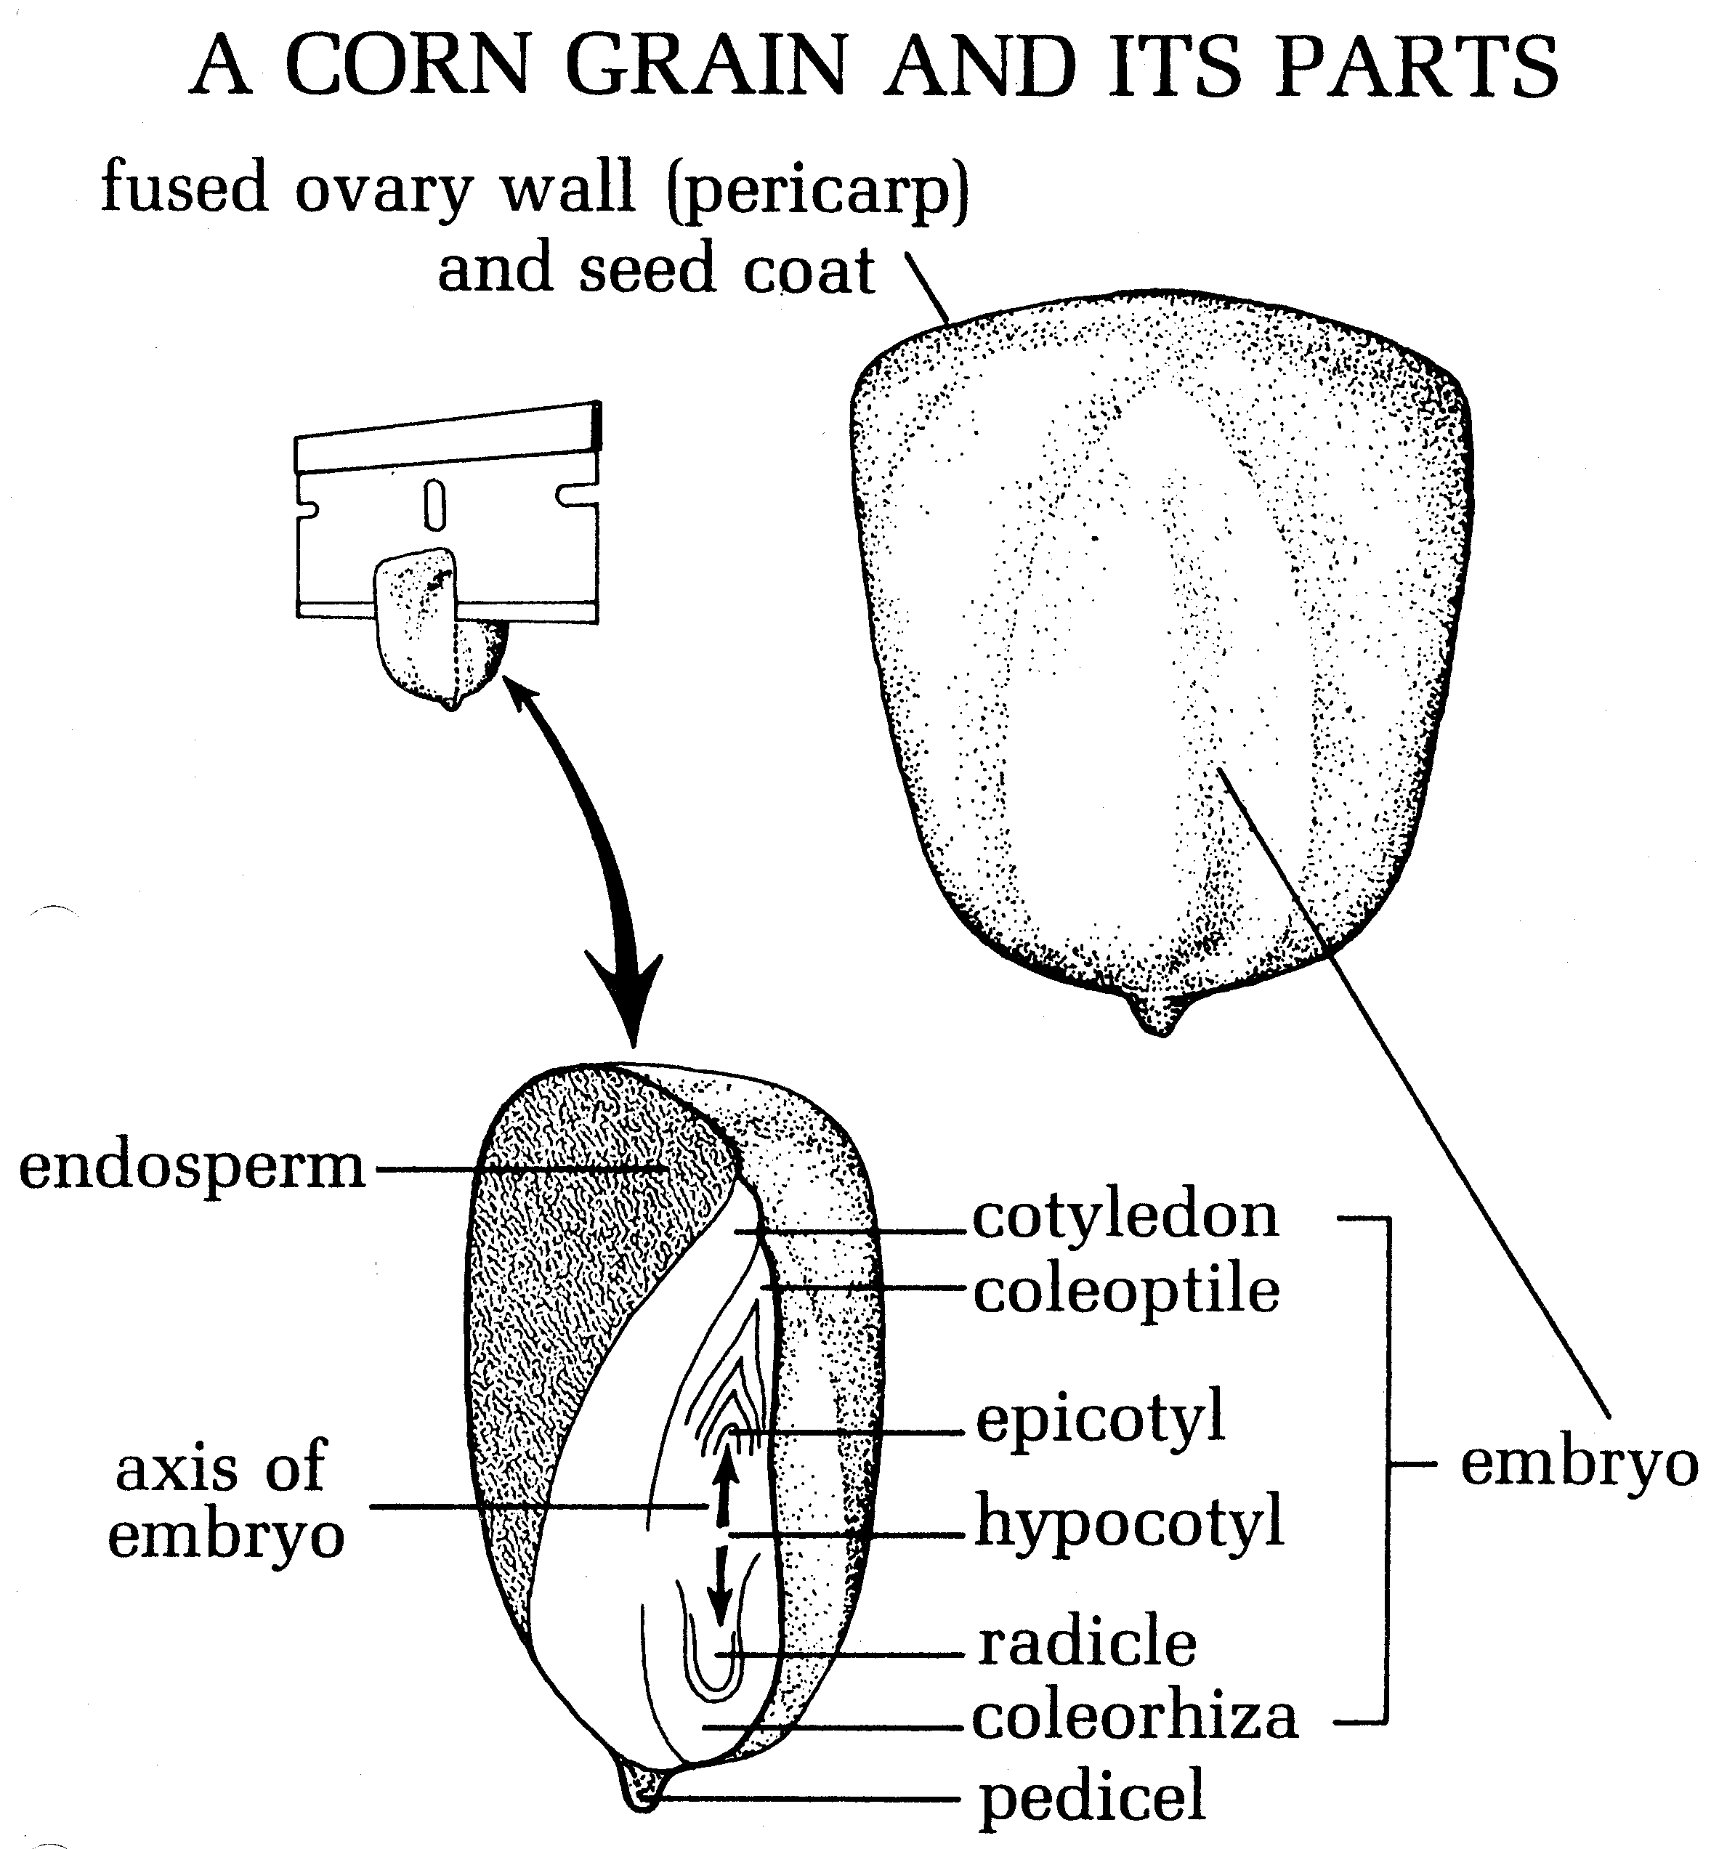
Parts of seed
Monocots
Epicotyl
Hypocotyl
Radicle
Cotyledon
Coleoptile
Endosperm
Seed coat

Slide 7
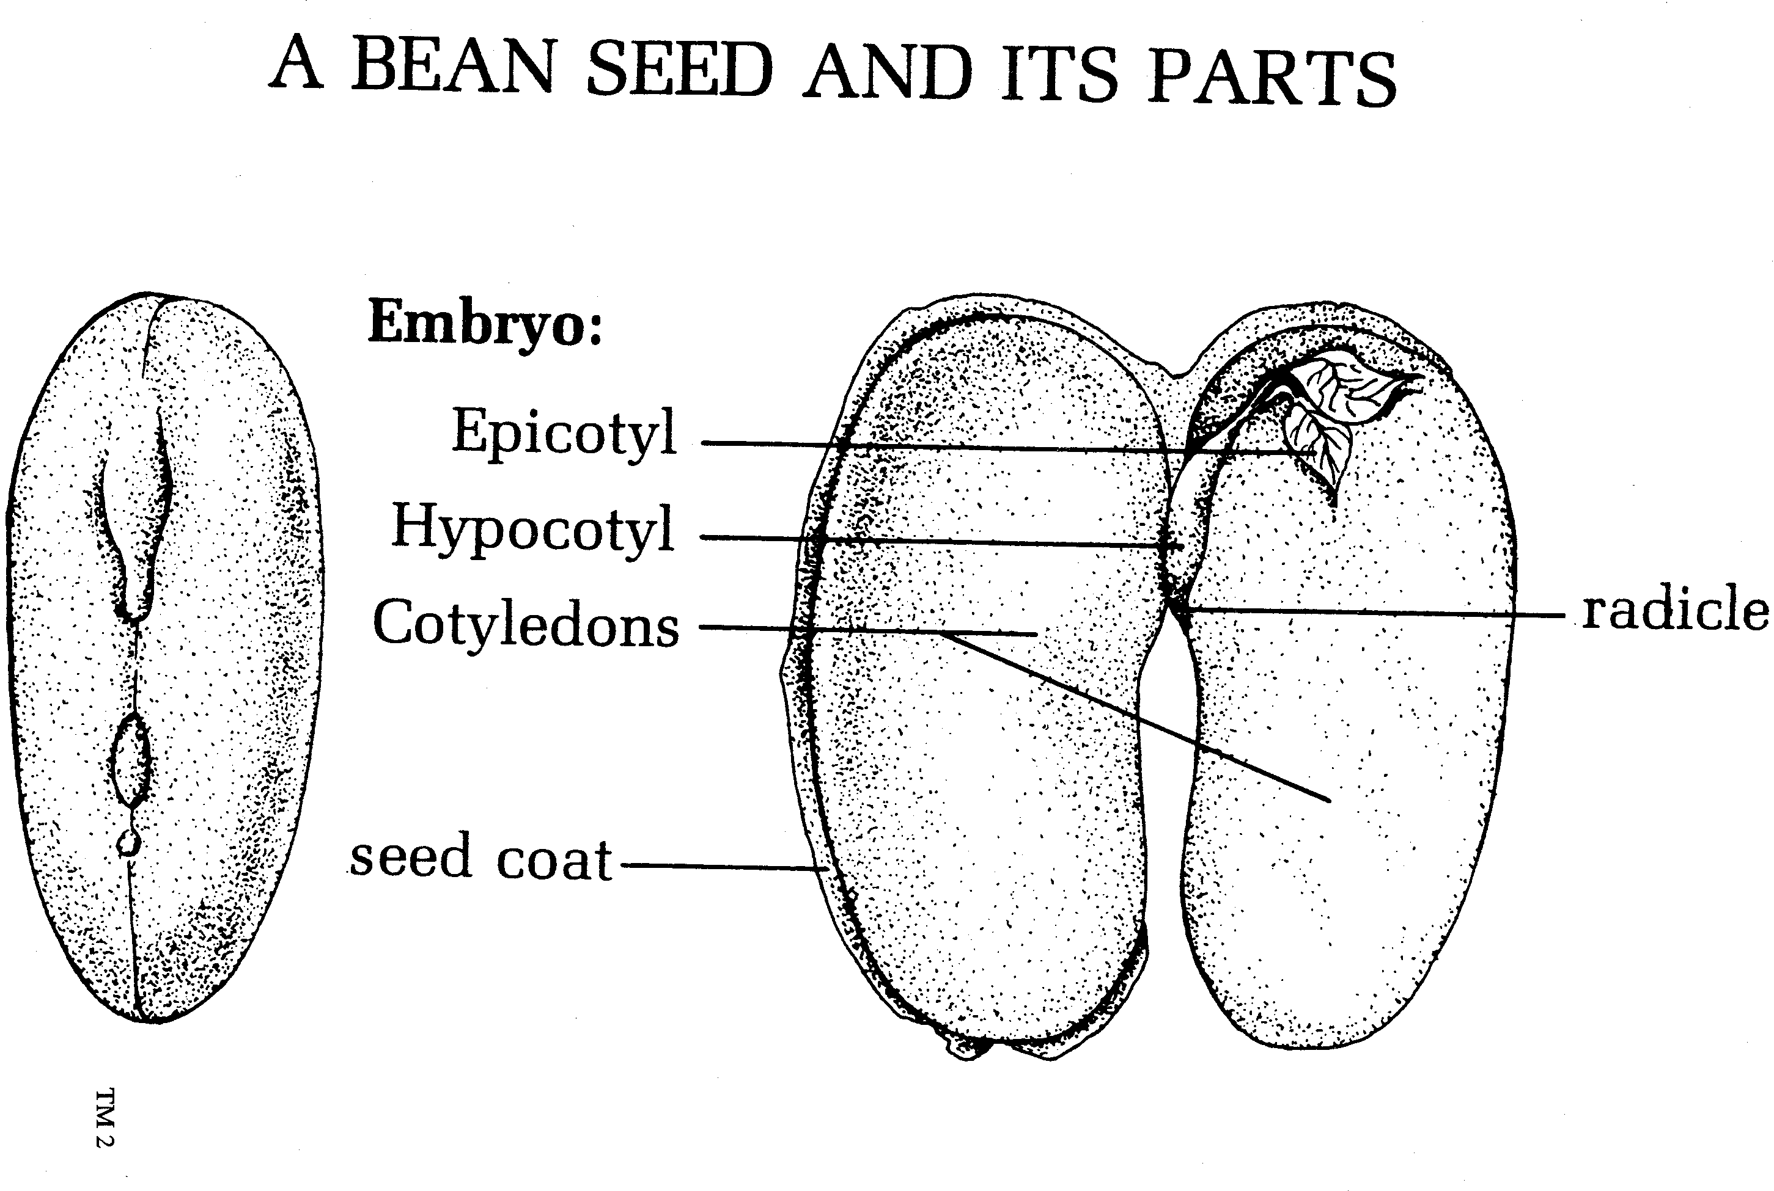
Parts Of seed
Dicot
Epicotyl
Hpocotyl
Radicle
Cotyledons
Seed coat

Slide 8
Monocot stages of germination
Absorption of water and oxygen into seed
Seed coat ruptures and the primary root (radicle) begins to grow downward
Epicotyl elongates, coleoptile piercing the soil as it grows upward
Coleoptile unfolds

Slide 9
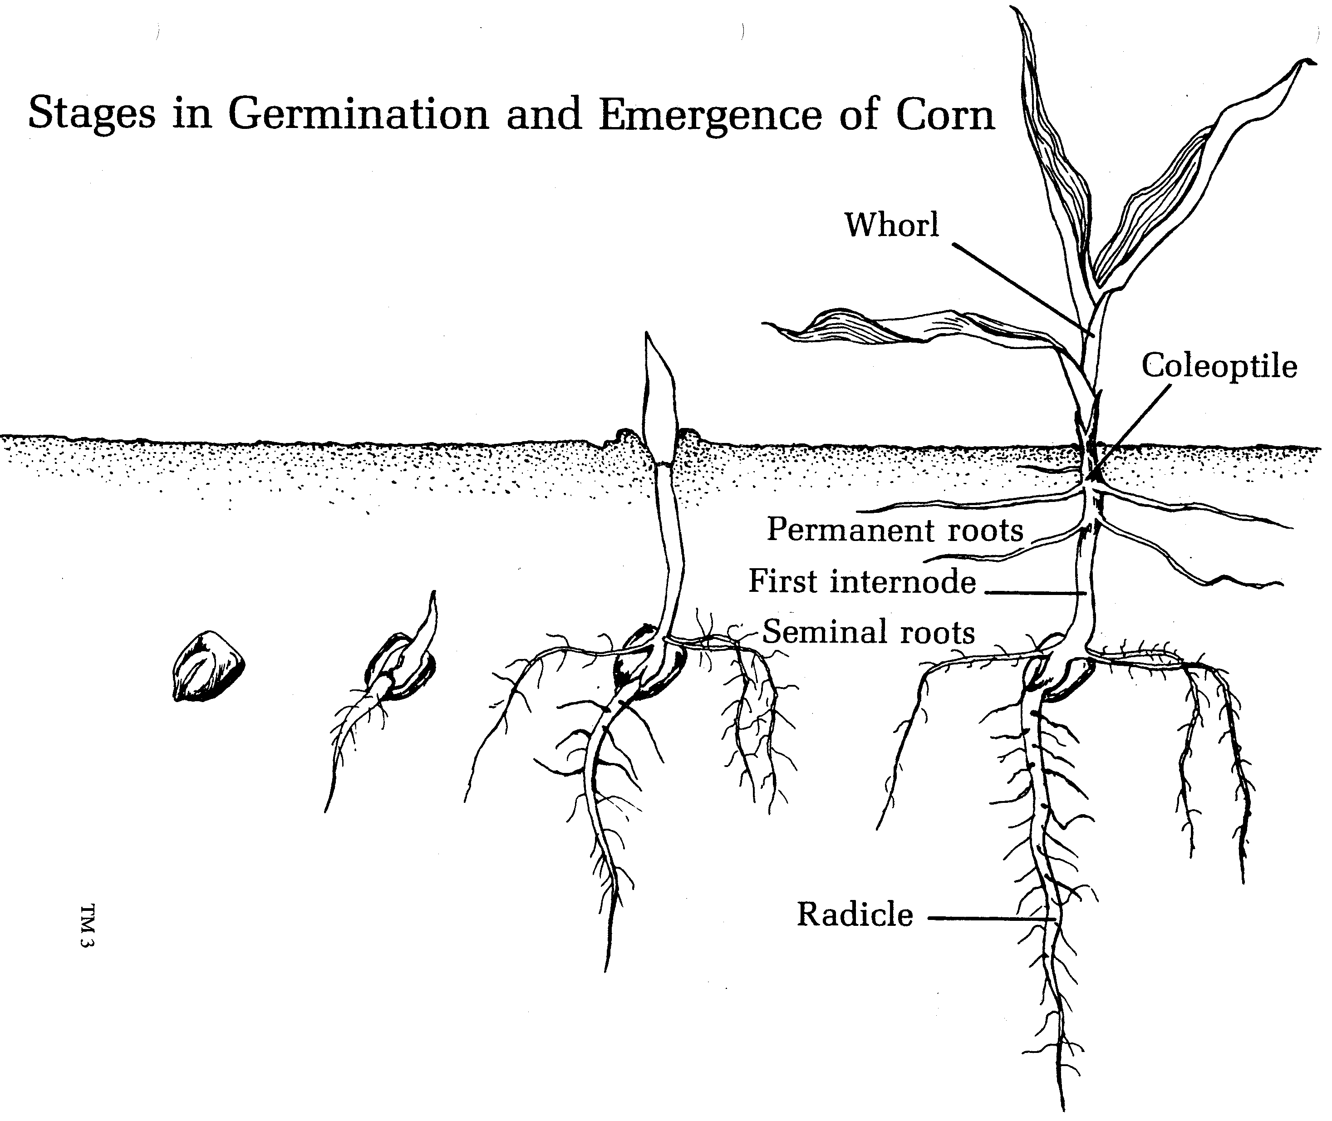

Slide 10
Dicot stages of germination
Absorption of water and oxygen into seed
Seed coat ruptures and the primary root (radicle) begins to grow downward
Hypocotyl curves into a loop and pushes through the soil, pulling the cotyledons toward the soil surface
Emergence of seedling occurs
Cotyledons spread apart and the stem tip is exposed to air and sunlight

Slide 11
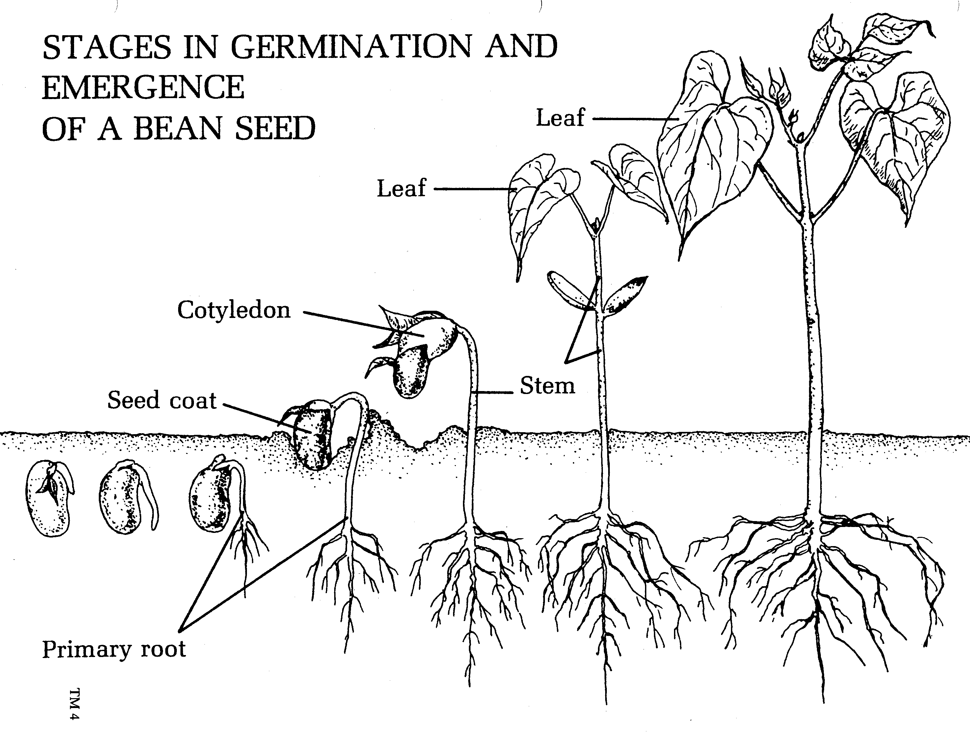

Slide 12
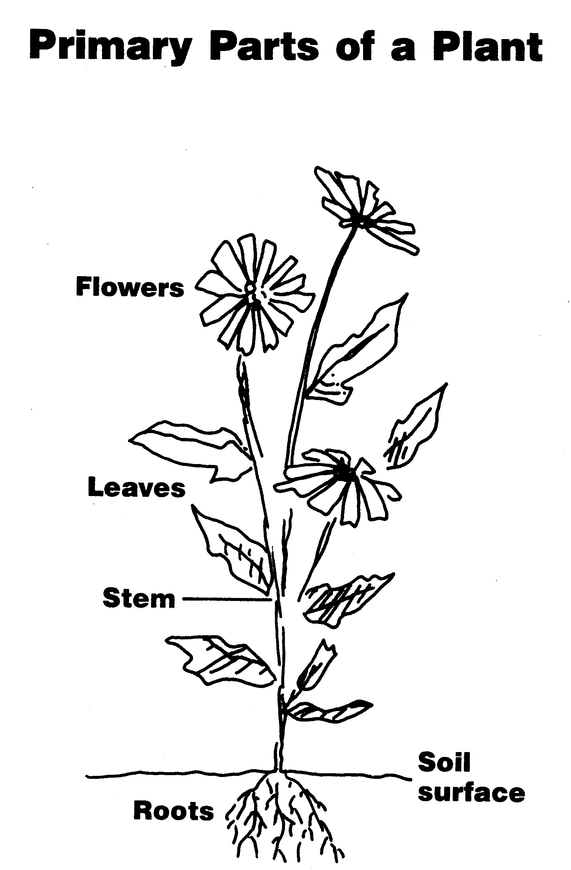
Primary plant parts
Roots
Stem
Leaves
flowers

Slide 13
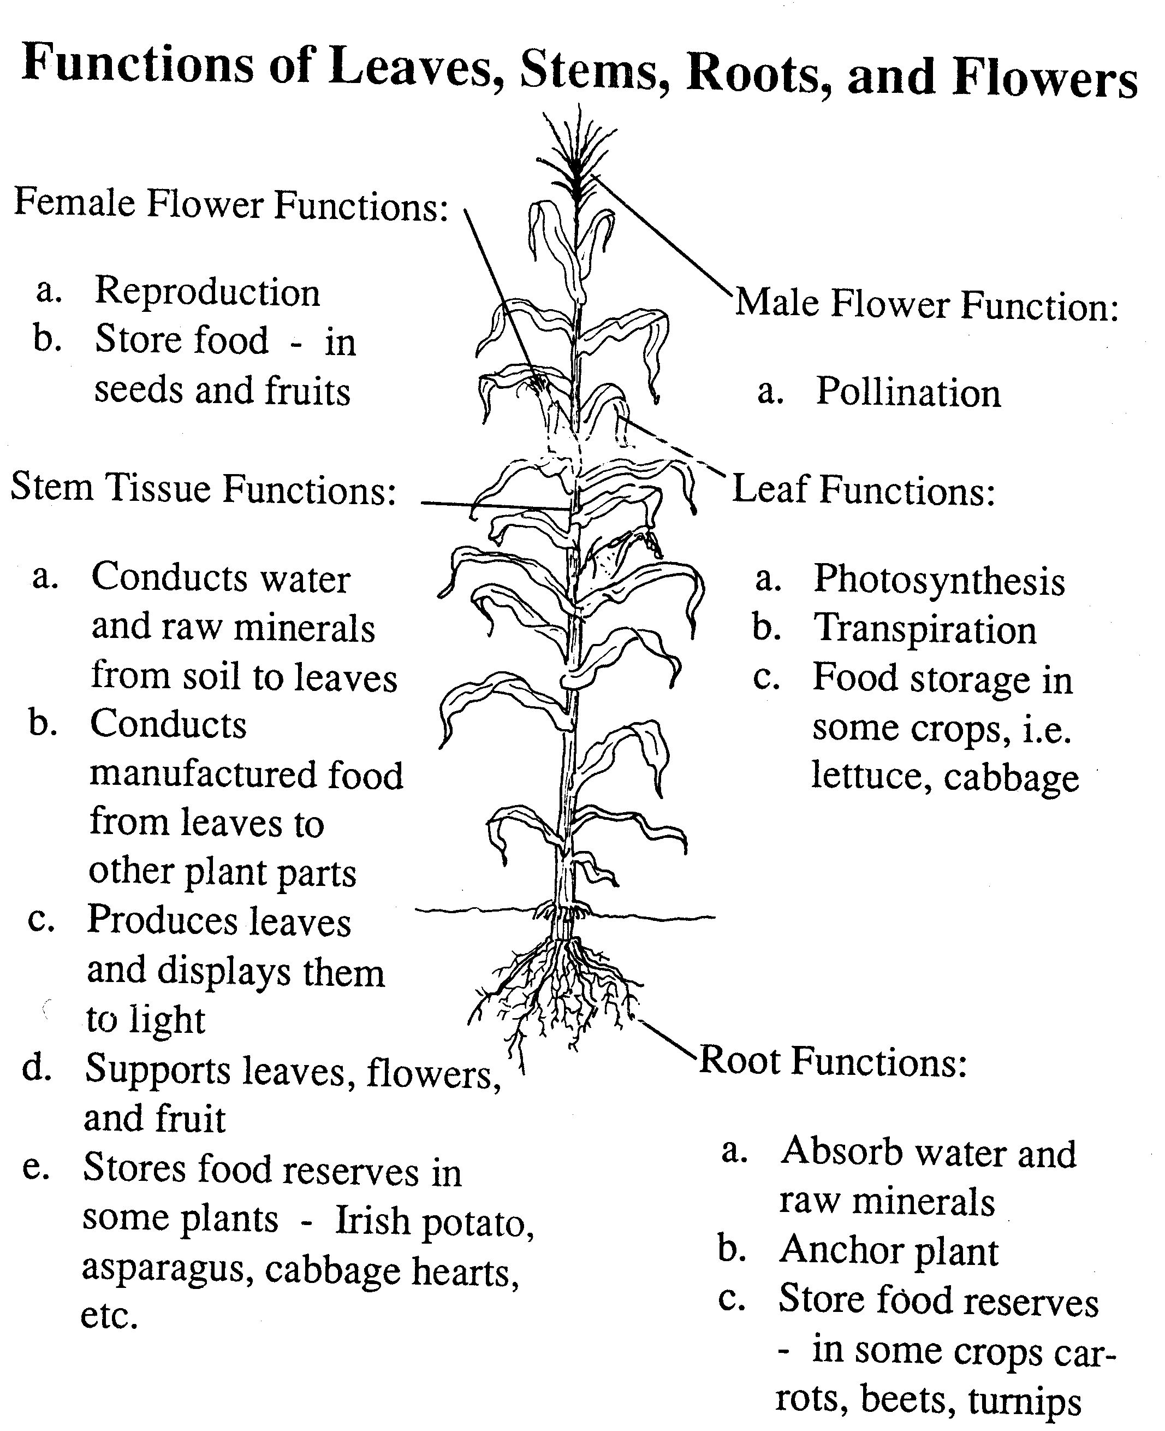

Slide 14
Functions of plant parts
roots
stem
Absorb water
Anchor and support plants
Stores food
Supports leaves, flowers, fruit, and seeds
Conducts water, nutrients, and food
Stores food

Slide 15
Functions of plant parts
leaves
flowers
Manufacture food for the plant
Necessary for transpiration
Store food
Serves as site of reproduction
Store food

Slide 16
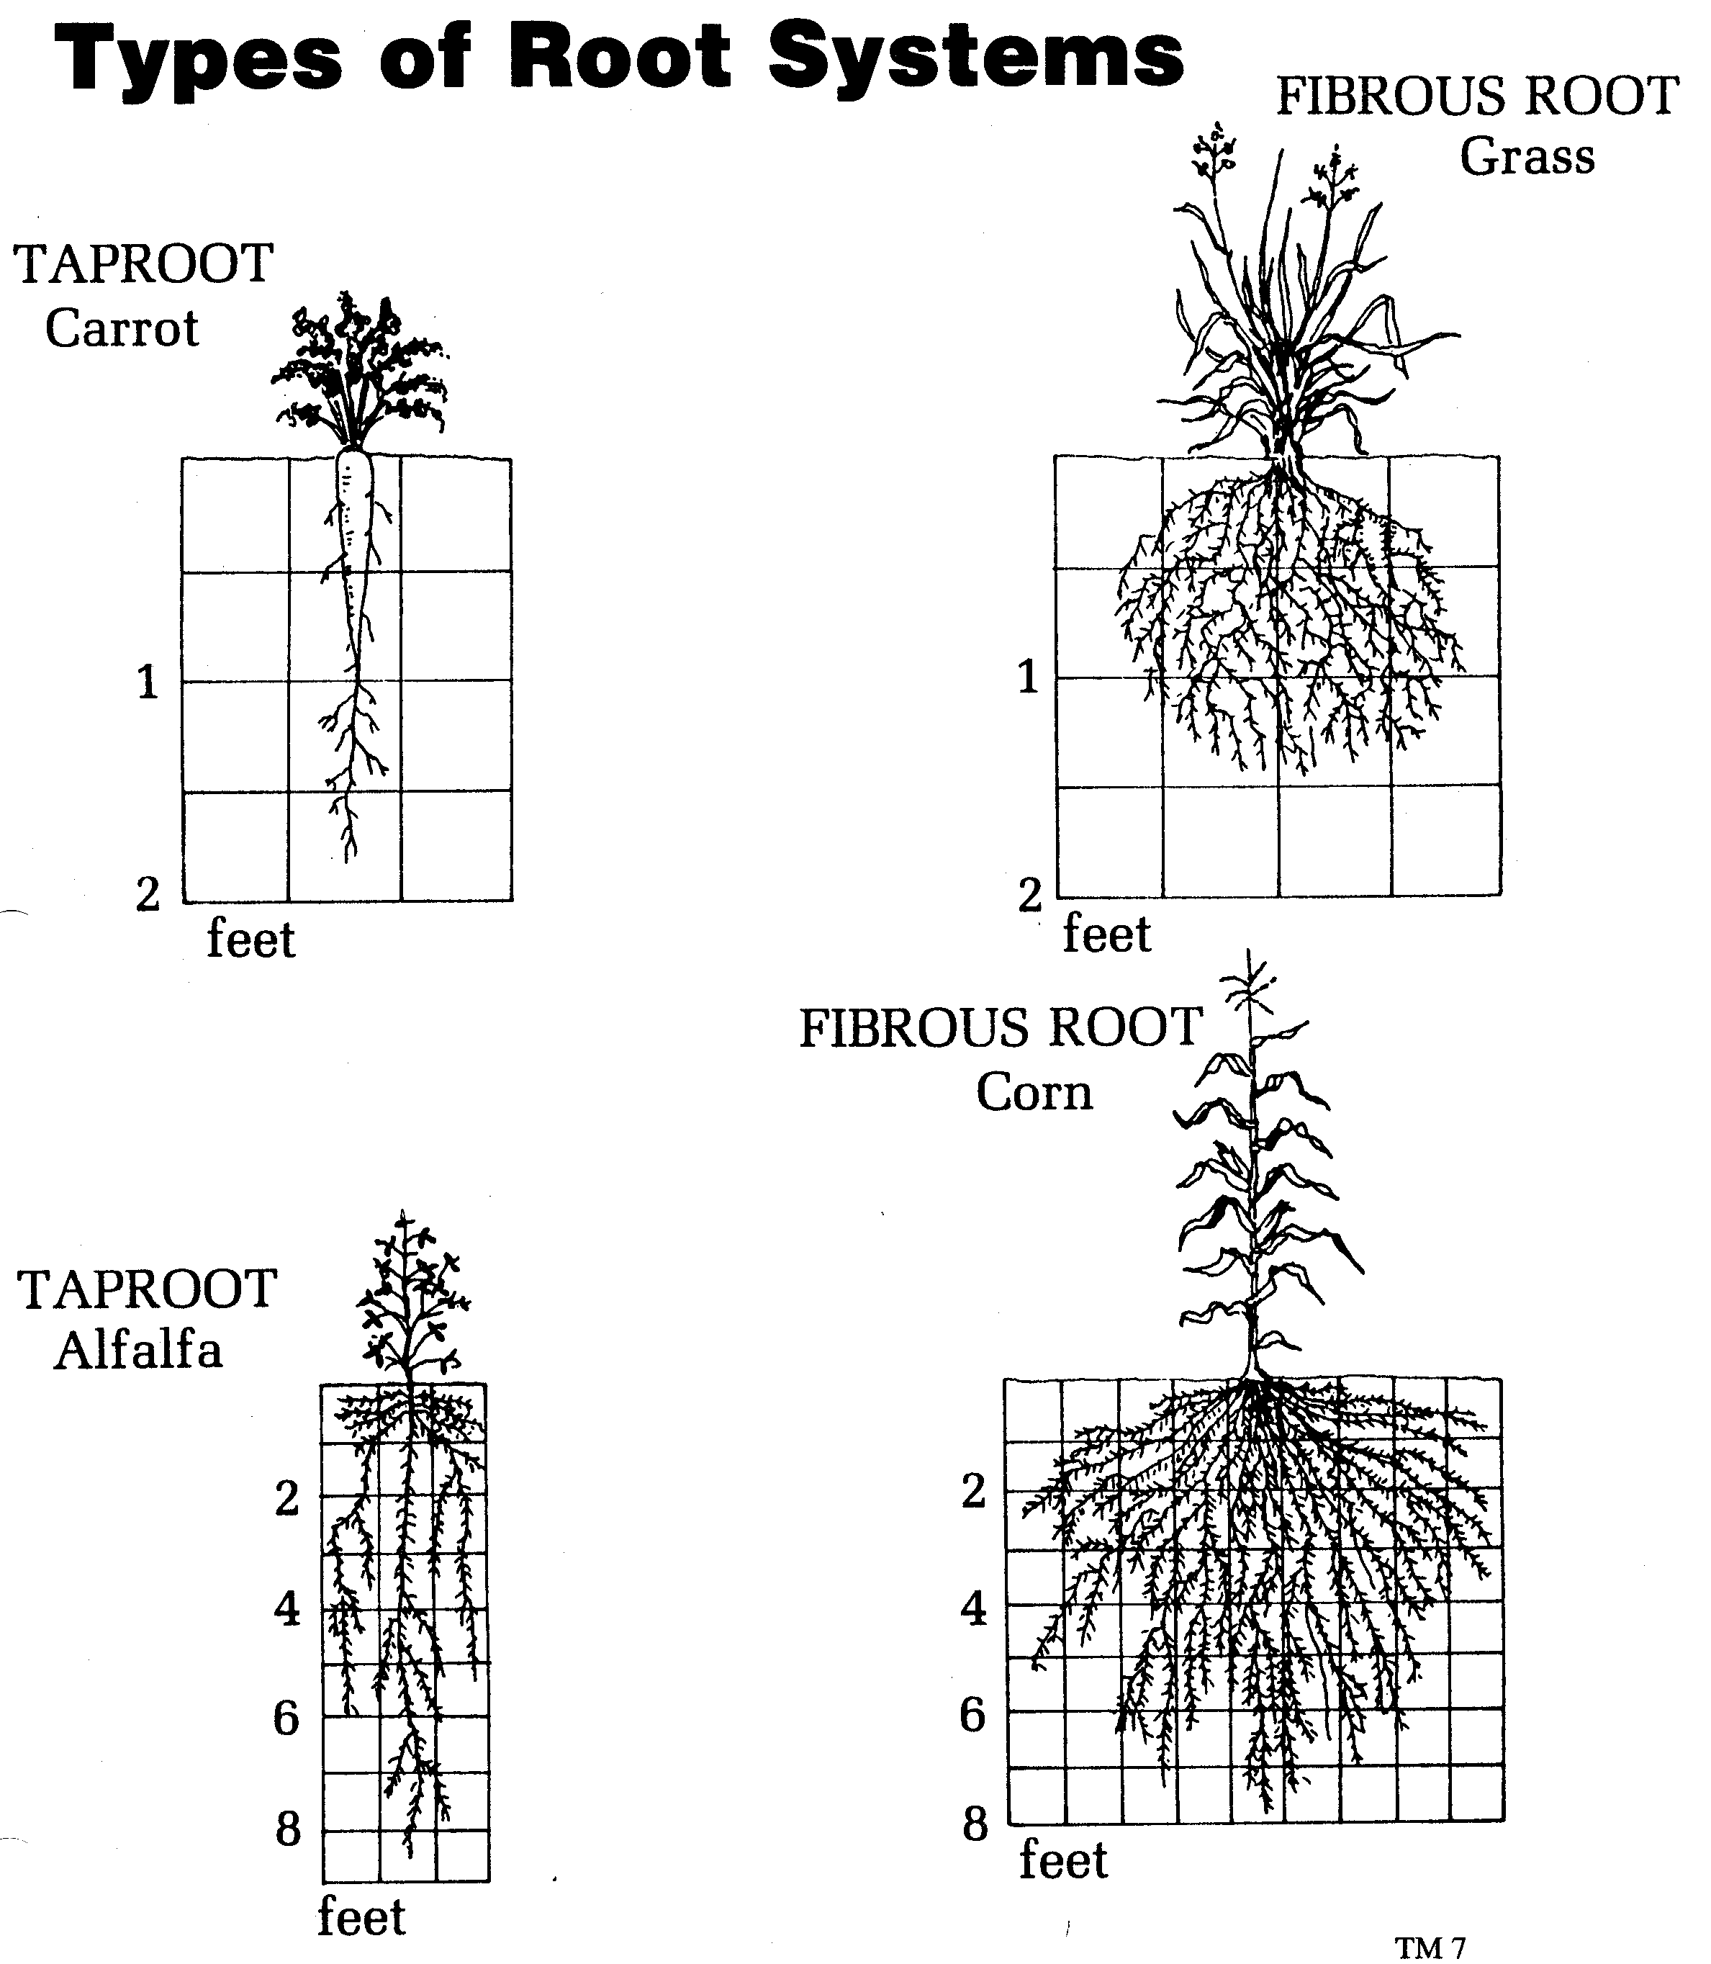
Types of root systems
Tap root system-one root larger than the others
Fibrous root system- all roots about the same size

Slide 17
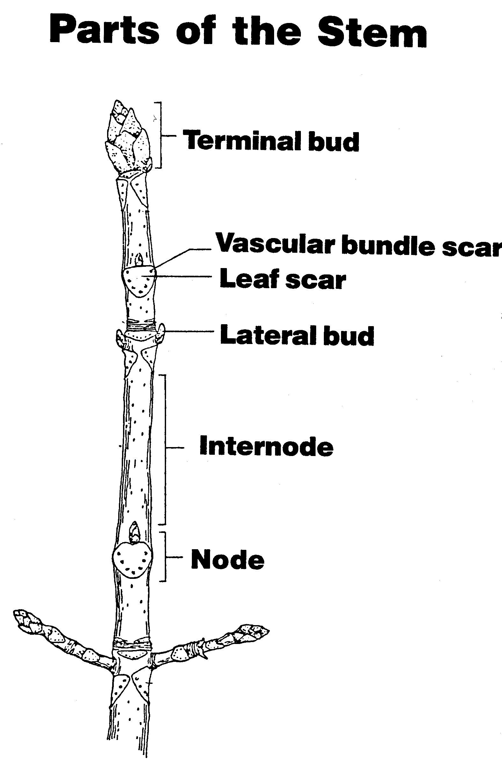
Parts of the stem
Node
Internode
Terminal bud
Lateral bud
Leaf scar
Vascular bundle scar

Slide 18
Types of stems
Herbaceous stems
Examples: Annual plants, and Vivacious plants
Ligneous stems
Examples: Trees, Shrubs, Bushes

Slide 19
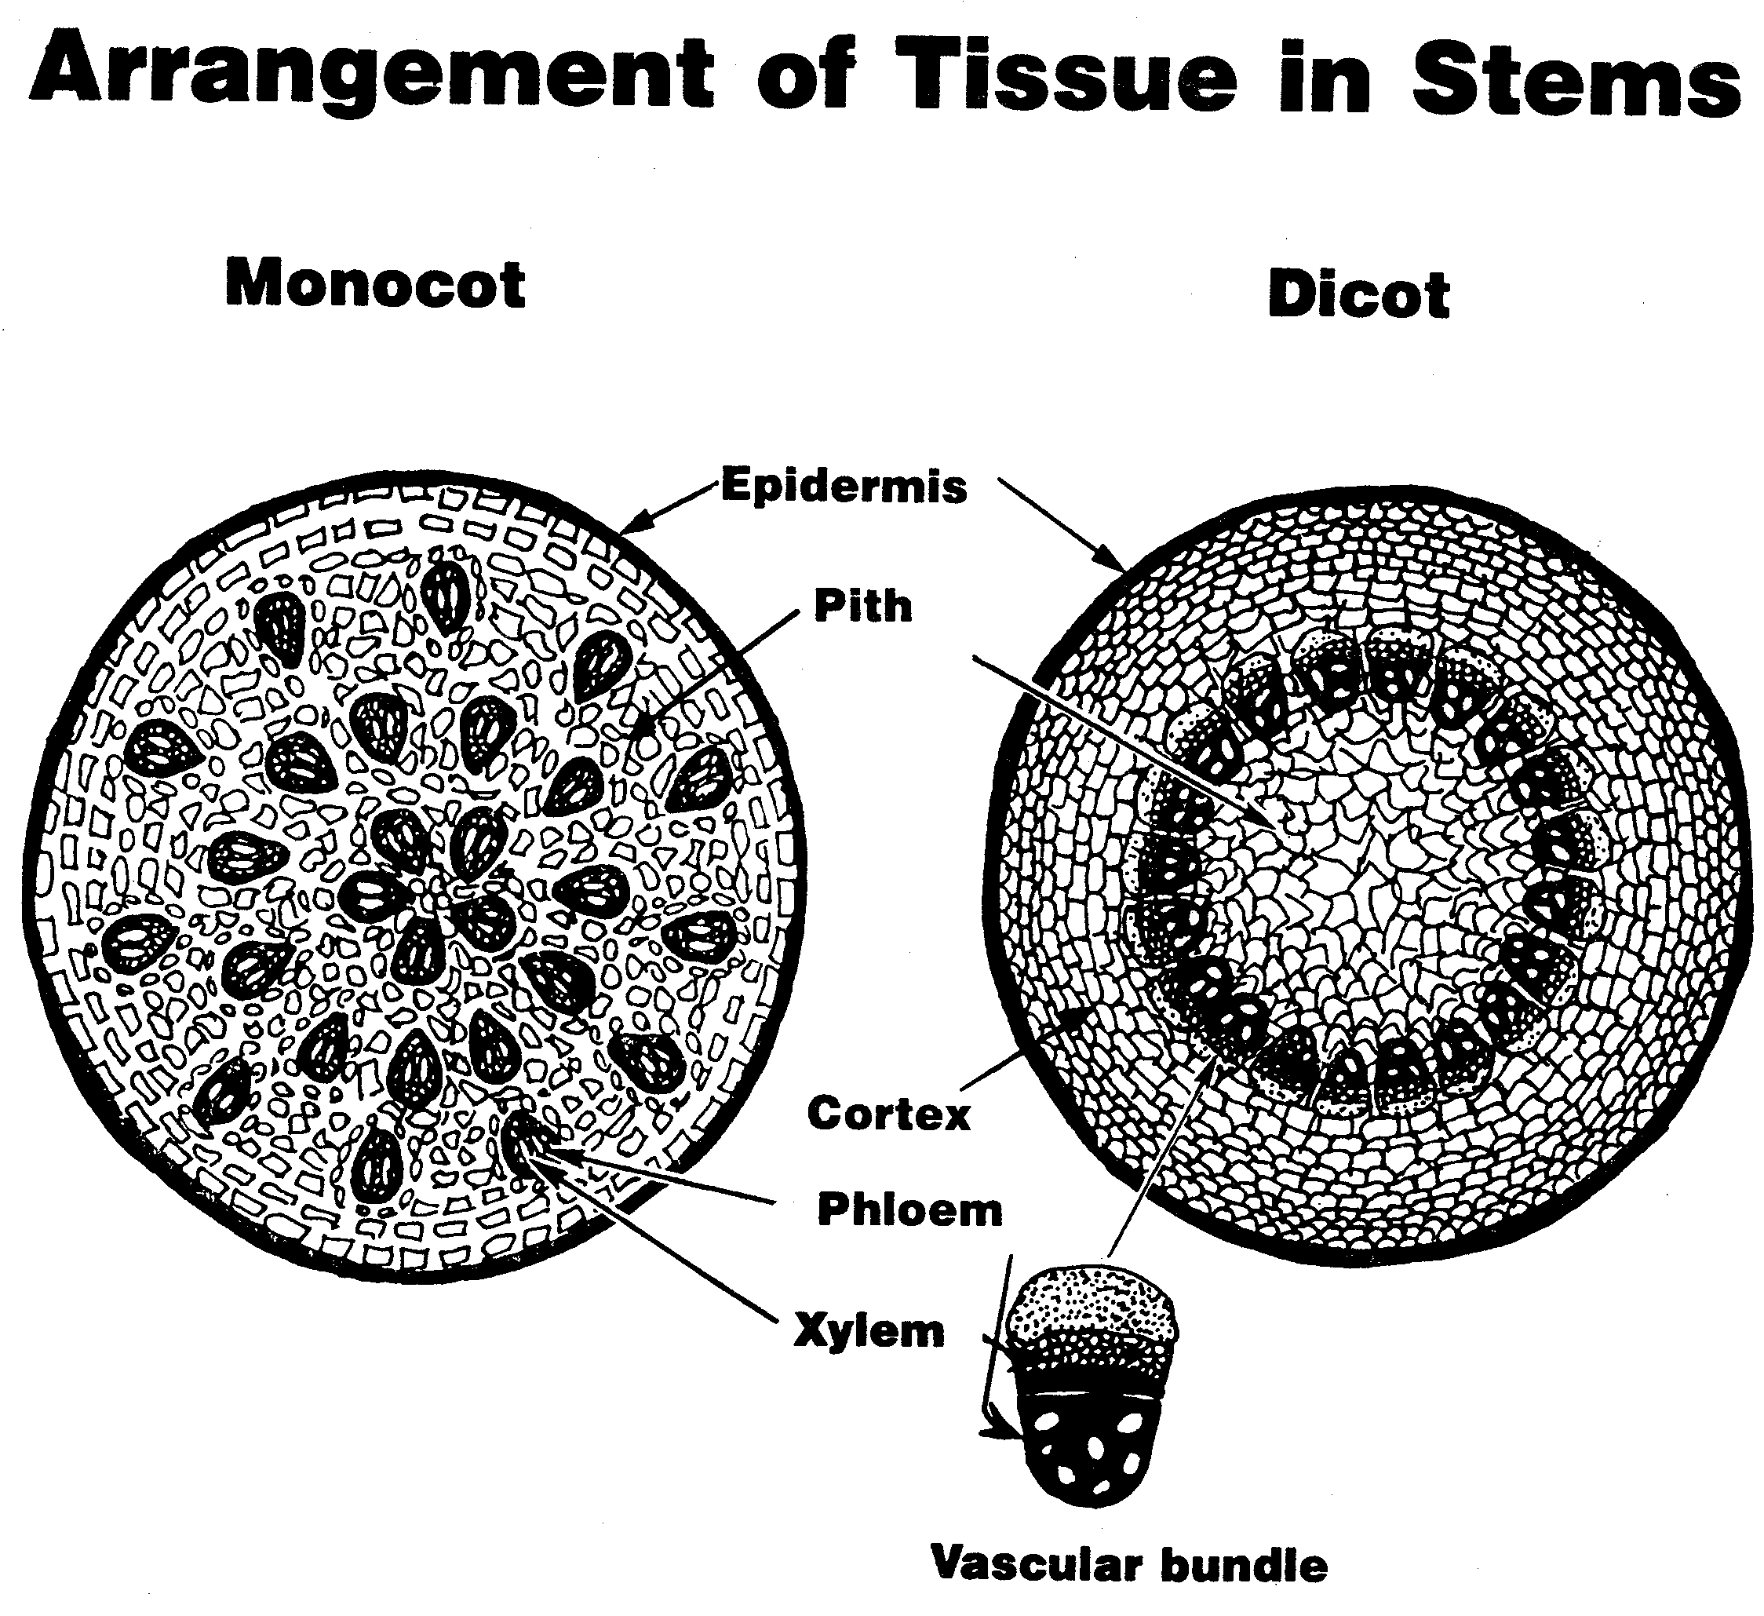

Slide 20
Tissue in a stem
monocots
dicots
Epidermis
Pith
Vascular bundles
Epidermis
Cortex
Vascular bundles
Pith

Slide 21
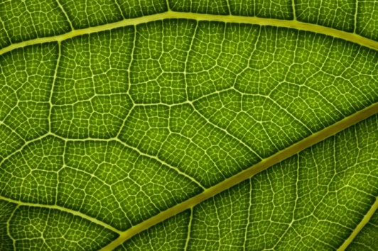
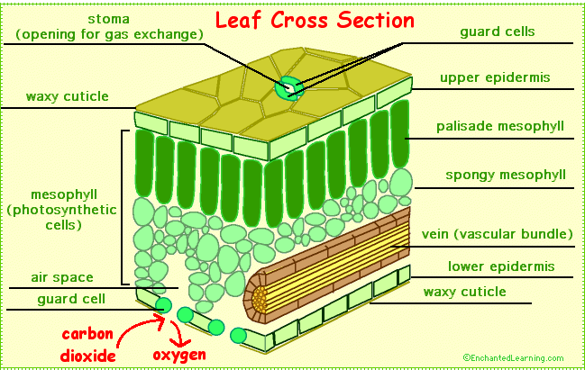
Structure of a leaf
A leaf is made up of many layers that are sandwiched between two layers of tough skin cells. They are called epidermis. These layers protect the leaf from insects, bacteria, and other pests.

Slide 22
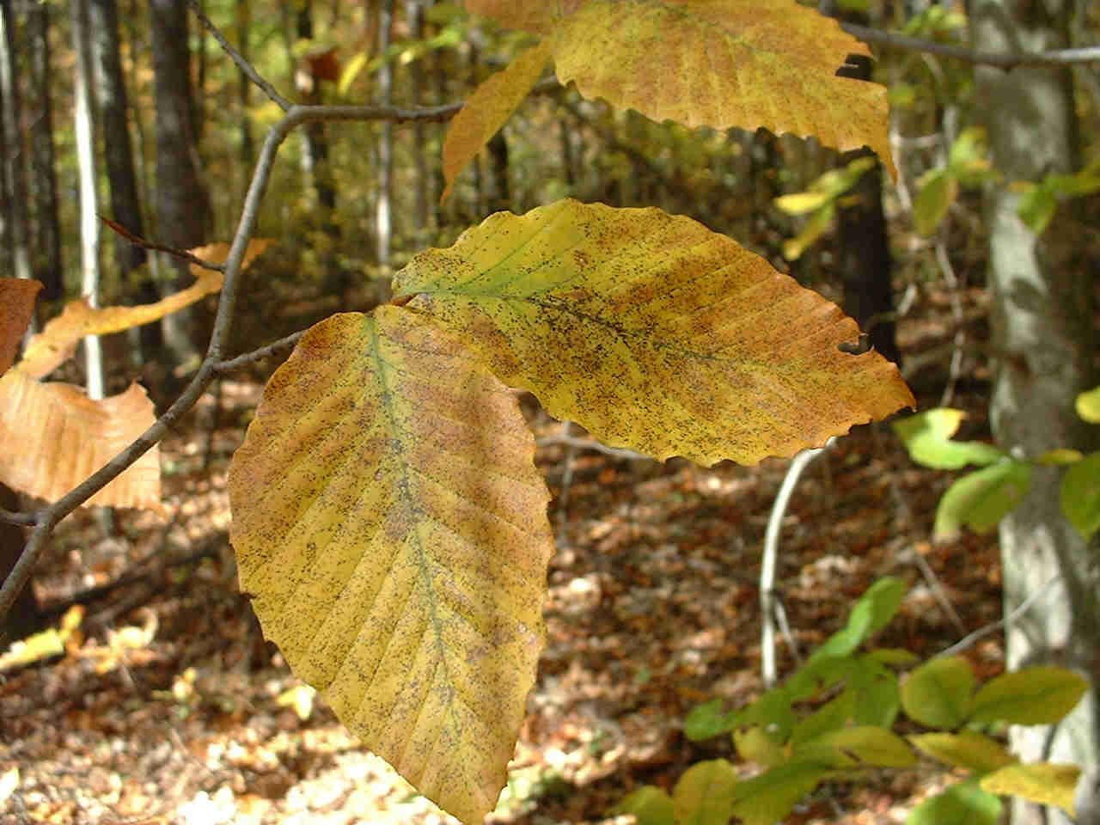
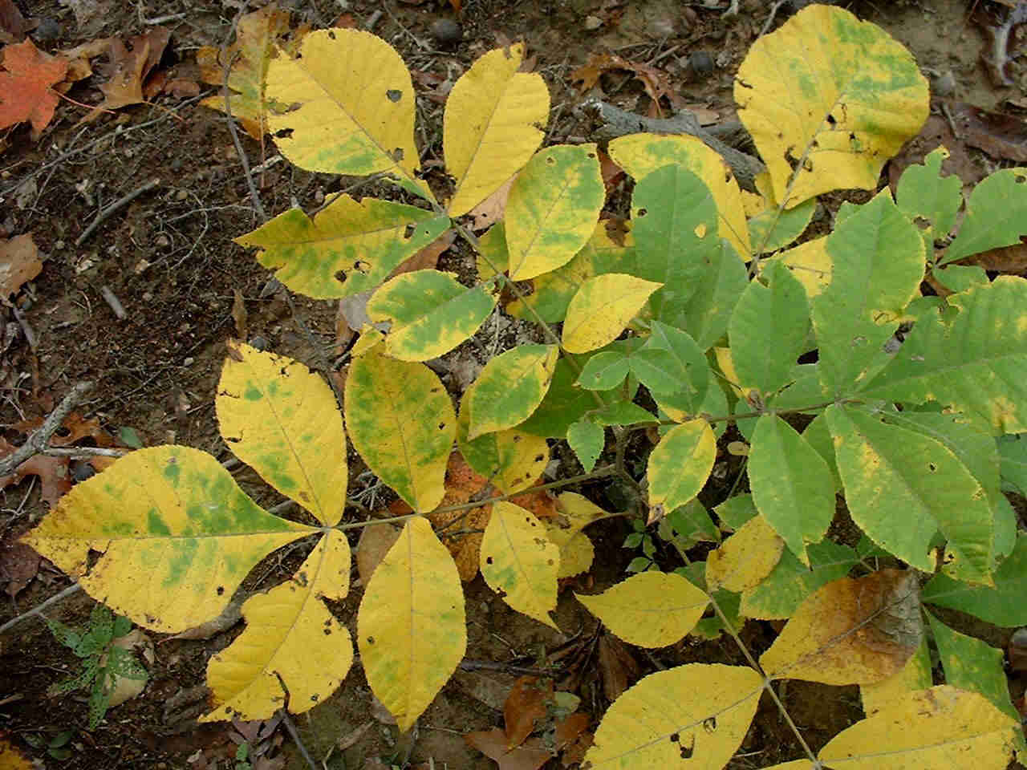
Leaf types
Simple leaf- consists of a single blade, not dissected into separate leaflets, but may have teeth or lobes.
Compound leaf- Leaf dissected into many smaller leaf like structures; there is a lateral bud at the base of a compound leaf but not at the base of a leaflet.

Slide 23
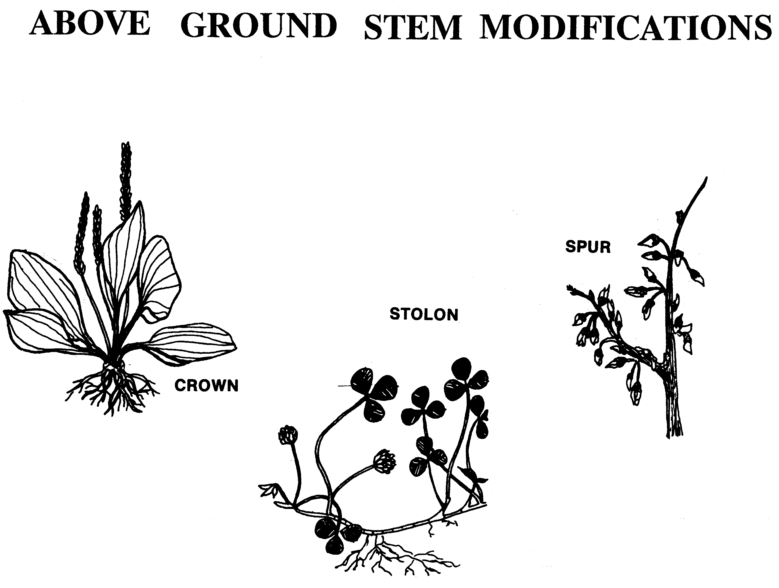

Slide 24
Above ground stem modifications
Crown- appears just above or just below ground level from which modified stems grow. This type of growth is common in soil grains.
Stolon- runners that grow along top of soils surface. This growth common in strawberry plants and clover
Spur- appears laterally on branches of fruit trees and bears fruit

Slide 25
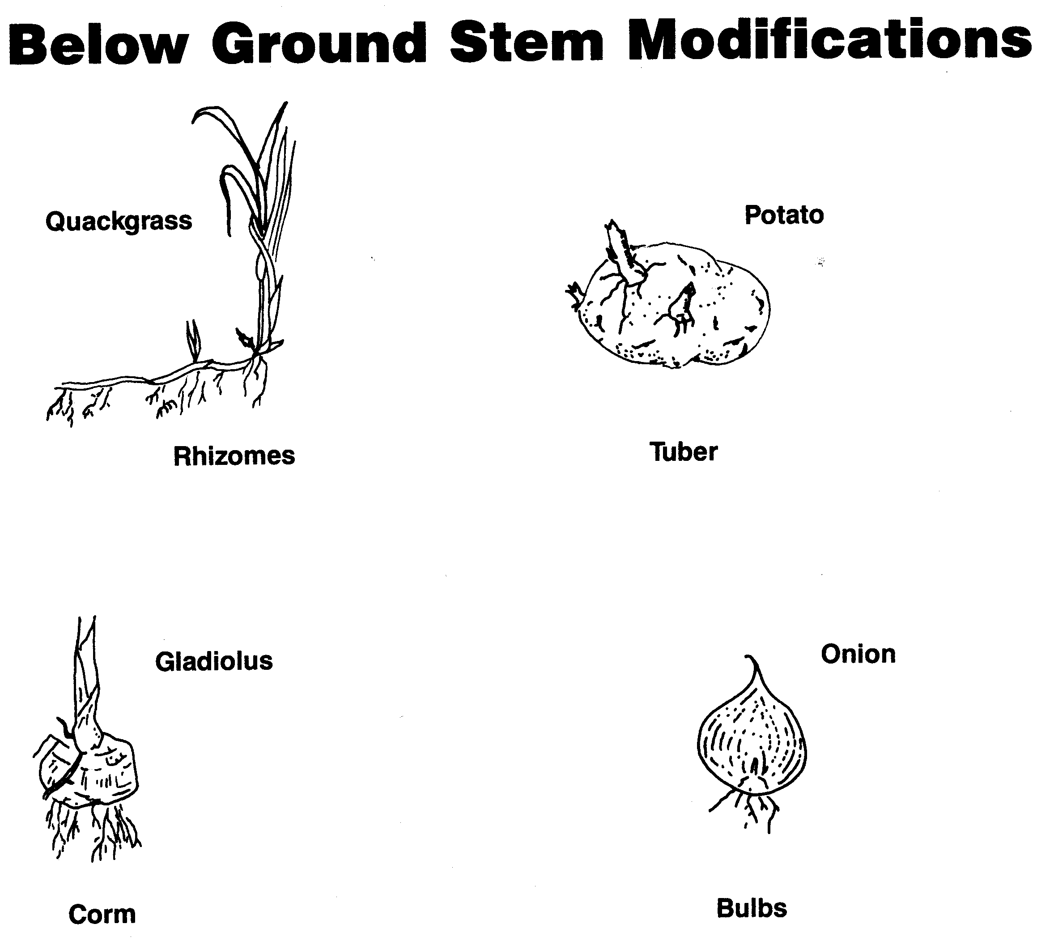

Slide 26
Below ground stem modifications
Rhizome- underground stems that grow horizontally below soil surface commonin bluegrass, brome grass, quack grass, and canada thistle
Tuber- enlarged fleshy parts found at tip of rhizome common to potatoes
Corn- fleshy, short underground stems with very few buds common to timothy and gladiolus
Bulb- short disc-shaped stem surrounded by leaf-like scale structures common to onion and garlic

Slide 27
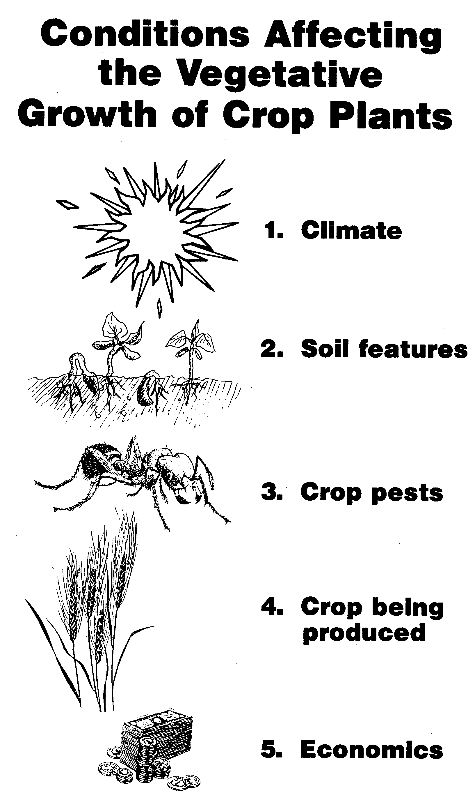

Slide 28
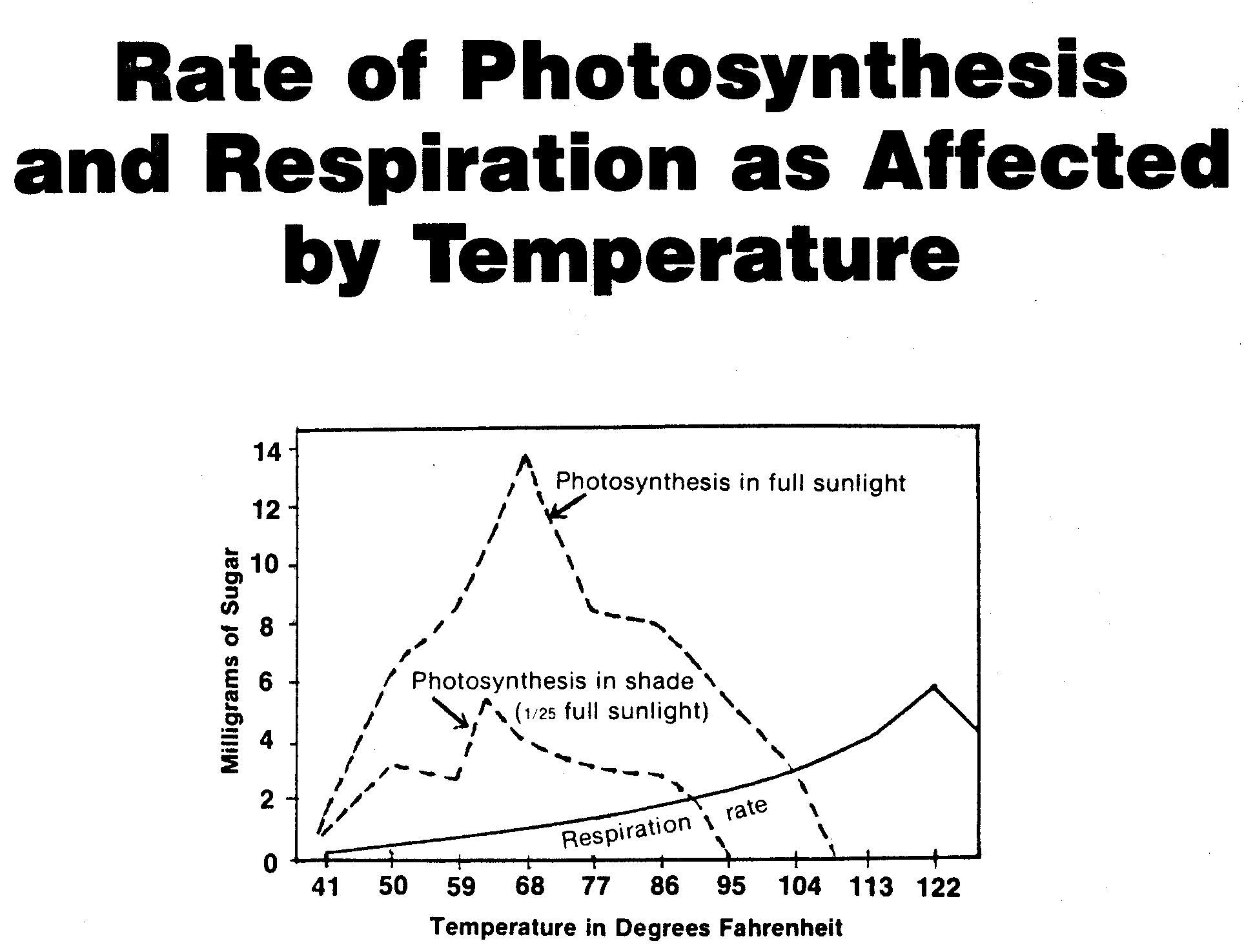
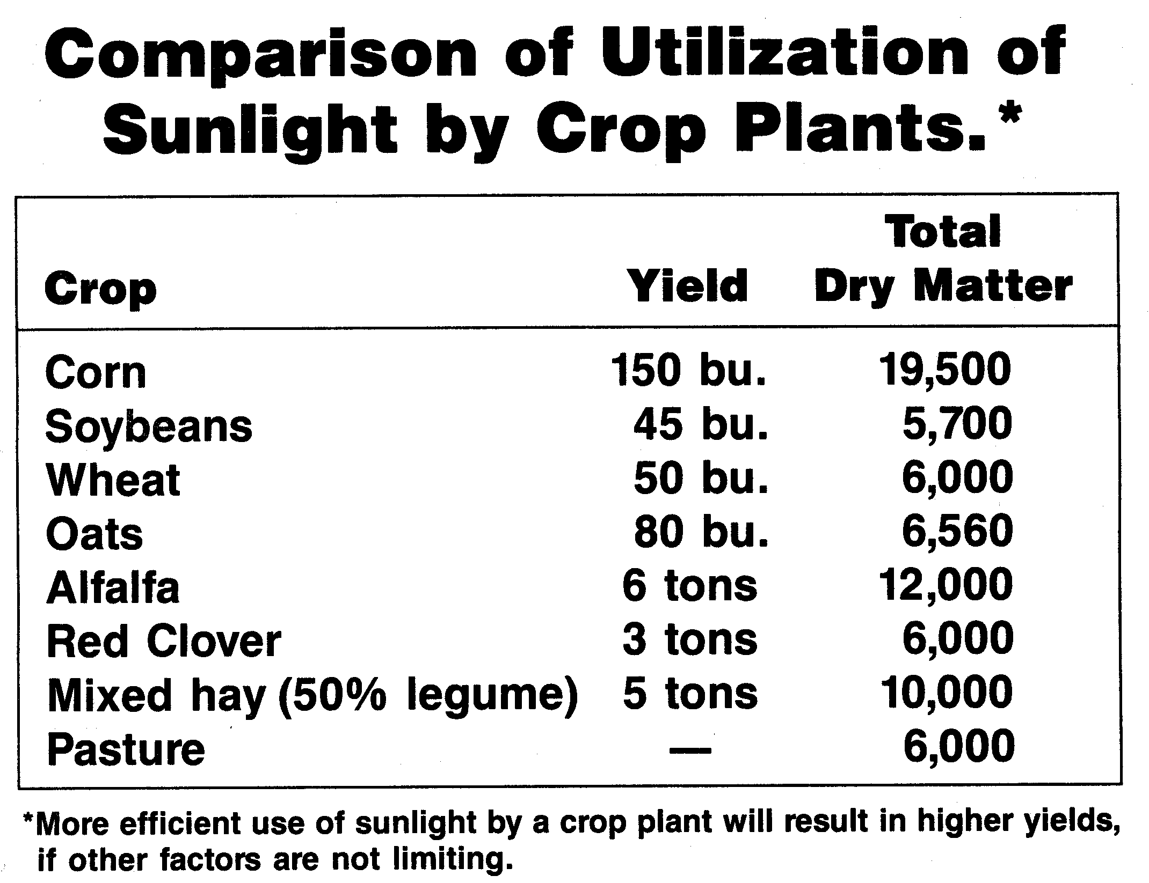
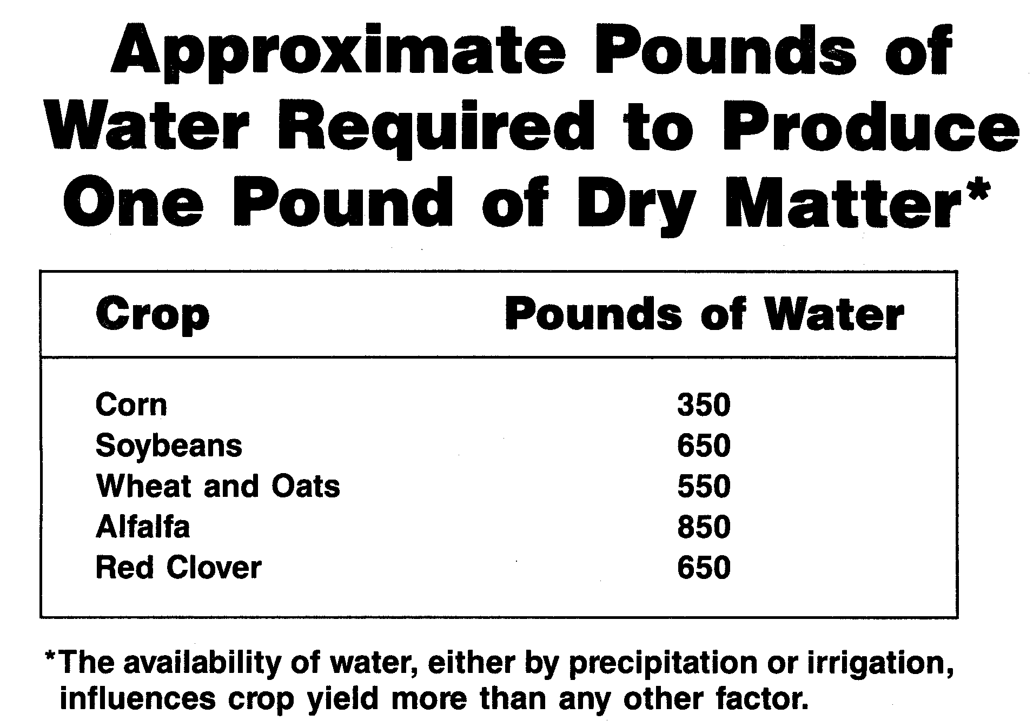

Slide 29
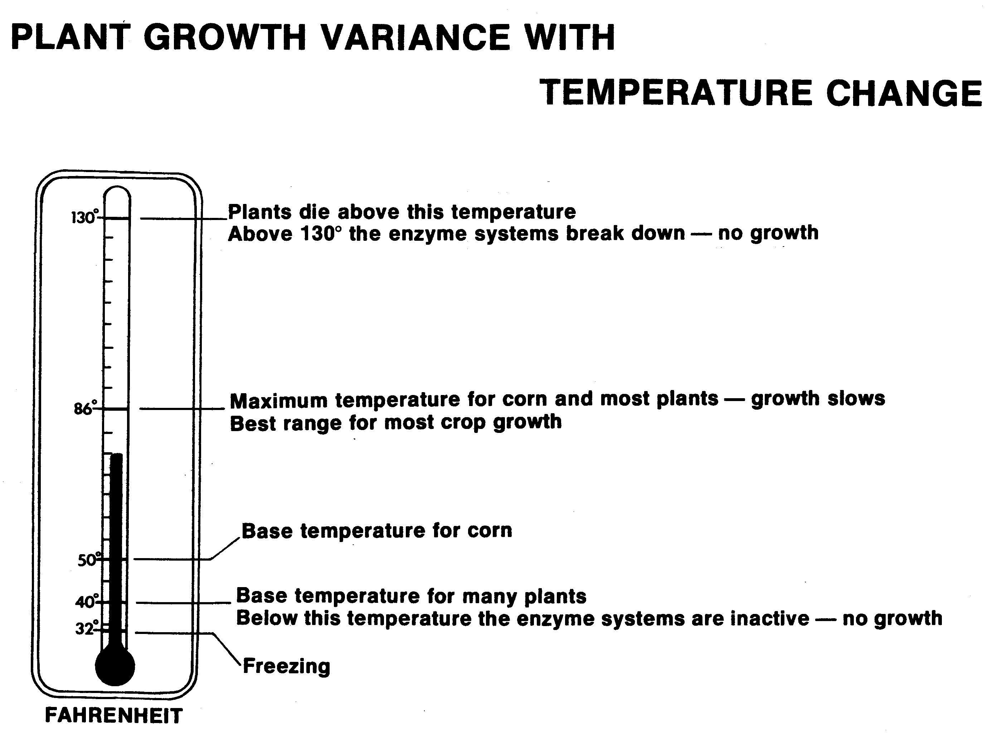

Slide 30
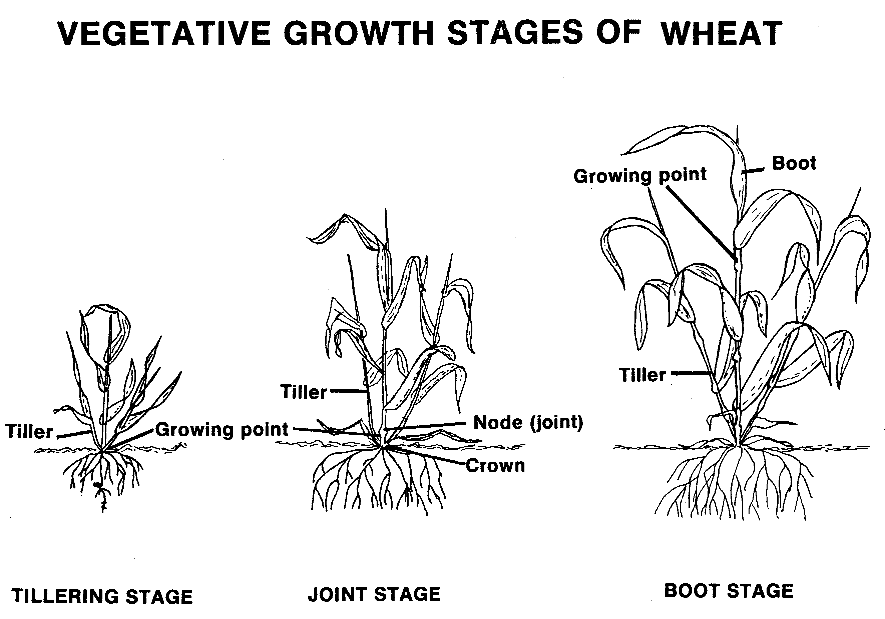
Vegetative growth stages of small grains
Tillering
Jointing
Boot

Slide 31
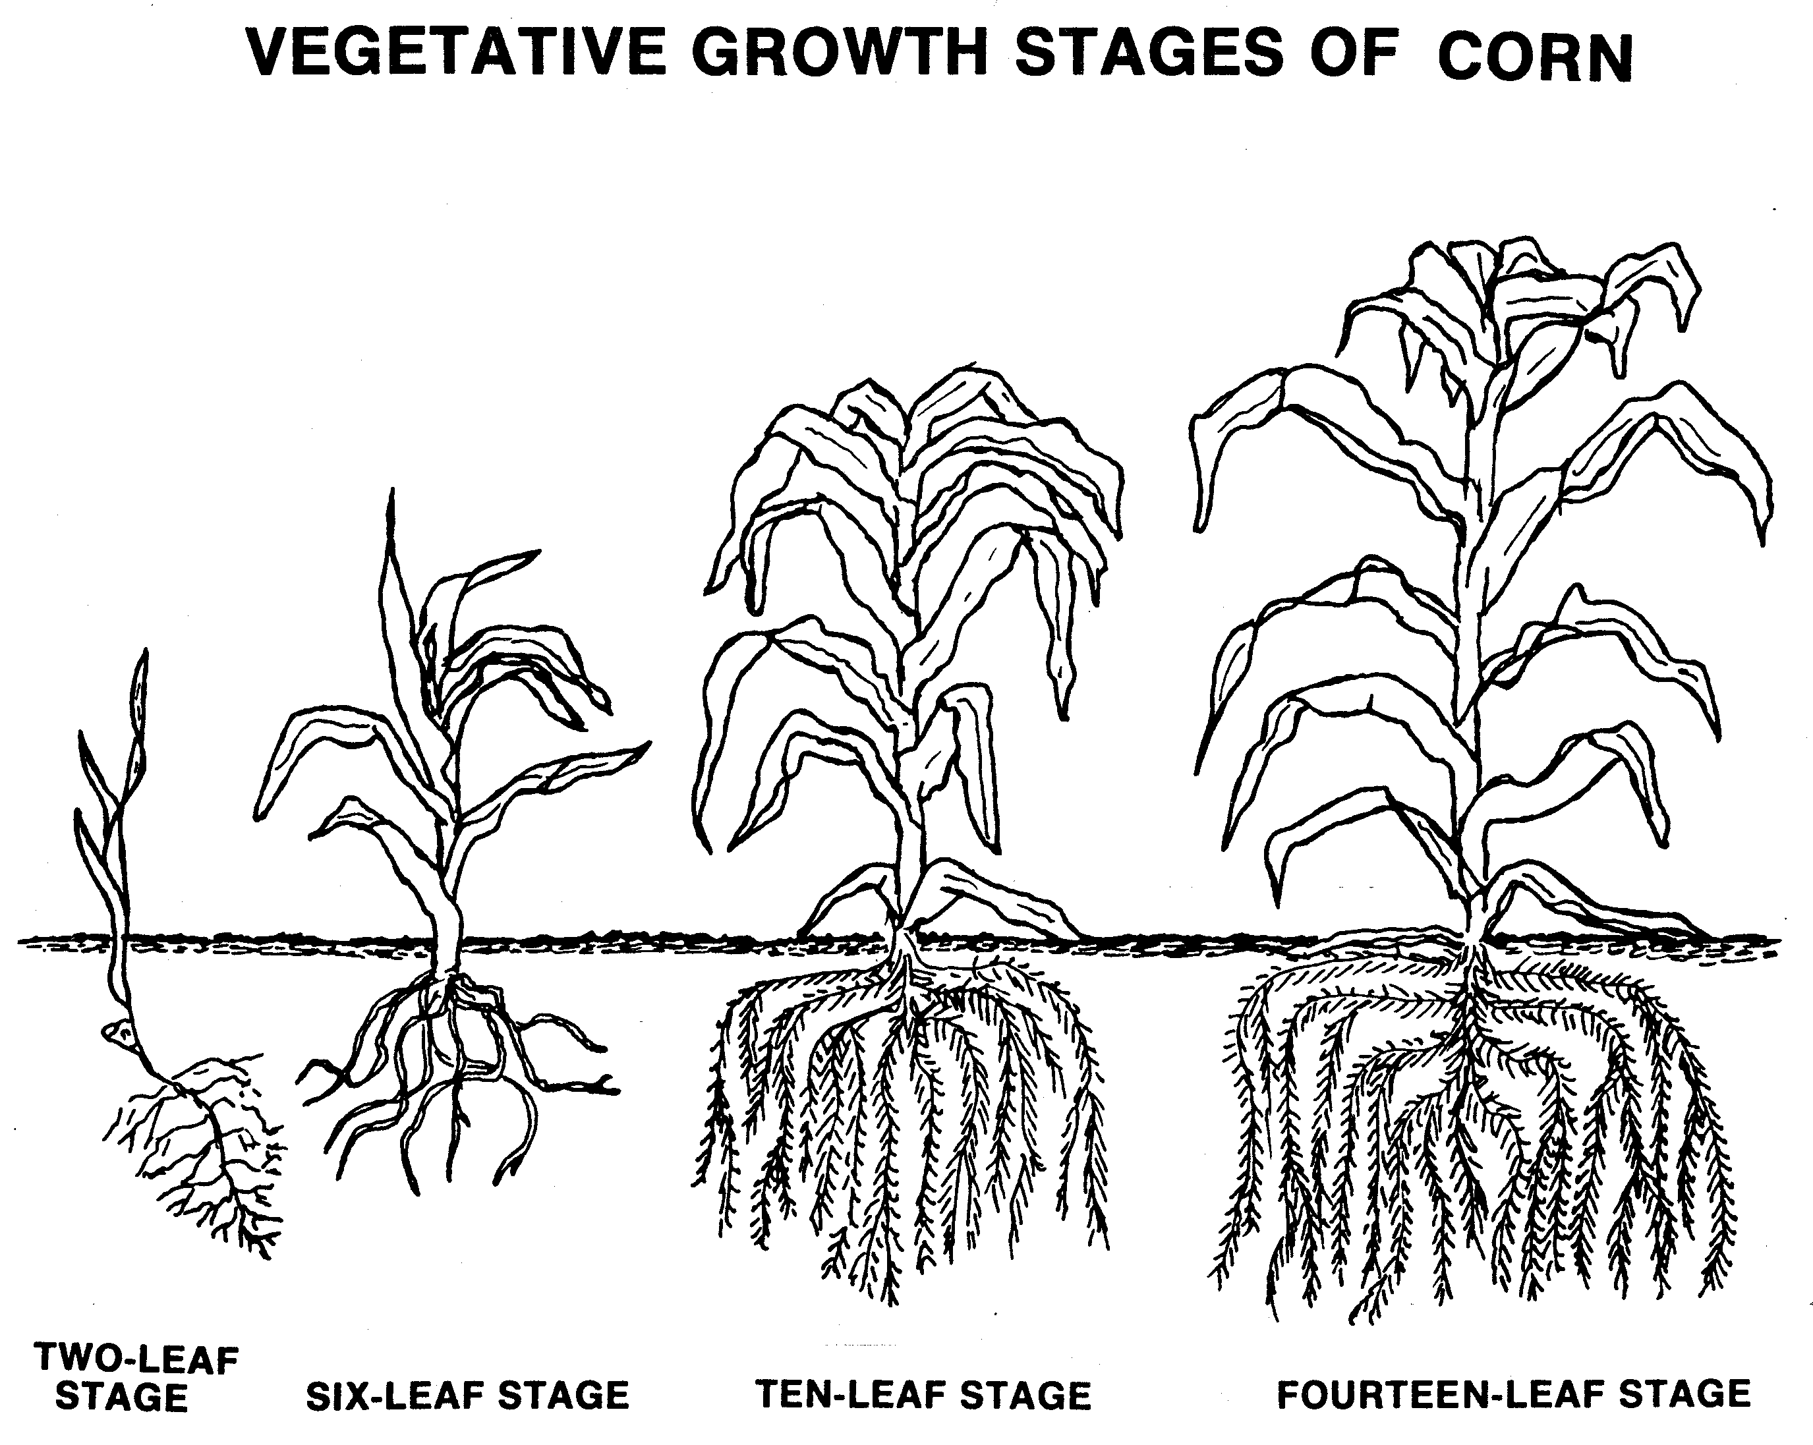
Vegetative growth stages of corn
Two-leaf stage
Six-leaf stage
Ten-leaf stage
Fourteen-leaf
stage
Two-leaf stage
Six-leaf stage
Ten-leaf stage
Fourteen-leaf stage

Slide 32
Life cycle of flowering plant
Seed germination and seedling growth
Vegetative growth
Flower formation
Pollination
Fertilization
Seed development

Slide 33
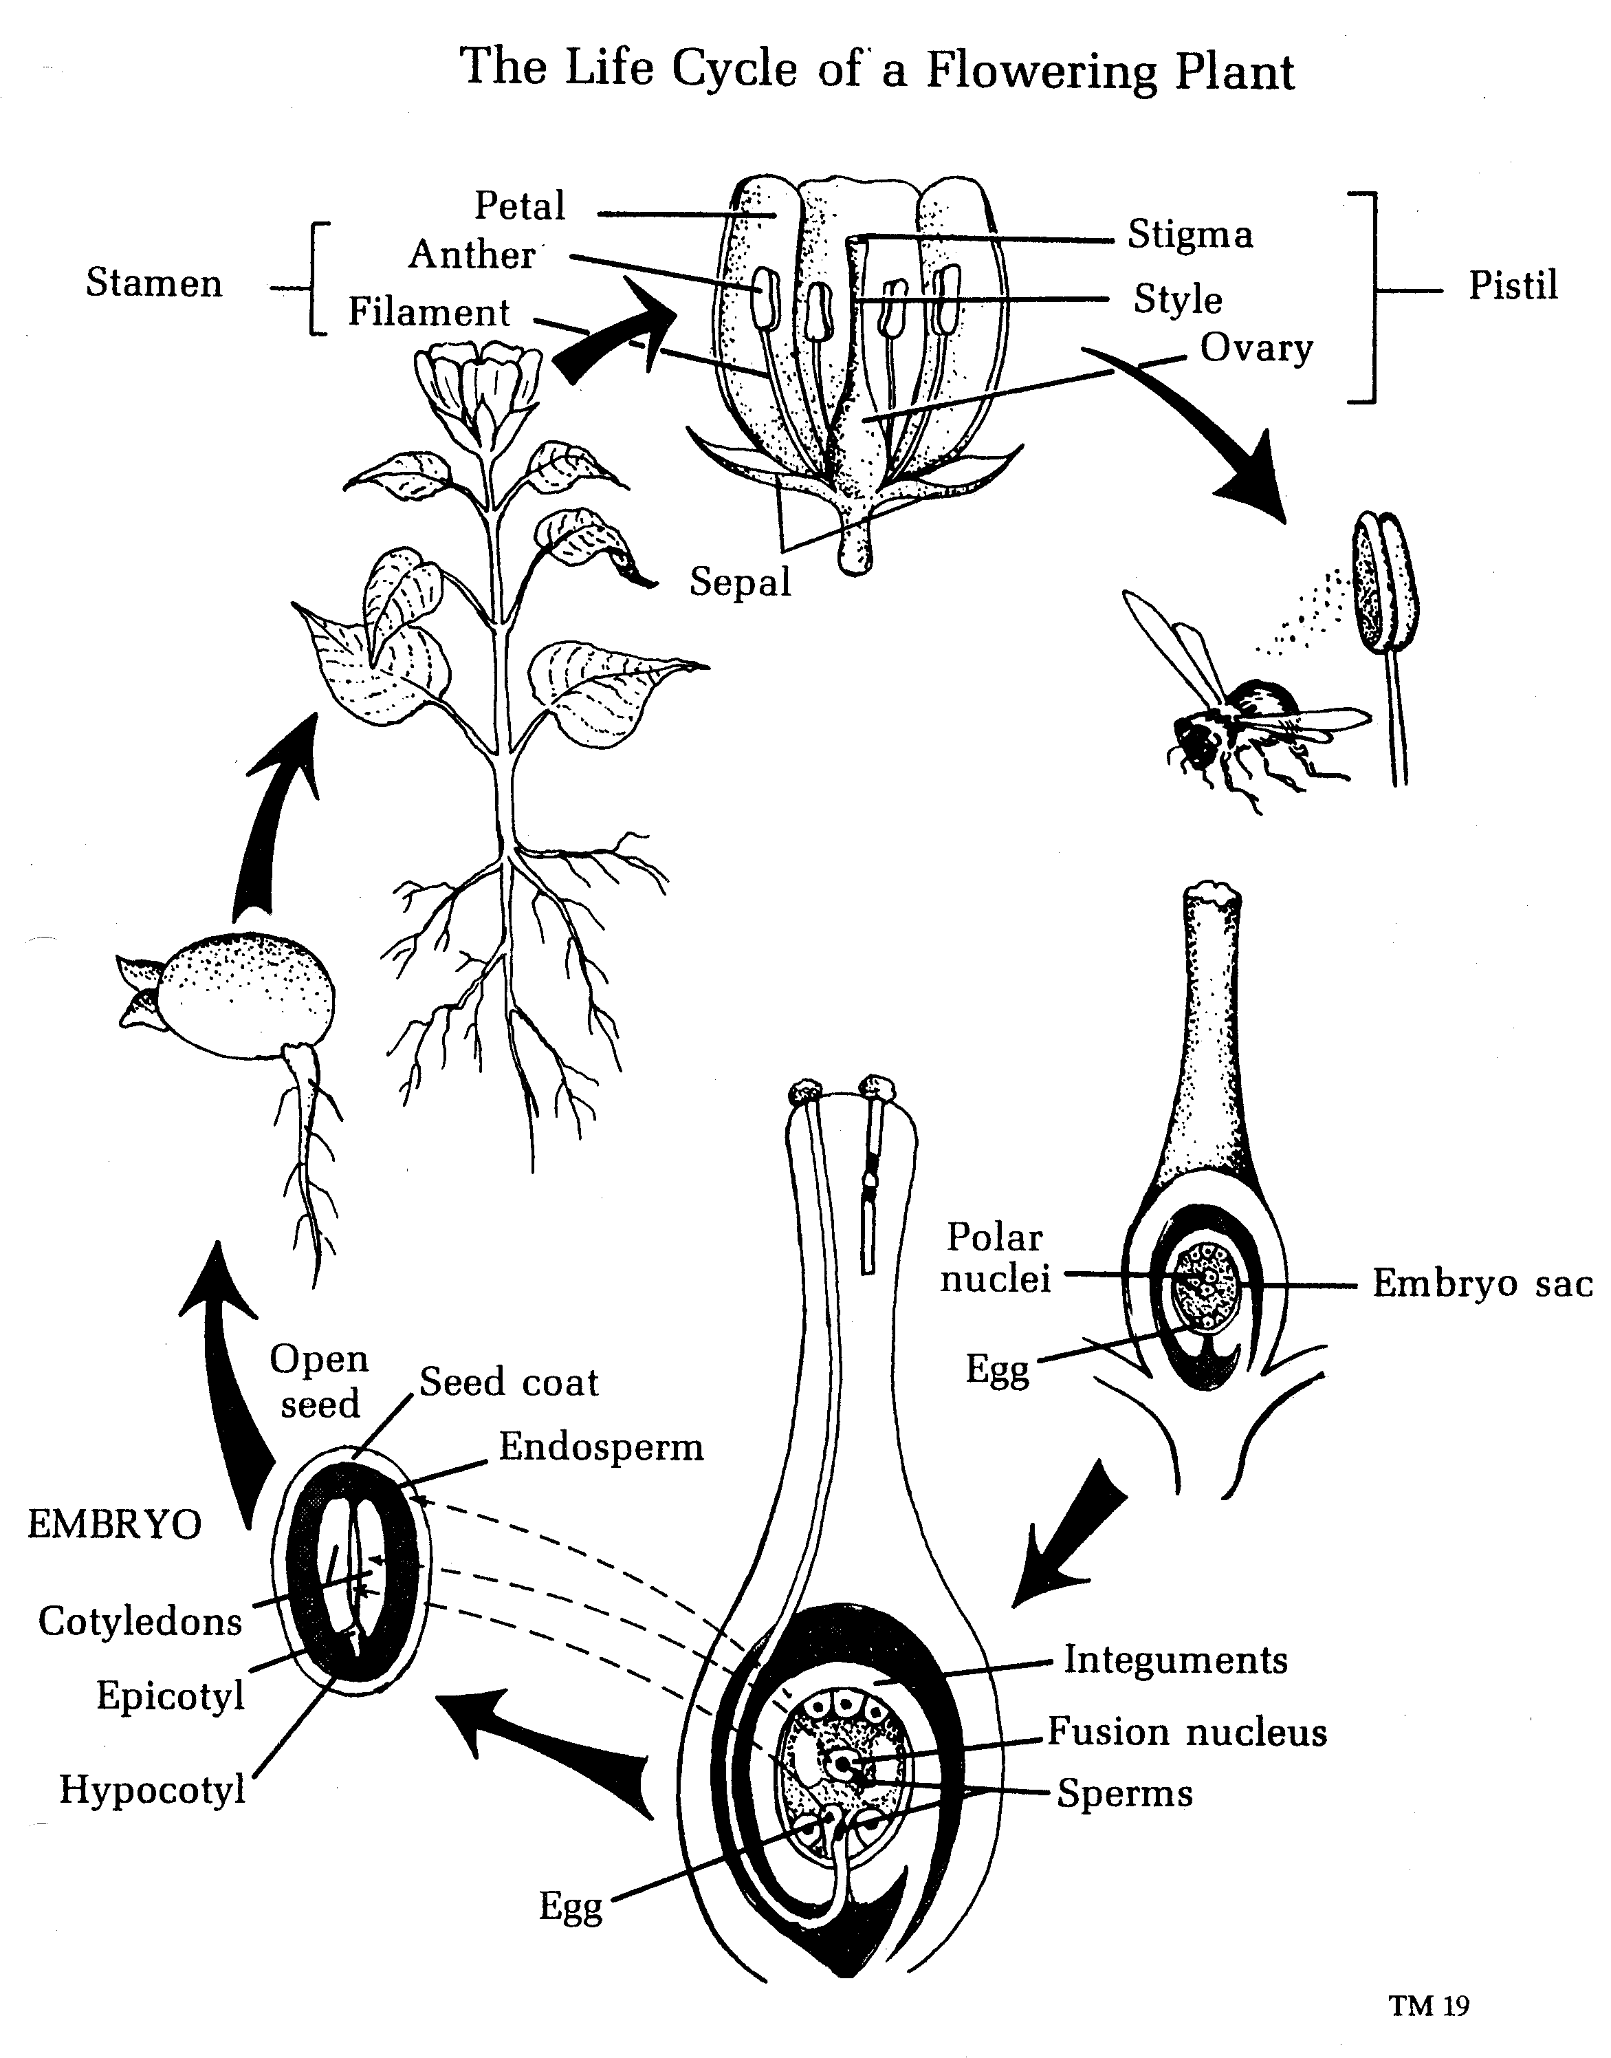

Slide 34
Parts of a complete flower
Pistil
stamen
Female part where egg cell originates
Stigma- upper part of pistil that catches pollen
Style- supports stigma
Ovary- produces ovules which develop into seeds
Male part of the flower
Filament- supports anther
Anther- bears the pollen

Slide 35
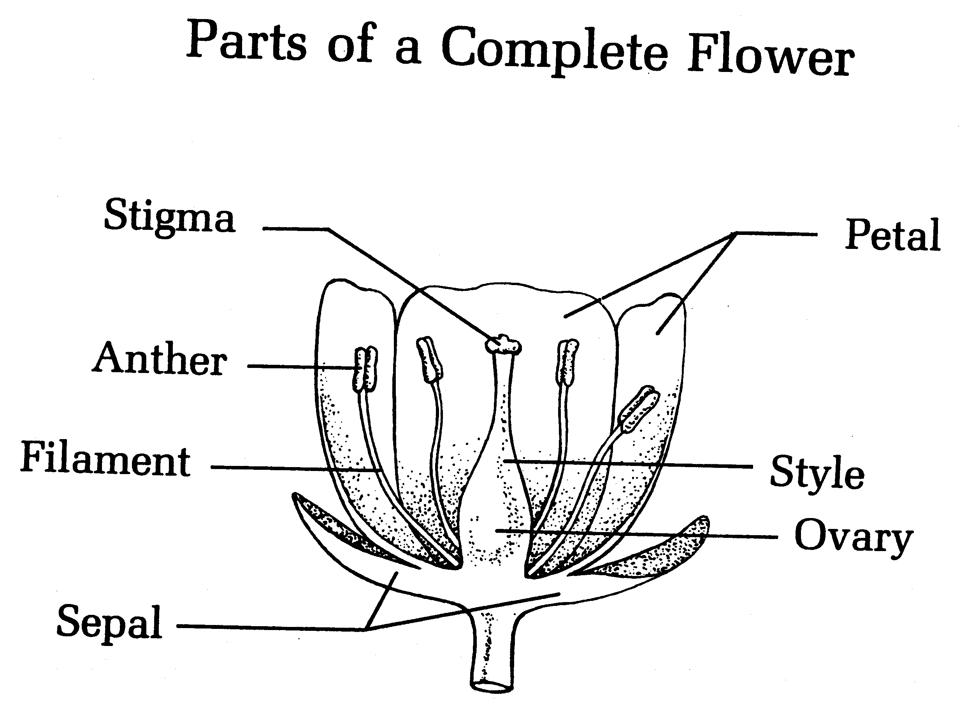
Parts of a complete flower
Accessory Organs
Corolla- petals of the flower
Calyx- sepals of the flower
Pedicel- stalk of an
individual flower

Slide 36
Types of flowers
Complete- has stamens, pistils, petals, and sepals on same flower common to dicots
Incomplete- has stamens and pistils but no petals or sepals common to monocots
Perfect- both stamens and pistils on the same flower
Imperfect- either stamens or pistils but not both on the same flower
Staminate- only male flower parts
Pistillate- only female flower parts
Monoecious- staminate and pistillate flowers found on the same plant (ex. Corn, cucumber, squash)
Dioecious- staminate and pistillate flowers found on separate plants (ex. Holly, date, palm, spinach)

Slide 37
Go fertilization!
Pollen grain alights on the surface of stigma→ forms a pollen tube → pollen tube grows down the style to the ovary → penetrates the ovary and the male cell unite with the ovule
Fertilization is the union of the male and female cells. The result is called a zygote. Cell division takes place and the zygote becomes the embryo of the seed.

Slide 38
Basic types of fertilization
Meristem (meristematic tissue)
permanent
Comprised of actively dividing cells that develop and differentiate into other tissues and organs
Cells have thin walls and dense protoplast
Develops from meristems
Non-dividing differentiated cells

Slide 39
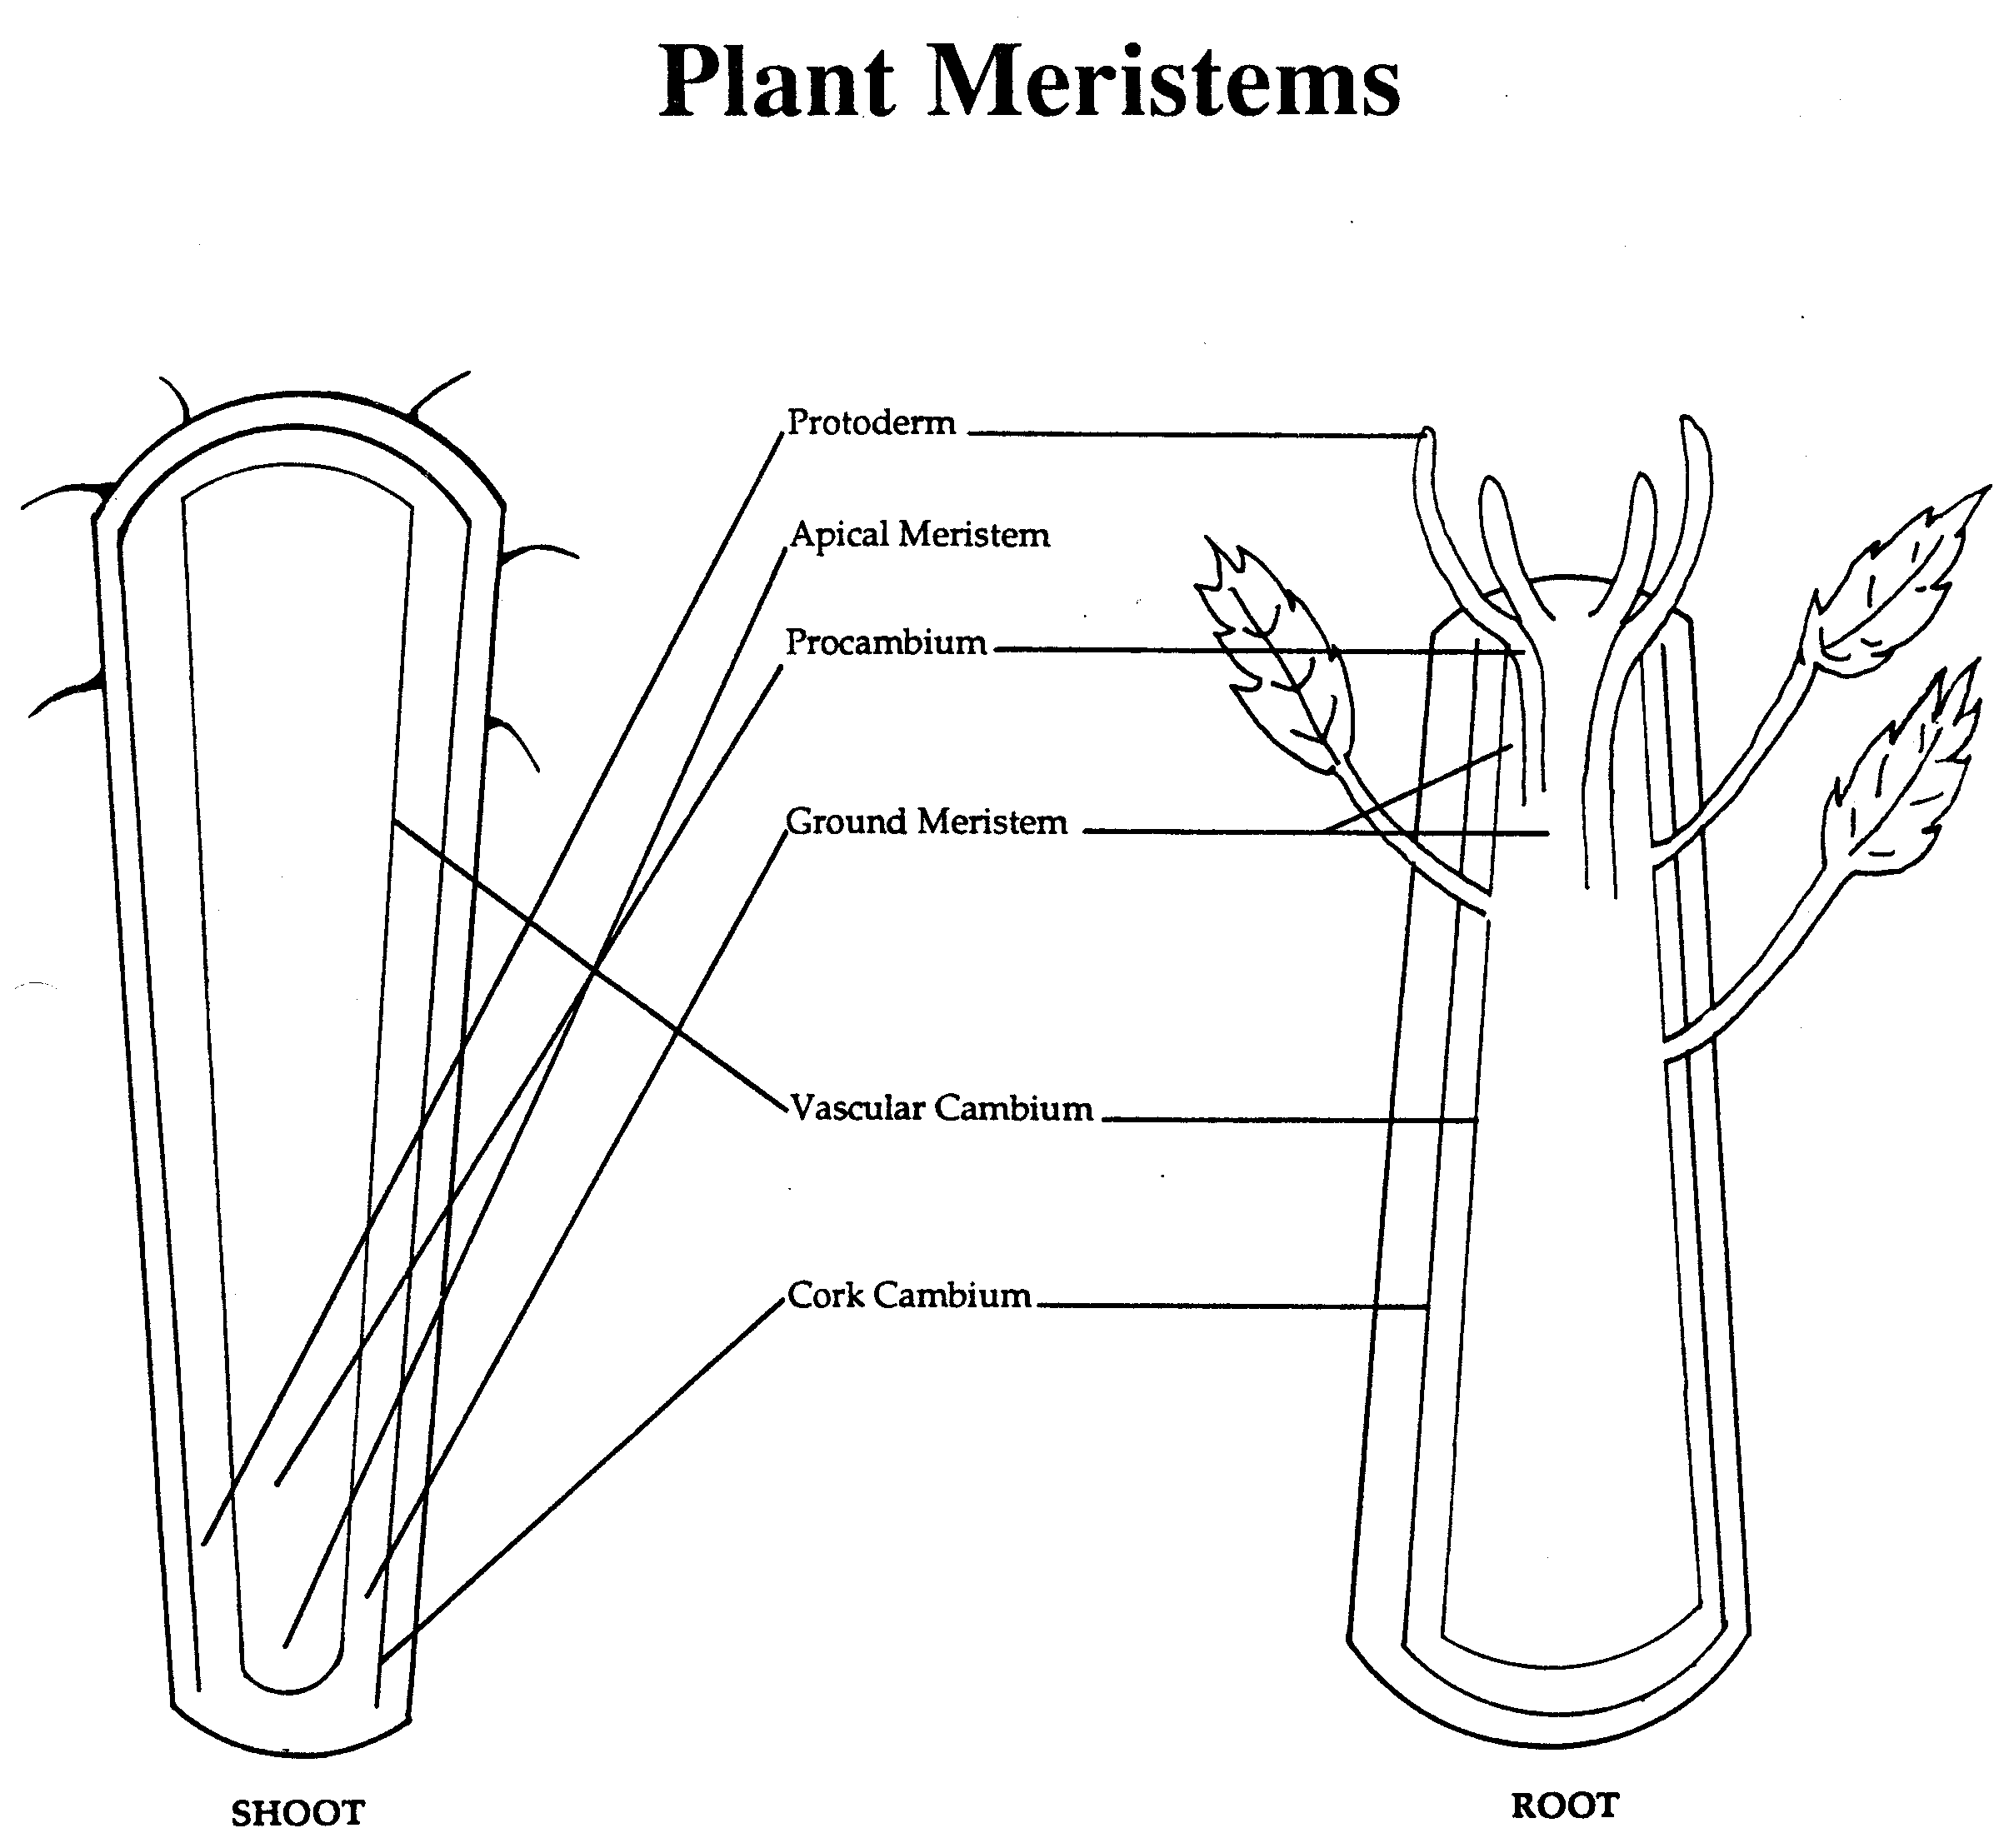

Slide 40
Apical meristems
Shoot meristems
Root meristems
Found in tops of the shoots
Responsible for producing new buds and leaves in a uniform pattern at the end of stem and laterally along stem
Growing points for root system
Found at various ends of the roots

Slide 41
Meristems tissue
Lateral meristems
Intercalary meristems
Account for girth and growth of woody stems
Composed of cellulose and pectin
Provide mechanical support for plant
Vascular cambium- produces new xylem and phloem
Cork cambium- produces bark (the protective covering of old stems and roots)
Number of growth rings indicates tree’s age
Active tissues that have been separated from the shoot terminal meristem by regions of more mature or developed tissue
Found near the nodes of grasses
Reason for continuous growth after mowing grasses

Slide 42
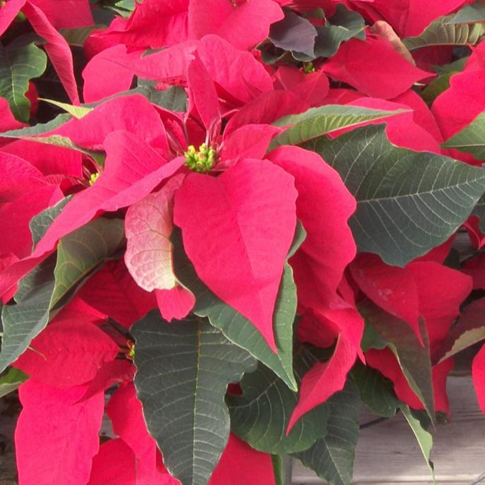
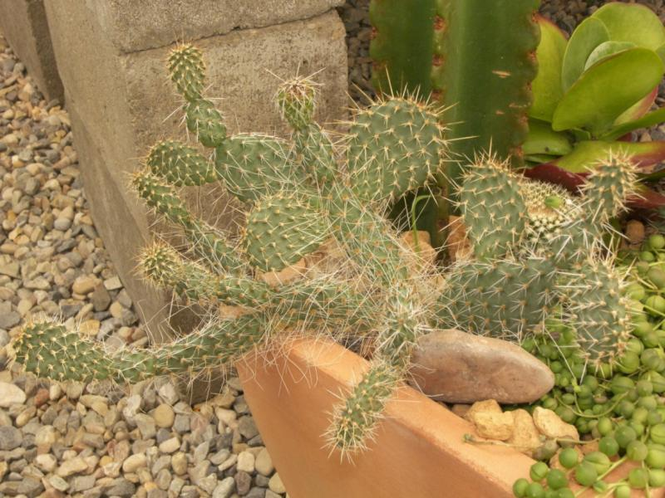
Modified Leaves
Colorful Poinsettia leaves become modified to create attention to the flower, and are then called ‘bracts’.
Cactus leaves become modified as protective structures. Stem serves both leaf and stem functions

Slide 43
Flowers
Reproductive structures (sexual)
Major parts include
Pistil
Stamen
Ovaries
Petals and sepals
See diagram for additional parts and locations
Perfect vs. Imperfect flowers

Slide 45
Flowers
Plants with both male and female flowers on the same plant are called monoecious (meaning ‘one house’)
Squash, corn, birch
Plants with male and female flowers on different plants are dioecious (male and female plants)
Holly, Ginkgo biloba
No fruit unless you have a female plant that receives proper pollen from the male plant flowers

