Slide 1
Small Gas Engines Operation, Maintenance and Repair

Slide 2
Why are Small Gas engines used
Lightweight
Compact
Economical on fuel
Portable
Air-cooled
Easy to service
Relatively inexpensive
Power source for small equipment.

Slide 3
Examples
Lawn mower
Chainsaws
Construction conveyors
Feed elevators
Post hole diggers
Generators
Rotor tillers
Irrigation pumps
Concrete surfacers
Sprayers
Air compressors
Recreational equipment
Boats
Personal Water Crafts
RC Planes and Cars
Atv
Motorcycles

Slide 4
Major Engine Components
Cylinder/Block
The core of the engine is the cylinder. The piston moves up and down inside the cylinder the block is the housing for the engines internal parts.
Head
A piece of metal that seals the top of the cylinder and holds the spark plug.

Slide 5
Major Engine Components
Valves
The intake and exhaust valves open at the proper time to let in air and fuel and to let out exhaust. Note that both valves are closed during compression and combustion so that the combustion chamber is sealed.
Piston
A cylindrical piece of metal that moves up and down inside the cylinder.

Slide 6
Major Engine Components
Piston rings
Piston rings provide a sliding seal between the outer edge of the piston and the inner edge of the cylinder. The rings serve two purposes:
They prevent the fuel/air mixture and exhaust in the combustion chamber from leaking into the sump during compression and combustion.
They keep oil in the sump from leaking into the combustion area, where it would be burned and lost.
Connecting Rod
a connecting rod connects the piston to the crankshaft. It can rotate at both ends so that its angle can change as the piston moves and the crankshaft rotates.

Slide 7
Major Engine Components
Crank Shaft
a shaft that transfer power from the piston to the outside of the engine for use.
Fly Wheel
a weighted wheel with a magnet for engine momentum and coil ignition.
Carburetor
A device for mixing fuel in proper proportions with air to produce an ideal combustible gas.

Slide 8
Trouble Shooting Basics
Check for Fuel-
Assure that fuel can travel from the fuel tank to the combustion chamber.
This can be tested by squirting a small amount of fuel into the carburetor to see if the engine will momentarily start
Check for Spark-
Observe the spark from the spark plug.
This can be accomplished by laying the spark plug on the block of the engine while starting it.
Check Compression-
Determine the compression of the engine using a compression testing gauge.
Insert the tester into the sparkplug hole and attemt to start the engine with the throttle open. It should complete 4-5 revolutions

Slide 9
Engine Systems
Air/Fuel System
Ignition system
Lubrication/Cooling

Slide 10
Air/Fuel System
Carburetor-A device for automatically mixing fuel in thep proper proportion with air to produce a combustible gas.
Air filter-a Device for filtering, cleaning, and removing dust from the air admitted to an engine.
Fuel Tank-A reservoir designed to store fuel during the operation an internal combustion engine.
Fuel pump- A device for delivering fuel from the fuel tank to the carburetor.

Slide 11
Ignition System
Flywheel w/magnet-A heavy wheel usually with a magnet in which energy is absorbed and stored by means of momentum
Coil/Magneto-An electrical device that generates current when rotated by an outside source of power
Points & condenser-
Sparkplug-A device inserted into the combustion chamber of an engine the ignites an air/fuel mixture with a spark.

Slide 12
Lubrication/Cooling System
Oil
Crankcase-Oil filled crankcase lubricates the engines internal parts by means of a pump, slinger or splash system as is the case of a 4-stroke engine
Mix w/fuel-Oil mixed with fuel in varying ratios to provided lubrication to an engines internal components as is the case in 2-stroke engines.
Fuel-The atomization and evaporation of fuel cools some engine parts as it travels to the combustion chamber

Slide 13
Lubrication/Cooling System
Antifreeze/Coolant-A fluid such as ethylene glycol that absorbs heat from an engine and releases the heat in a radiator.
Radiator and water pump- device for circulating a coolant through an engine and releasing heat to cool the engine parts.
Cooling fins-Fins on an engine cylinder to increase its surface area to improve its ability to release heat from combustion and friction.

Slide 14
2-Stroke vs 4-Stroke engines
The goal of both engines is to produce power.
Both must perform the following steps to accomplish this.
Intake
Compression
Power
Exhaust
It will blow your mind

Slide 15
Remember it’s 1 Cycle
4-Stroke engine
4 strokes
2 revolutions of the crankshaft
1 cycle
2-Stroke engine
2 strokes
1 revolution of the crankshaft
1 cycle

Slide 16
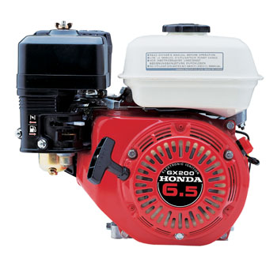
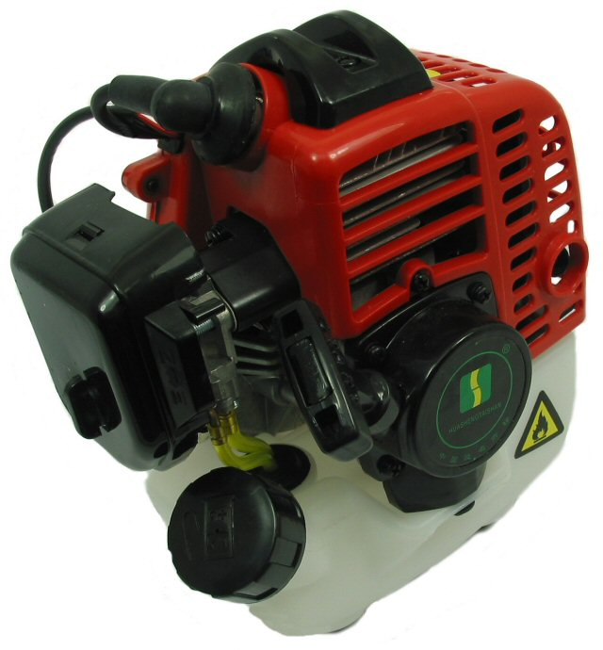
How is this Possible?

Slide 17
4-stroke engine
Completes one cycle in 4 distinct and identifiable strokes
Lubrication is provided by oil from the crankcase by means of pumping, flinging, splashing and submersion.

Slide 18
4-stroke engine
Intake Stroke
The intake strokes starts with the piston near the top also know as TDC and ends shortly after the bottom of its stroke BDC.
The intake valve is opened, allowing the cylinder to receive the fuel-air mixture as the piston moves down.
The valve is then closed, sealing the cylinder.

Slide 19
4-stroke engine
Compression Stroke
The compression stroke begins with the piston at the bottom of the cylinder and rises up to compress the fuel-air mixture.
Since the intake and exhaust valves are closed, there is no escape for the fuel-air mixture and it is compressed to a fraction of its original volume.

Slide 20
4-stroke engine
Power Stroke
The power stroke begins when the piston almost reaches the top of its stroke and the fuel-air mixture is ignited.
As the mixture burns and expands, it forces the piston down on its power stroke.
The valves remain closed so that all the force is exerted on the piston.

Slide 21
4-stroke engine
Exhaust Stroke
The exhaust stroke begins when the piston nears the end of its power stroke.
The exhaust valve is opened and the piston rises, pushing out the burned gases.
When the piston reaches the top, the exhaust valve is closed and the piston is ready for a new four-stroke cycle.

Slide 22
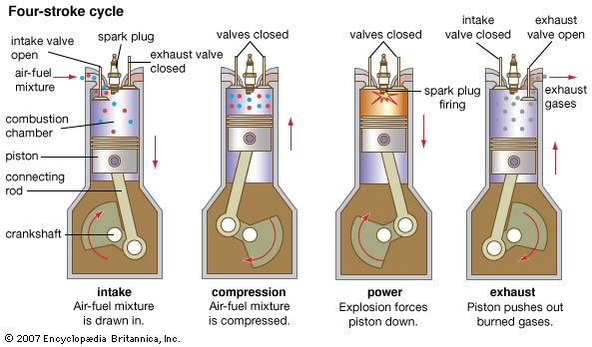
4-stroke engine
http://www.animatedengines.com/otto.html

Slide 23
2-stroke engine
A 2-stroke engine combines strokes to accomplish the cycle twice as fast as the 4-stroke engine
Very sensitive to air/vacuum leaks
Only lubrication is provided by the oil that is mixed with the fuel

Slide 24
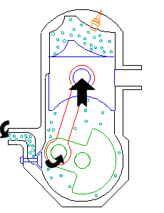
2-stroke engine
Intake
The fuel/air mixture is first drawn into the crankcase by the vacuum that is created during the upward stroke of the piston

Slide 25
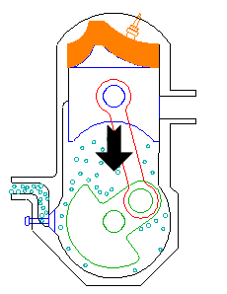
2-stroke engine
Crankcase compression
During the downward stroke, the poppet valve is forced closed by the increased crankcase pressure. The fuel mixture is then compressed in the crankcase during the remainder of the stroke.

Slide 26
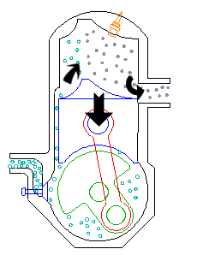
2-stroke engine
Transfer/Exhaust
Toward the end of the stroke, the piston exposes the intake port, allowing the compressed fuel/air mixture in the crankcase to escape around the piston into the main cylinder. This expels the exhaust gasses out the exhaust port, usually located on the opposite side of the cylinder. Unfortunately, some of the fresh fuel mixture is usually expelled as well.

Slide 27
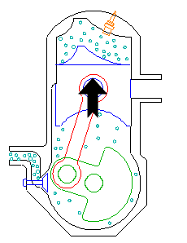
2-stroke engine
Compression
The piston then rises, driven by flywheel momentum, and compresses the fuel mixture. (At the same time, another intake stroke is happening beneath the piston).

Slide 28
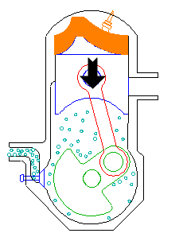
2-stroke engine
Power
At the top of the stroke, the spark plug ignites the fuel mixture. The burning fuel expands, driving the piston downward, to complete the cycle. (At the same time, another crankcase compression stroke is happening beneath the piston.)

Slide 29
2-stroke engine

Slide 30
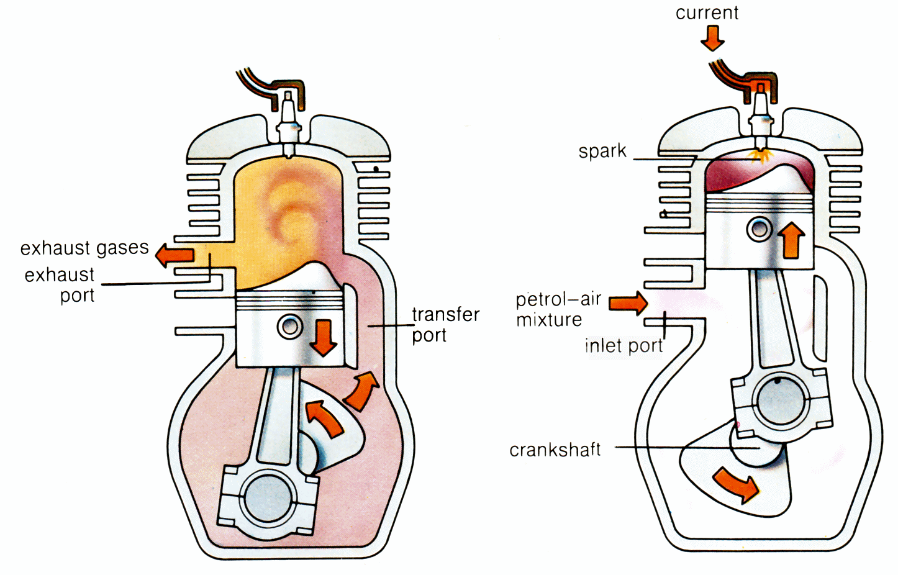
2-stroke engine
http://www.animatedengines.com/twostroke.html

Slide 31
2-stroke/4-stroke comparison
# of Major moving parts
Power Strokes
Running Temperatures
Overall engine size
Engine Weight
Bore size equal hp
Fuel and oil
Fuel consumption
Oil consumption
Sound
Operation
Acceleration
General Maintenance
Nine
One every two revolutions of the Crankshaft
Cooler running
Larger
Heavier construction
Larger
No mixture required
Fewer gallons per hour
Oil recirculates in engine
Generally quiet
Smoother
Slower
Greater
Three
One every revolution of the crankshaft
Hotter running
Smaller
Lighter in weight
Smaller
Must be oil mixed
More Gallon per hour
Oil is burned with fuel
Louder in operation
More erratic
Very quick
Less

Slide 32
2-stroke/4-stroke comparison
Initial Cost
Versatility of operation
General operating efficiency
Pull starting
Flywheel
Greater cost
Limited slope operation due to lubrication system
Less efficient
Two crankshaft rotations required to produce one ignition cycle.
Requires heavier flywheel to carry engine through three non power strokes
Less cost
Lubrication not affected at any angle of operation
More efficient
One revolution produces an ignition phase
Lighter flywheel

